Slide 1
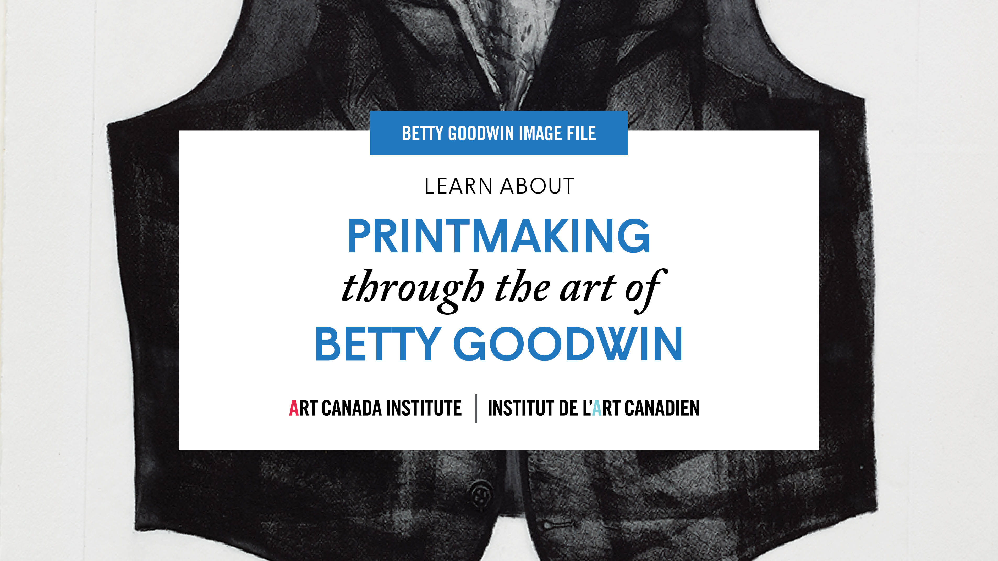

Slide 2
Betty Goodwin inking a plate in her studio, February 1970.

Slide 3
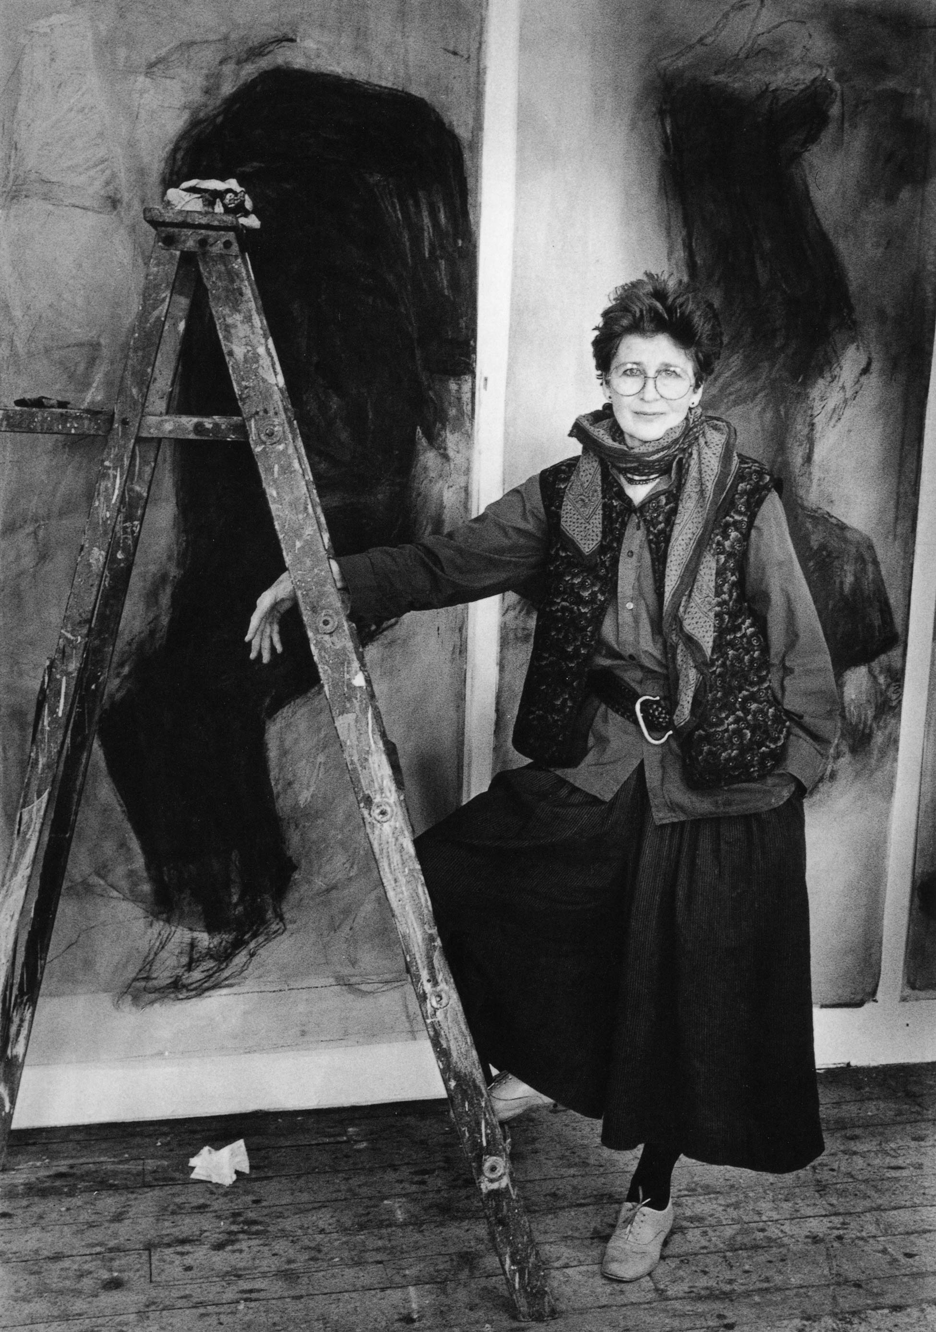
Betty Goodwin poses in her Montreal studio, 1986.

Slide 4
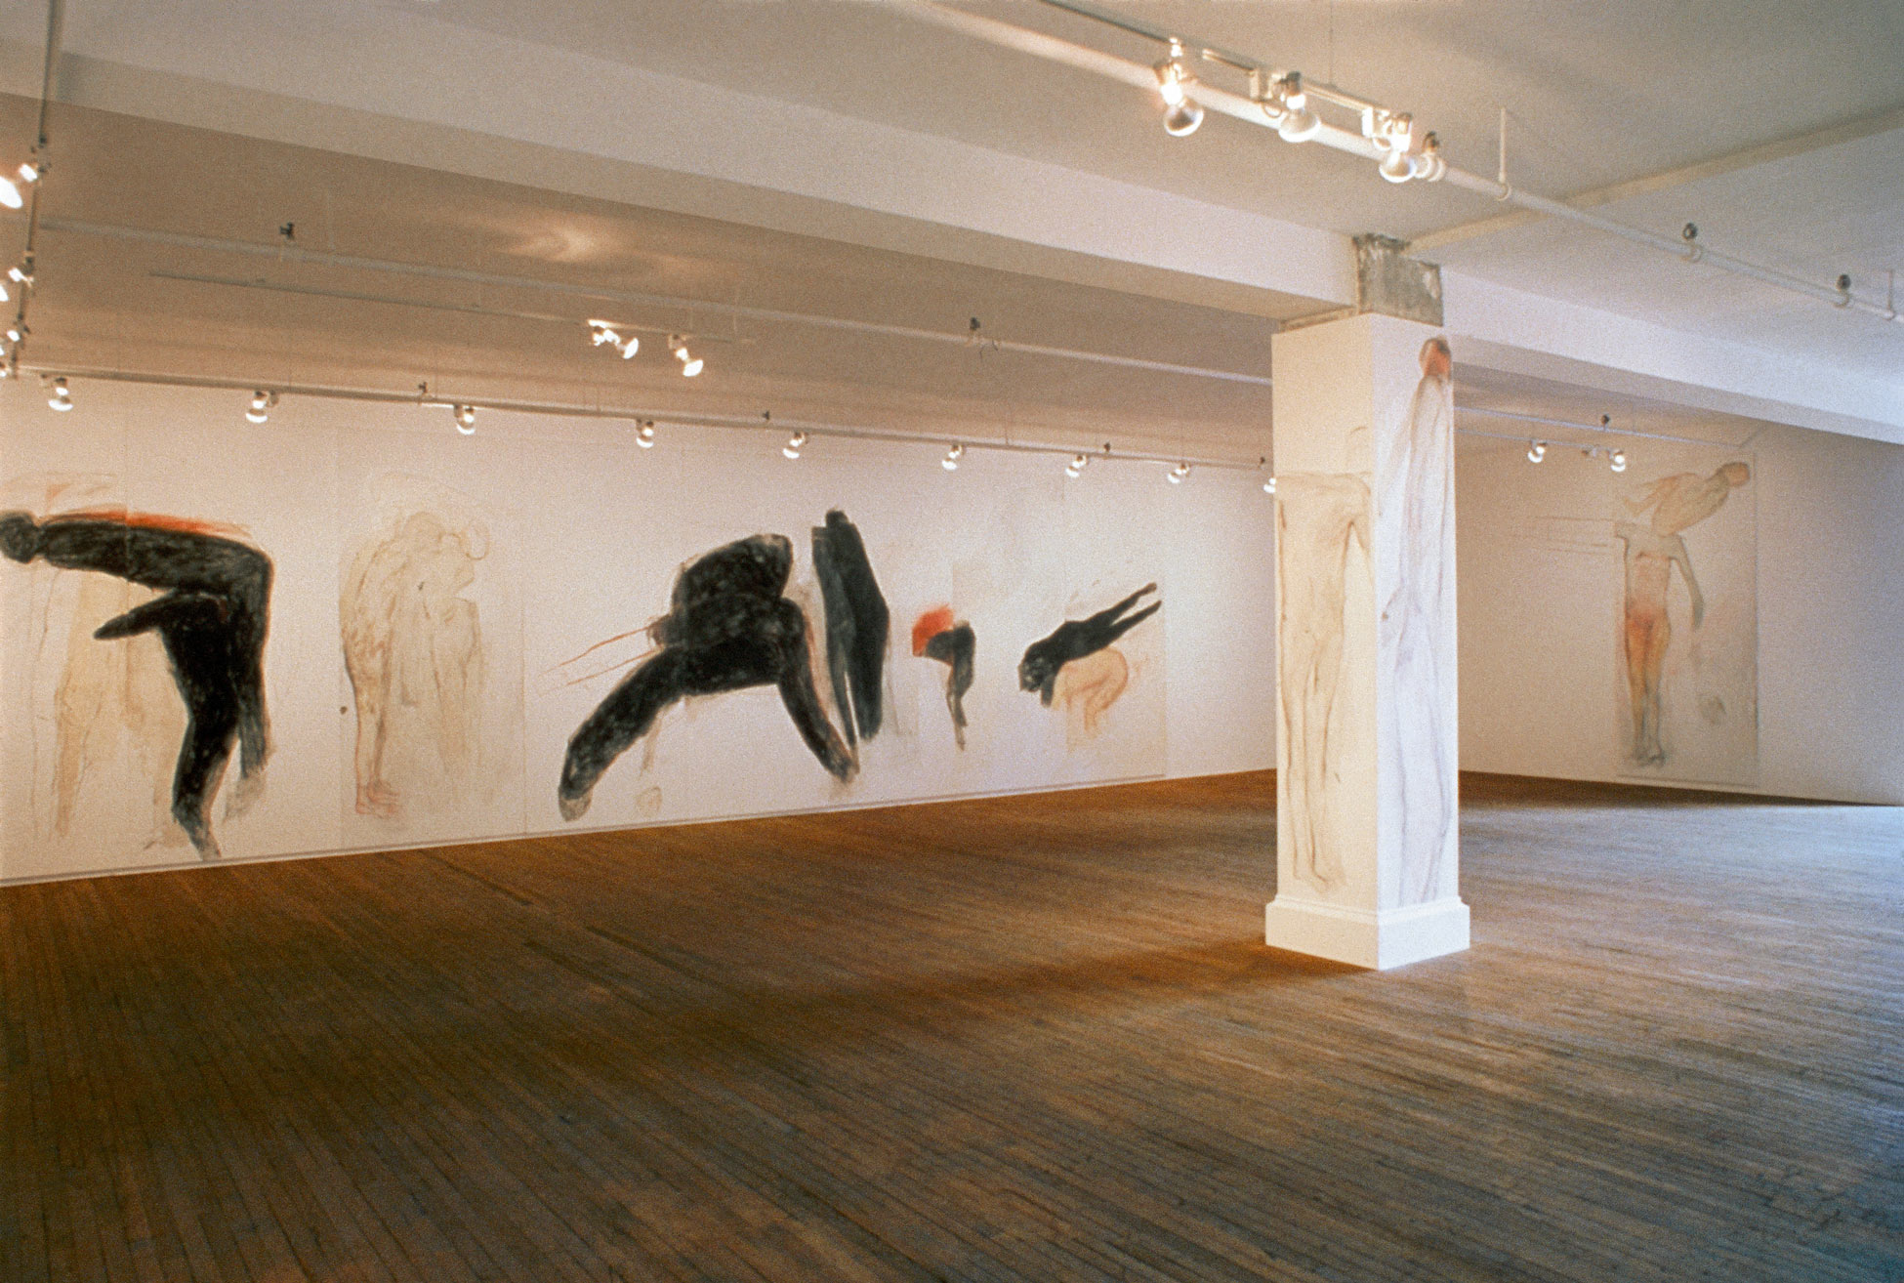
Betty Goodwin, Carbon, 1986. Goodwin experimented with prints, large-scale drawings, and installations such as this one.

Slide 5
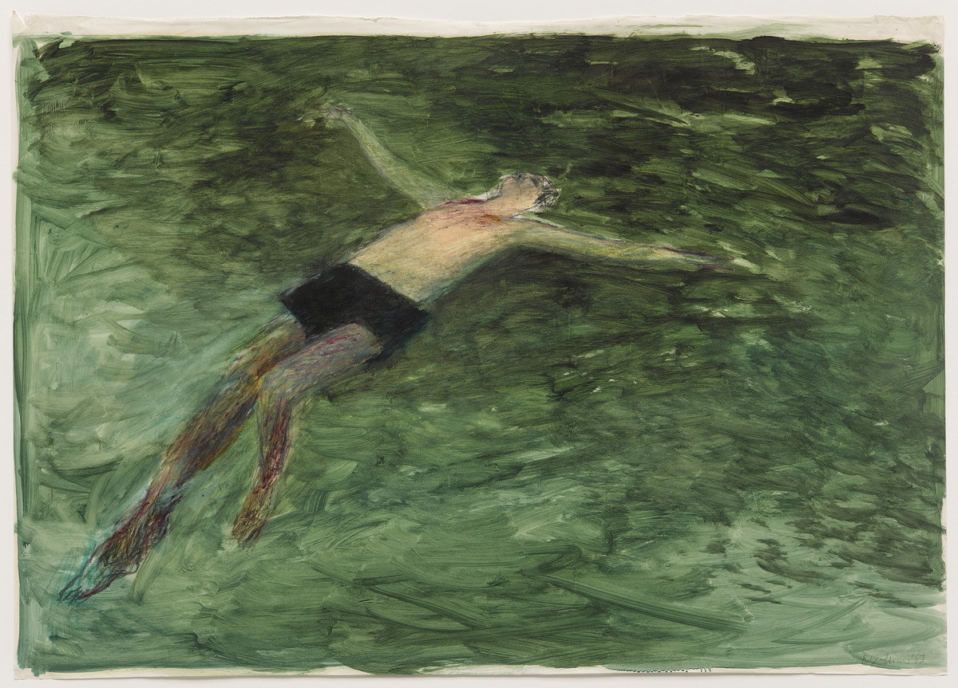
Betty Goodwin, Untitled, 1982. In her Swimmers series, Goodwin explored human experience through depictions of the body.

Slide 6
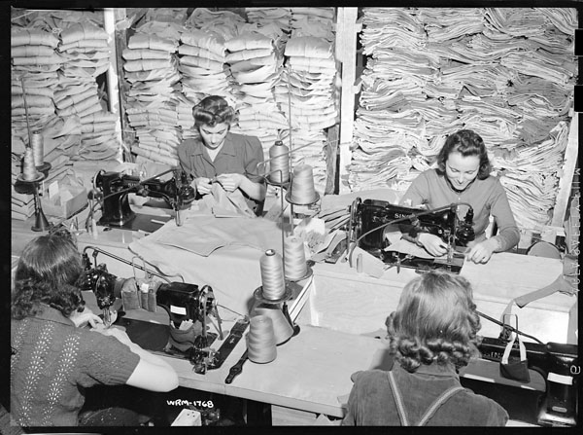
Women workers in Alberta supporting the war effort by stitching military uniforms, April 16, 1942.

Slide 7
Paul-Émile Borduas, Flowered Quivers or 8.47, 1947. Borduas was a key signatory of the Refus global manifesto.

Slide 8
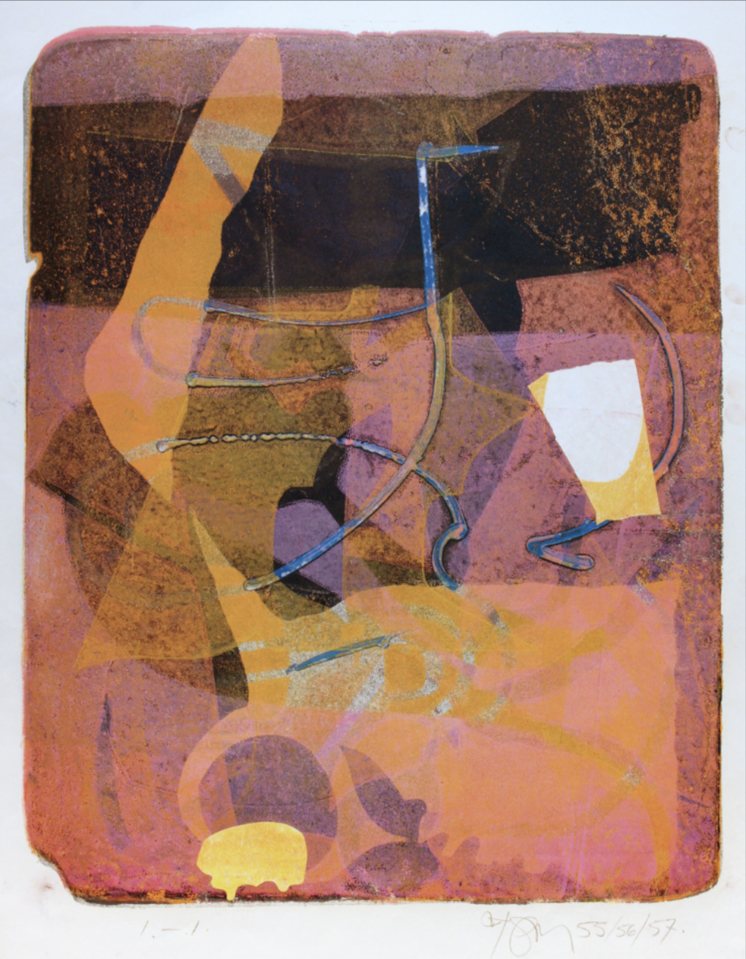
Harold Town, Old Games, 1955-57. Harold Town experimented with innovative printmaking techniques in his work.

Slide 9
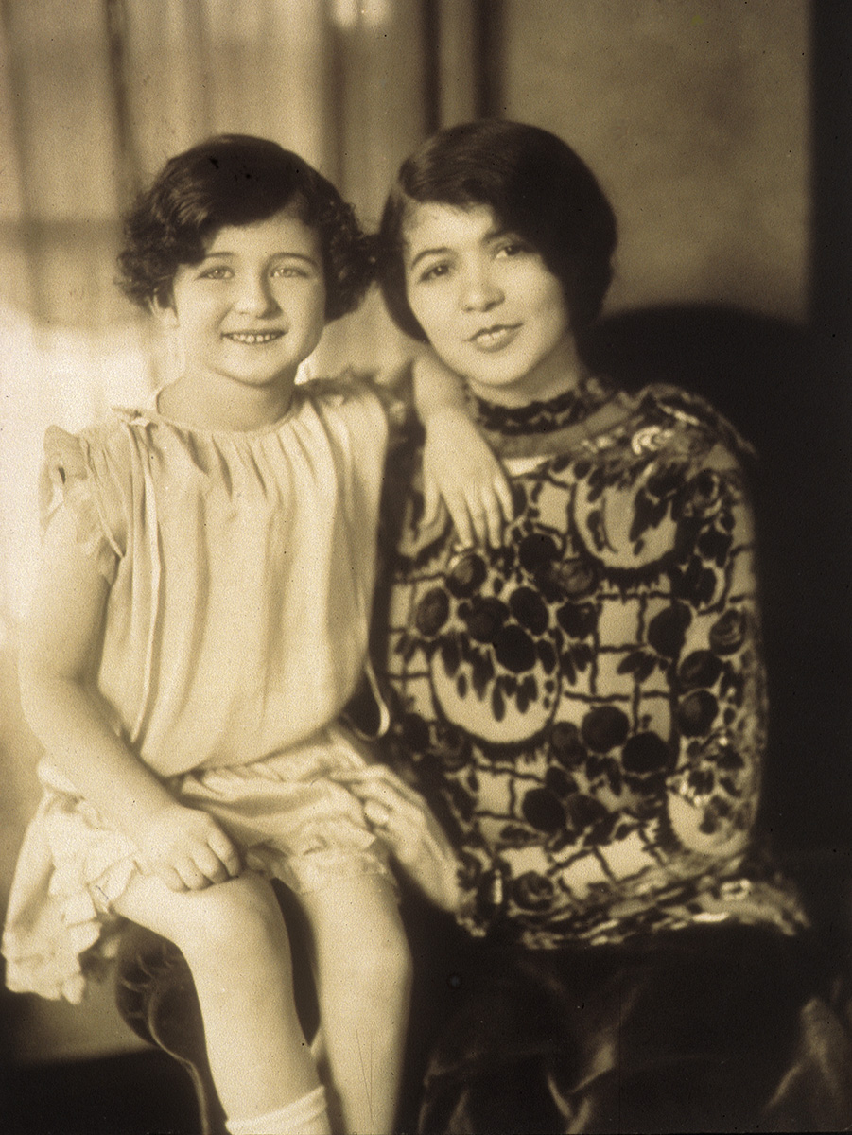
Betty Goodwin on her mother’s lap, n.d.

Slide 10
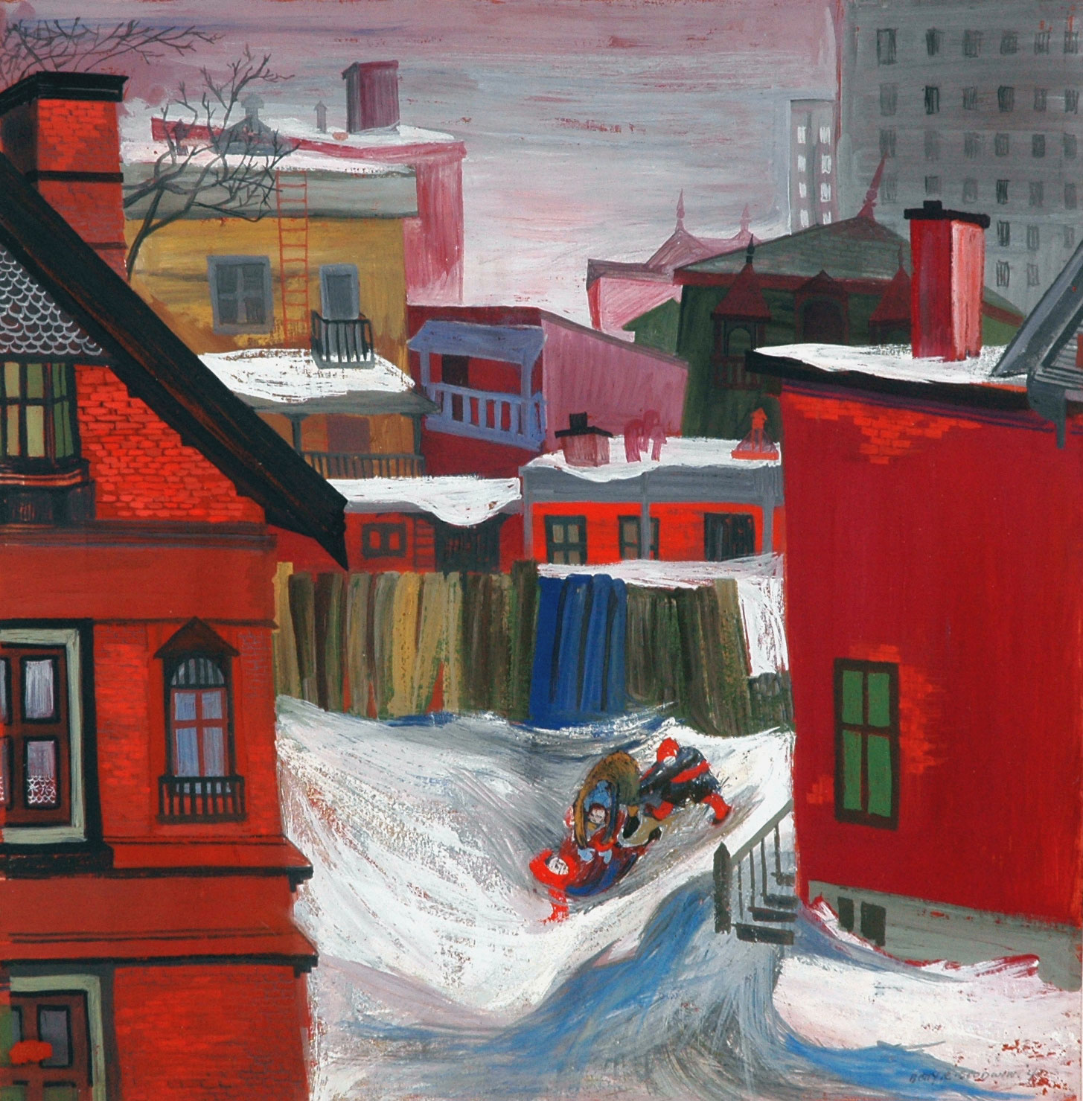
Betty Goodwin, View from my back window, 1947. Goodwin’s early practice involved painting, as in this work showing the view from her home.

Slide 11
Betty Goodwin, Vest, April 1972. Goodwin became known for her unique approach to printmaking.

Slide 12
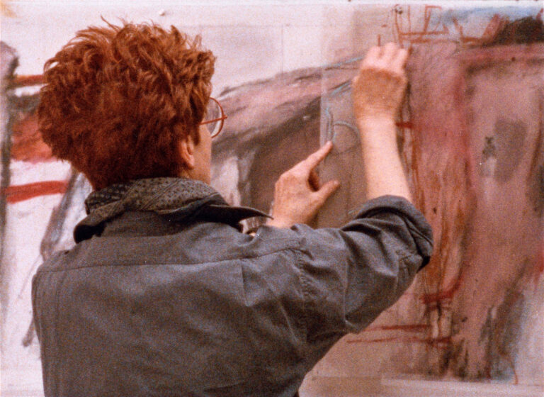
Betty Goodwin working in her studio, 1980s.

Slide 13
Betty Goodwin, Vest One, August 1969. This series was an important contribution to contemporary Canadian art.

Slide 14
Betty Goodwin, Two Vests, 1972. Goodwin chose the vest as her subject matter for its symbolic and material significance.

Slide 15
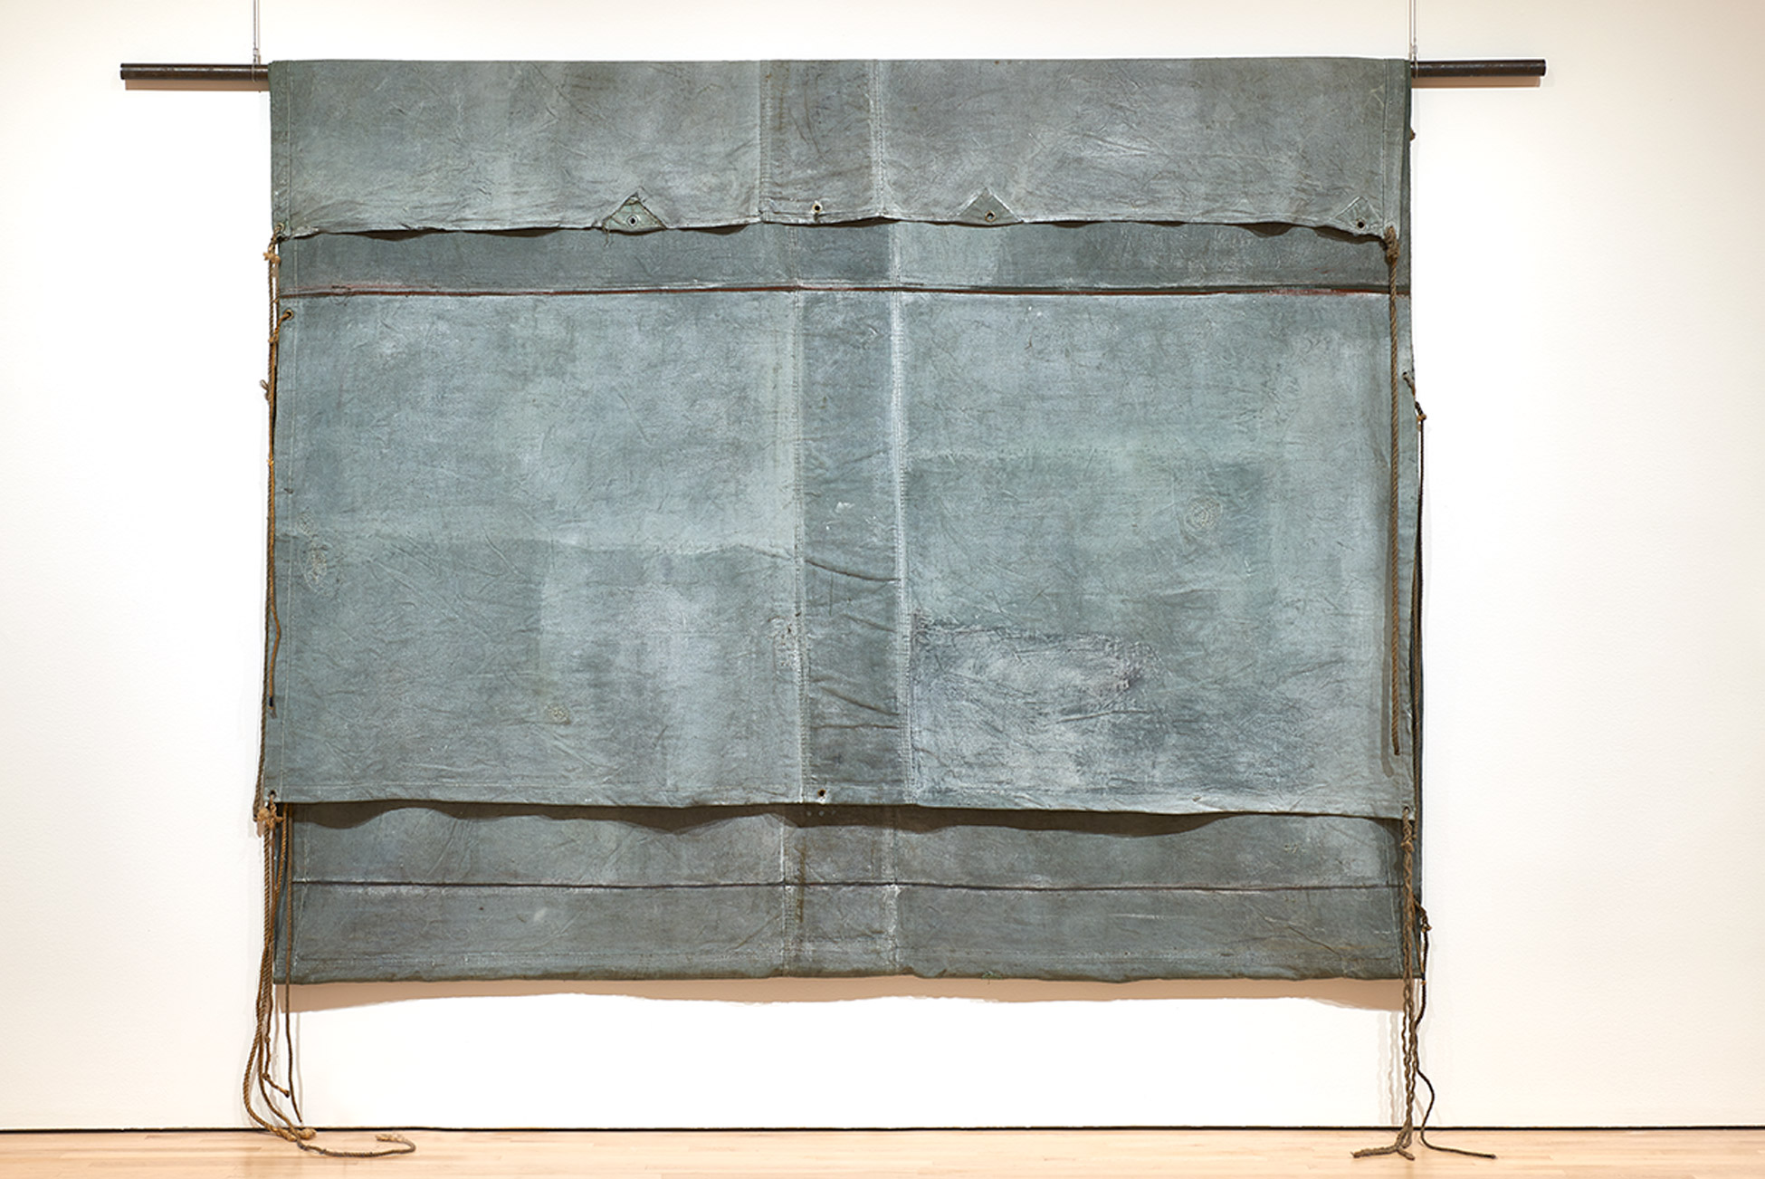
Betty Goodwin, Tarpaulin No. 3, 1975. Tarpaulins are an example of the found objects Betty Goodwin used in her work.

Slide 16
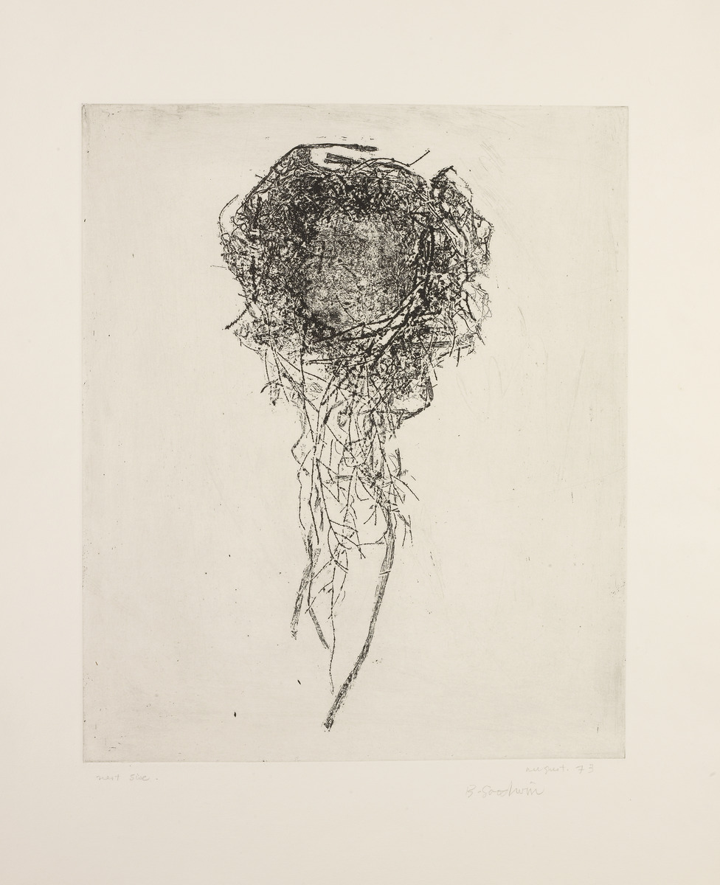
Betty Goodwin, Nest with Hanging Grass (Nest Six), 1973. This is another example of Goodwin’s use of found objects as inspiration for her prints.

Slide 17
Betty Goodwin, Gloves One, 1970. In works like this one, household objects are transformed into unexpected, two dimensional compositions.

Slide 18
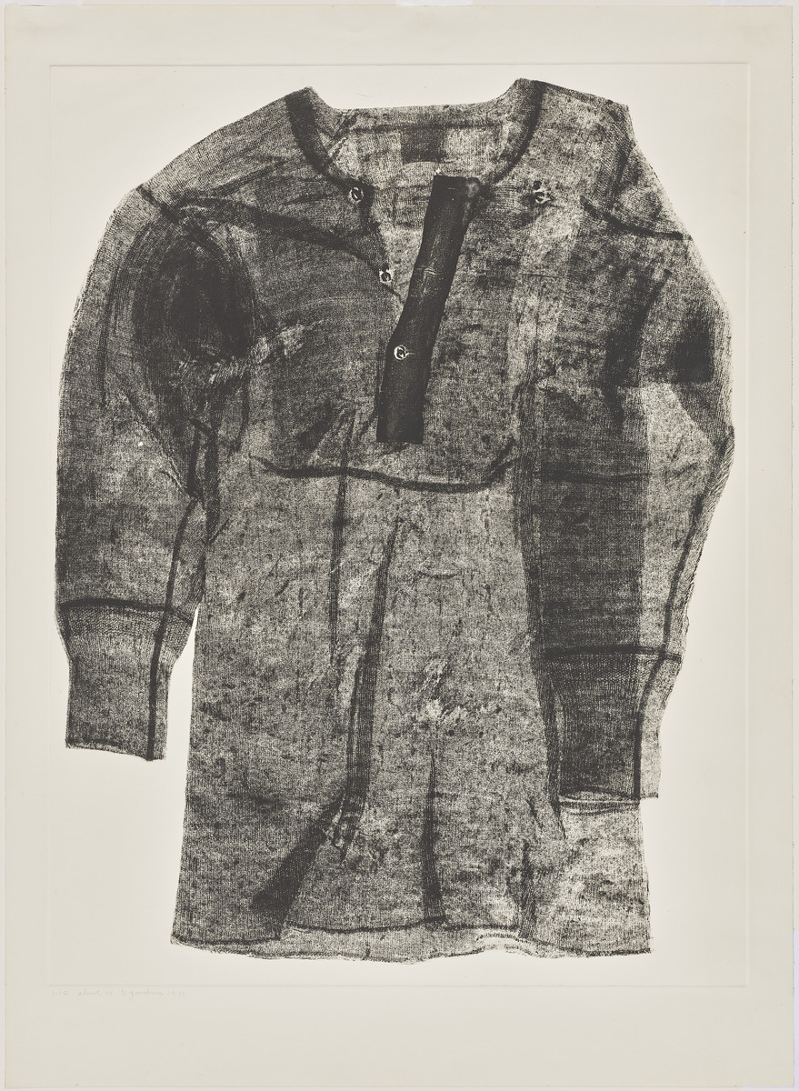
Betty Goodwin, Shirt IV, 1971. Goodwin’s interest in textiles can be traced back to her father’s career as a tailor.

Slide 19
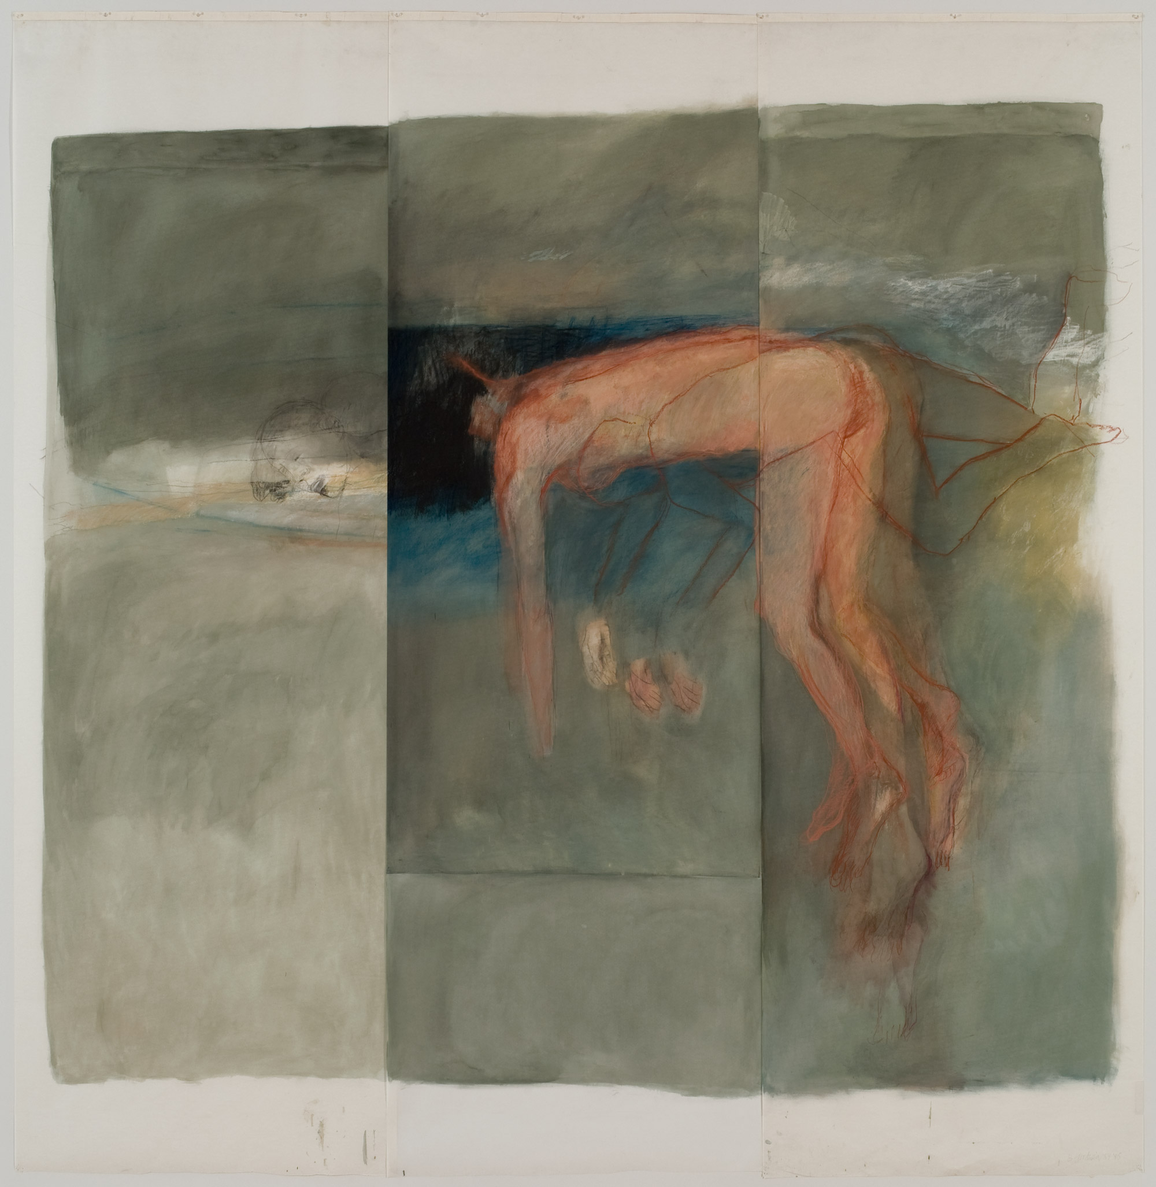
Betty Goodwin, So Certain I Was, I Was a Horse, 1984–85. This work is an example of Goodwin’s exploration of personal struggles.

Slide 20
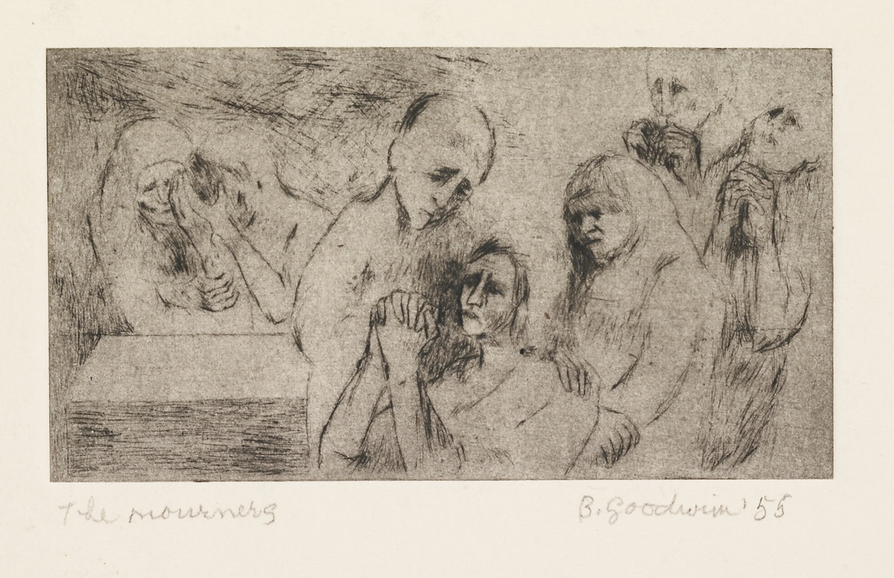
Betty Goodwin, The Mourners, 1955. Goodwin’s art was often inspired by world events, such as this piece created as a response to the Holocaust.

Slide 21
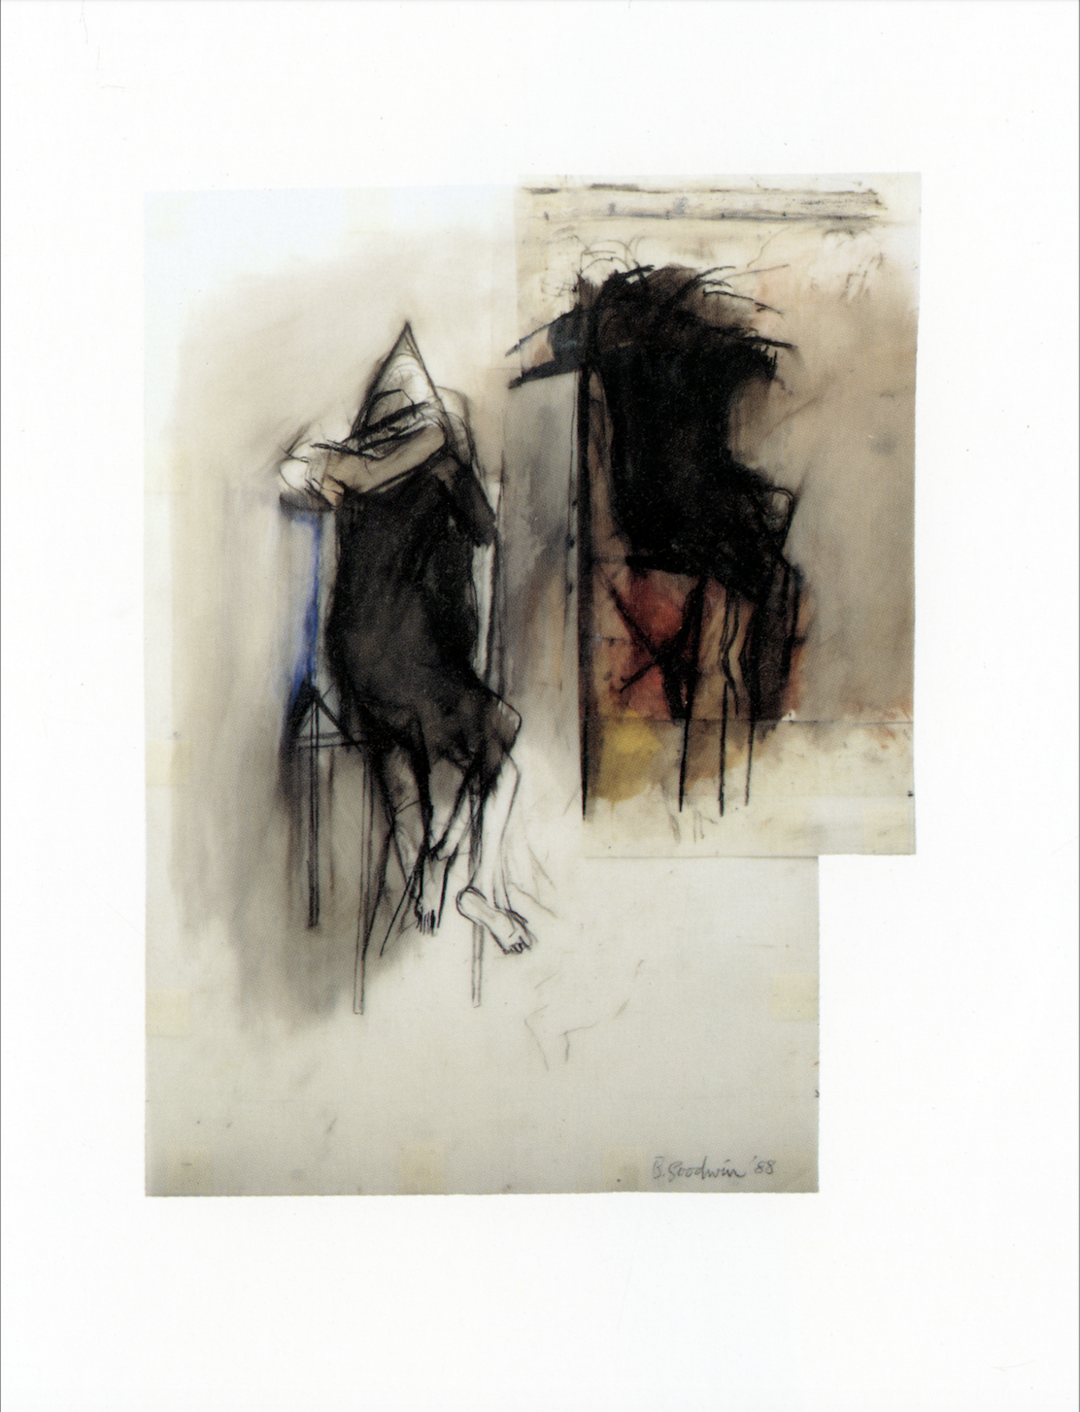
Betty Goodwin, Two Hooded Figures with Chair, No. 2, 1988. Political change, grief, and humanity are powerful themes explored in works like this one.

Slide 22
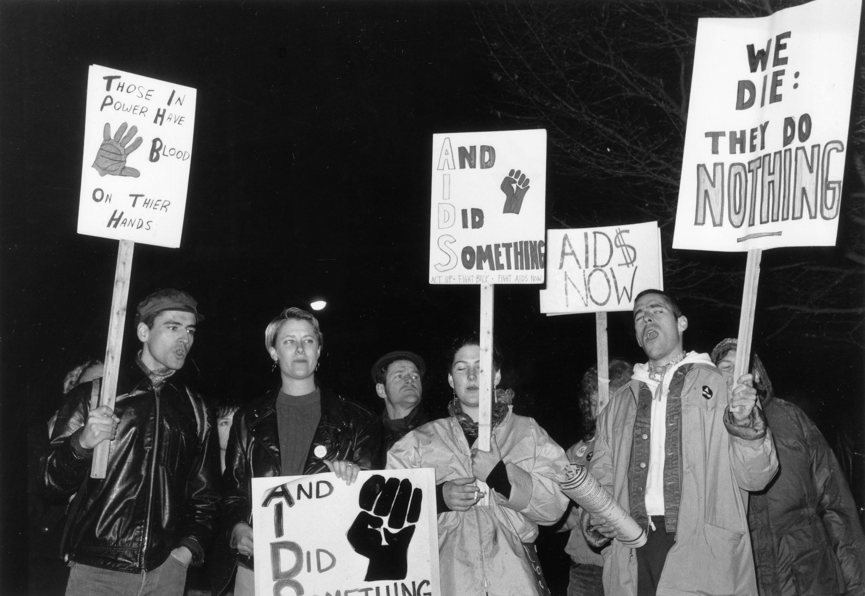
Protesters at an ACT UP (AIDS Coalition to Unleash Power) demonstration in Vancouver, 1990.

Slide 23
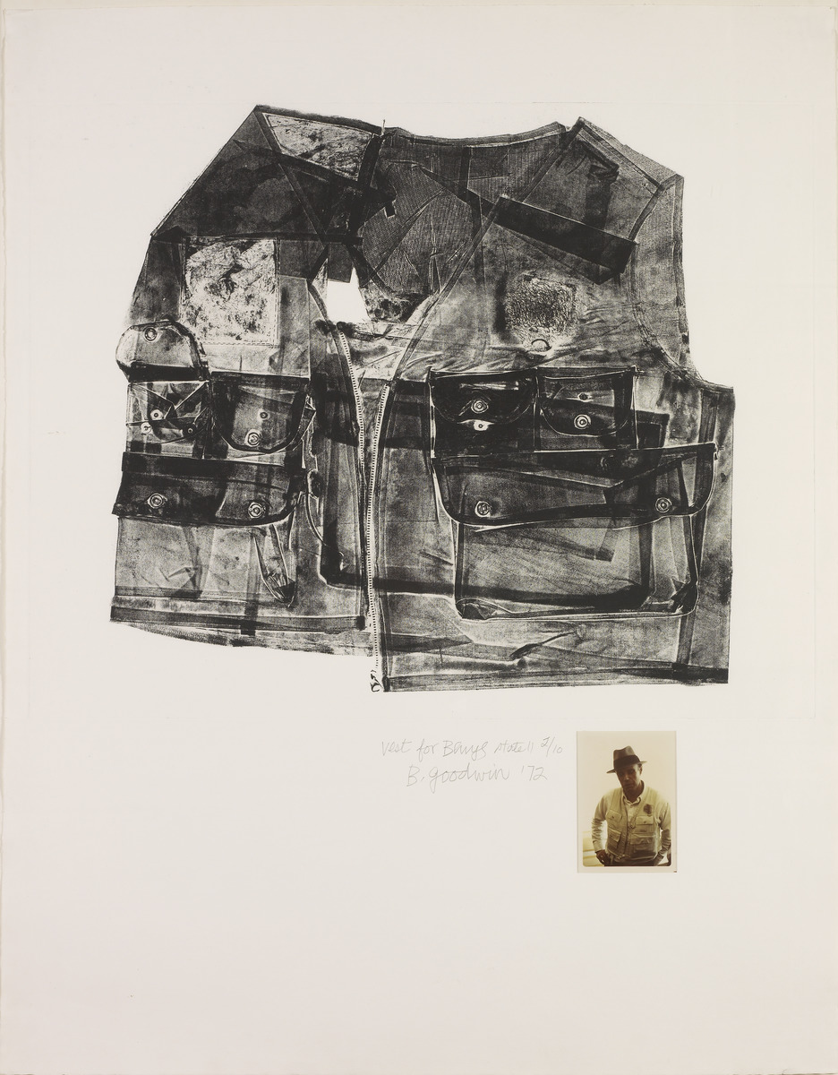
Betty Goodwin, Vest for Beuys, 1972.

Slide 24
Page from Betty Goodwin’s sketchbook, 1972–76.

Slide 25
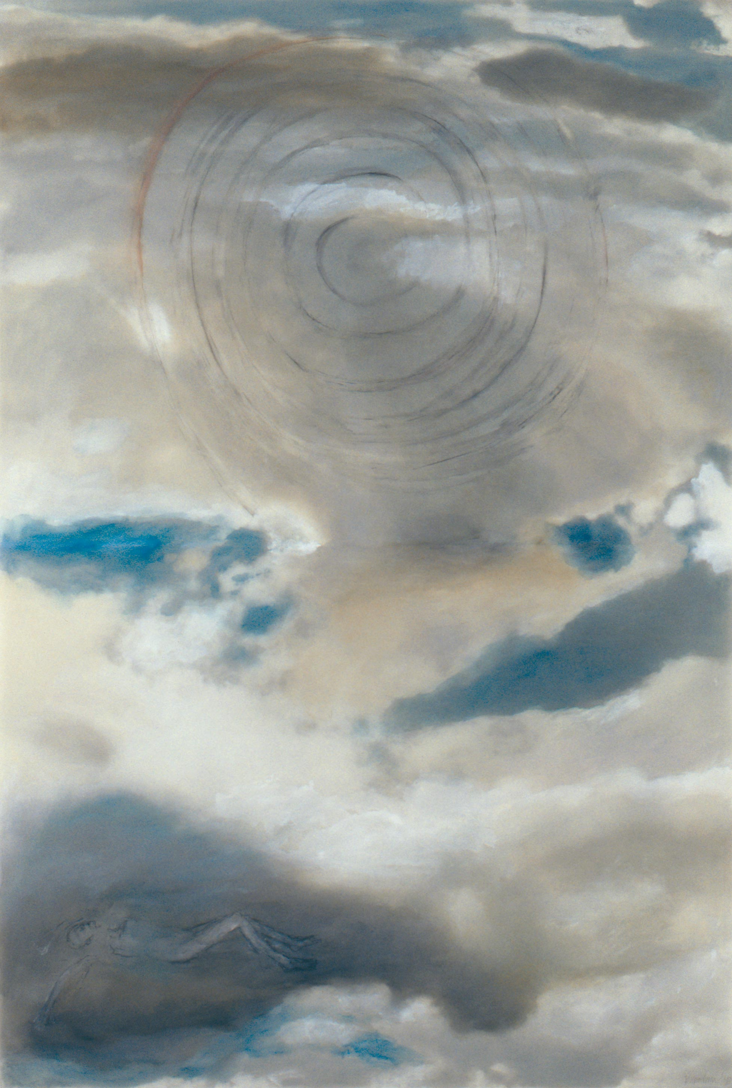
Betty Goodwin, Beyond Chaos, No. 7, 1998.

Slide 26
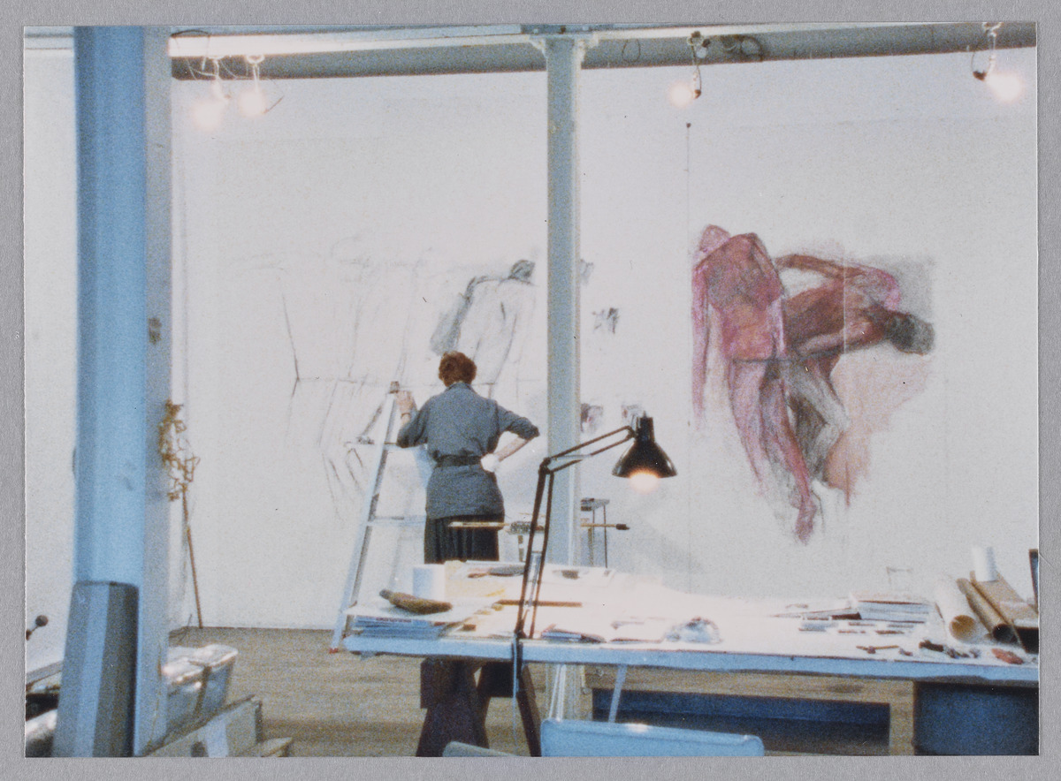
Betty Goodwin at work on a large-scale drawing in her Montreal studio, 1980s.

Slide 27
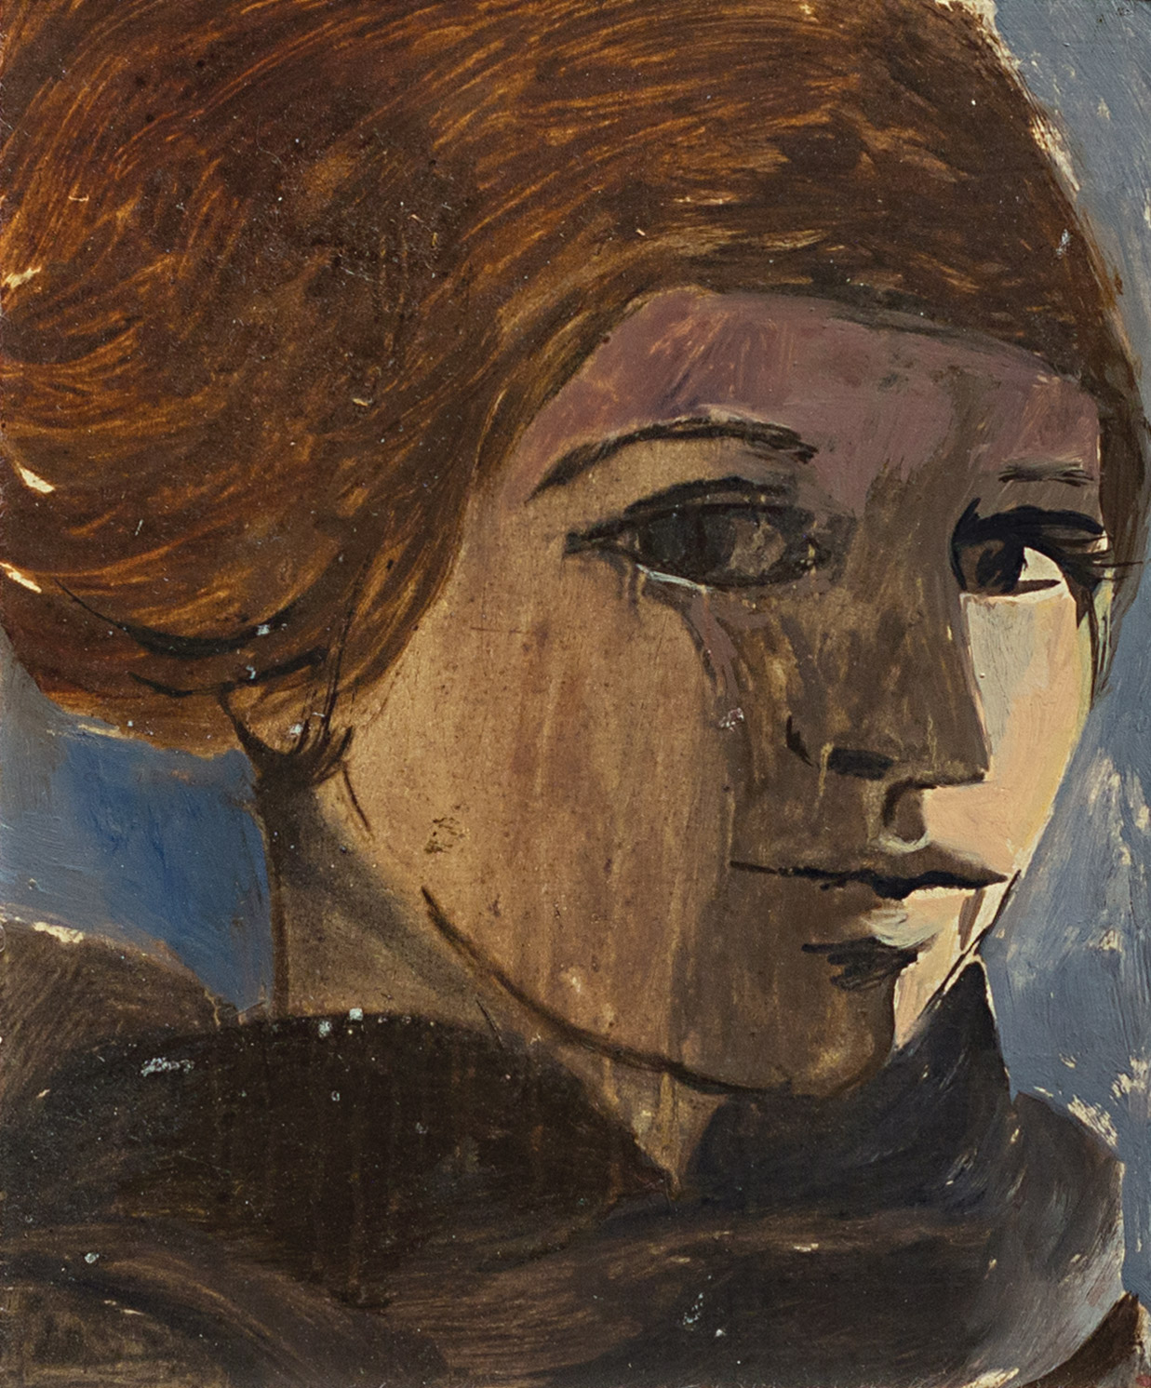
Betty Goodwin, Self-Portrait, c.1955. This is a rare painted self-portrait that Goodwin created in the early years of her career.

Slide 28
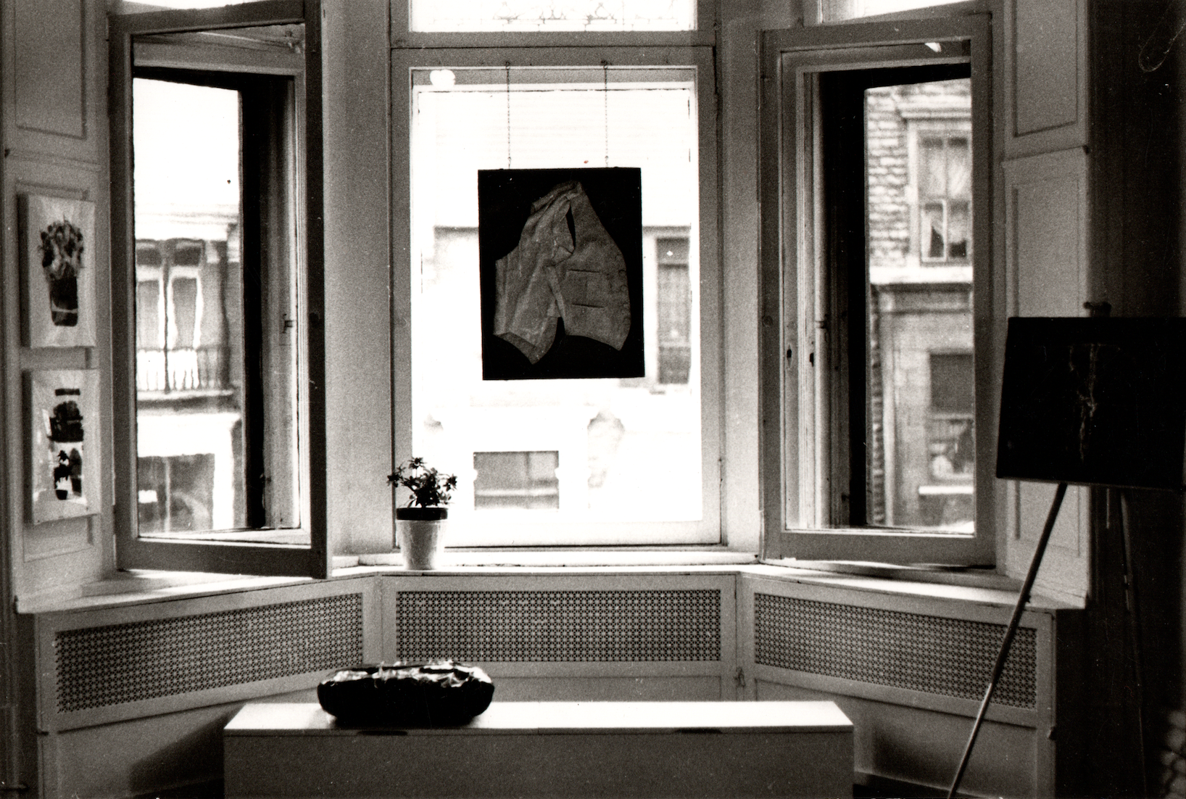
Installation view of one of Betty Goodwin’s vest prints hanging in the window of Montreal’s Galerie B, 1972.

