Slide 2
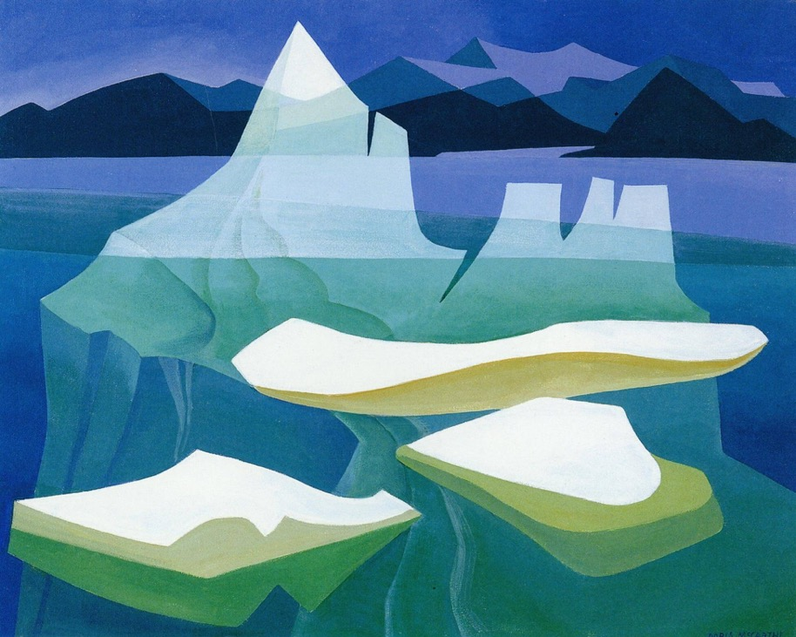
Doris McCarthy, Iceberg Fantasy No. 9, 1973. Icebergs became a reoccurring motif in McCarthy’s work following a trip to the Arctic in 1972.

Slide 3
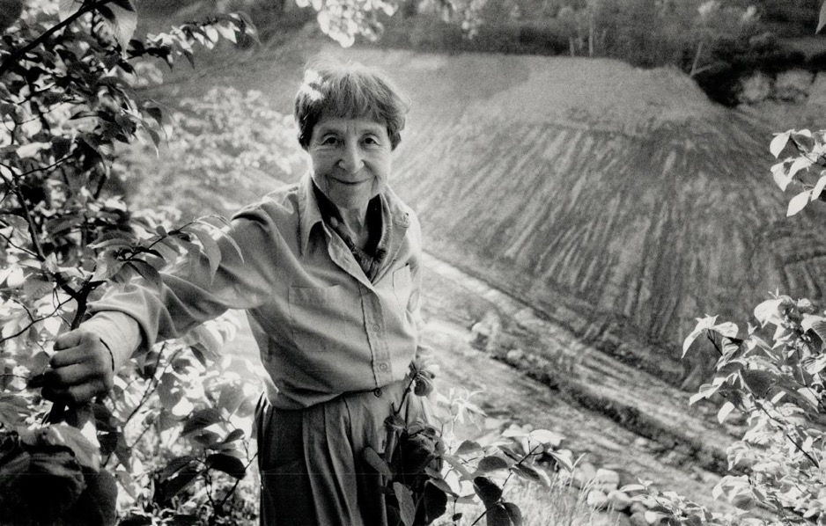
Doris McCarthy in 1989.

Slide 4
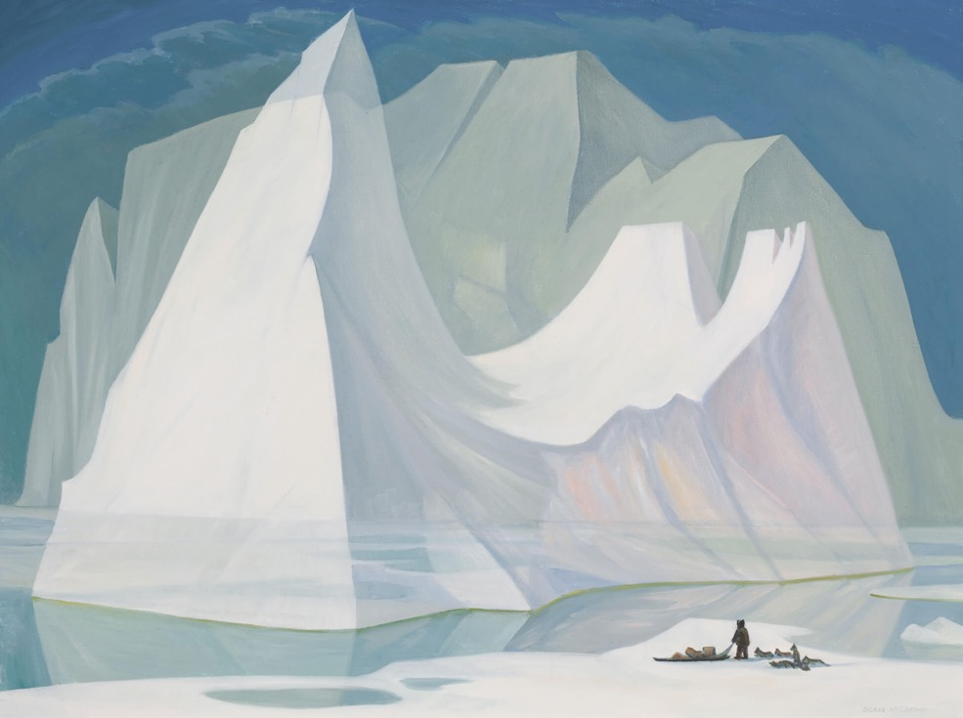
Doris McCarthy, Dog Team at the Berg, 1975. Frequent trips to the Arctic provided the basis for some of McCarthy’s most beloved landscape paintings.

Slide 5
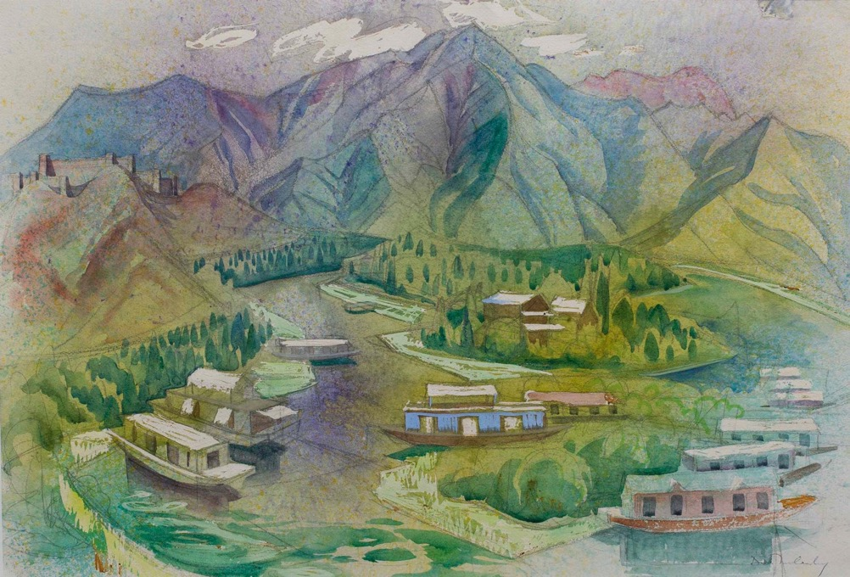
Doris McCarthy, Dhal Lake, Kashmir, 1961. Travel was a catalyst for much of McCarthy’s work.

Slide 6
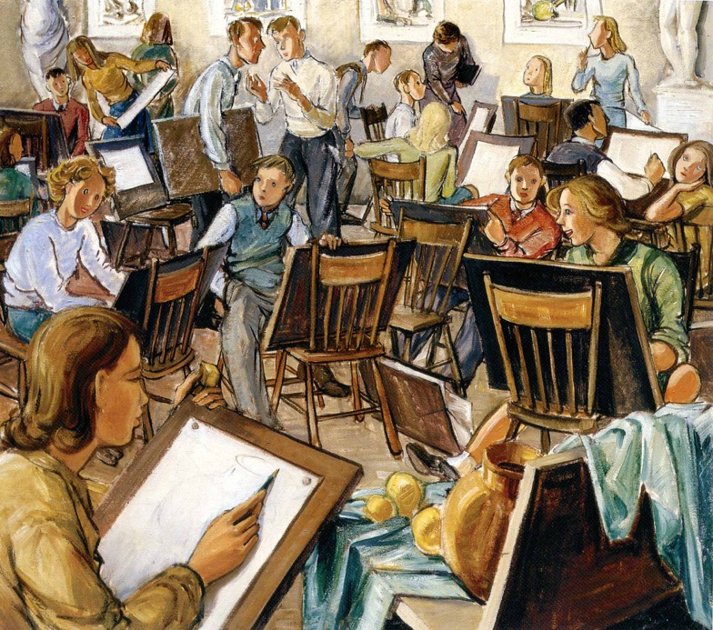
Doris McCarthy, The Drawing Class, 1946. As an art teacher, McCarthy enjoyed teaching drawing classes like the one depicted in this lively classroom scene.

Slide 7
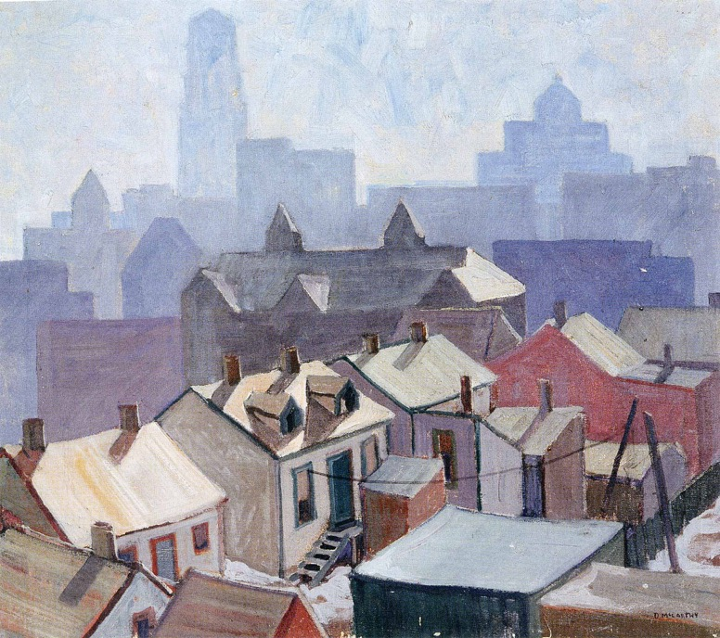
Doris McCarthy, View from Toronto General Hospital, 1931. This painting earned McCarthy a spot in the 1931 Ontario Society of Artists’ Annual Exhibition.

Slide 8
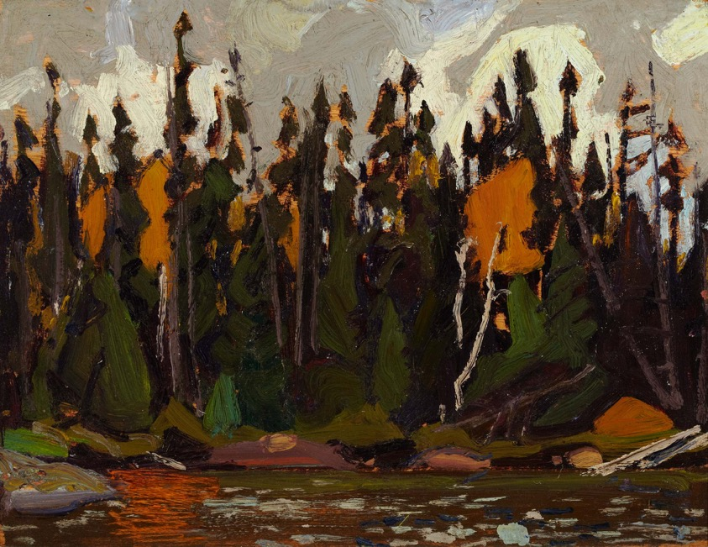
Arthur Lismer, Spruce, Algoma, 1922. Lismer was one of McCarthy’s most important teachers.

Slide 9
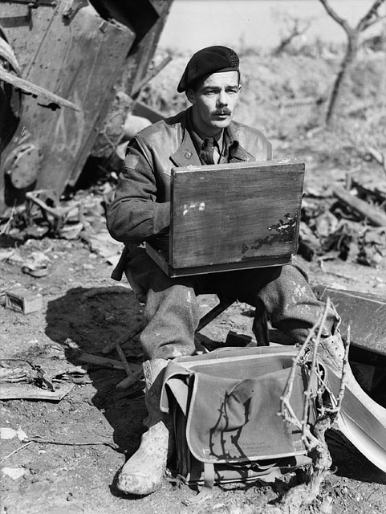
Captain Lawren P. Harris, official war artist, sketching during World War II.

Slide 10
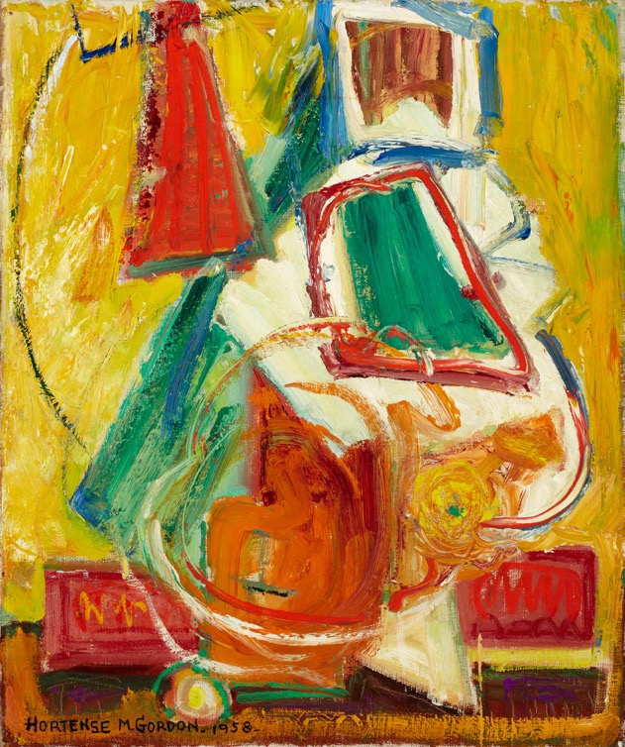
Hortense Gordon, Colour Rhythm, 1958. A founding member of Painters Eleven, Gordon’s works were exhibited in the Canadian Abstract Exhibition in 1953.

Slide 11
Doris McCarthy, City of Scarborough Flag, 1968.

Slide 12
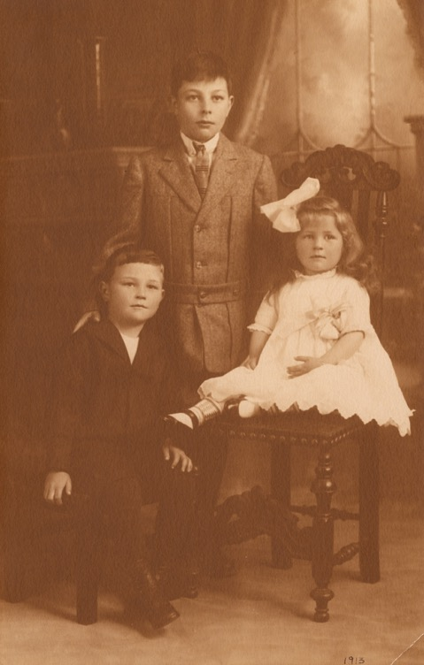
Doris McCarthy and brothers Doug (left) and Kenneth (centre), 1913.

Slide 13
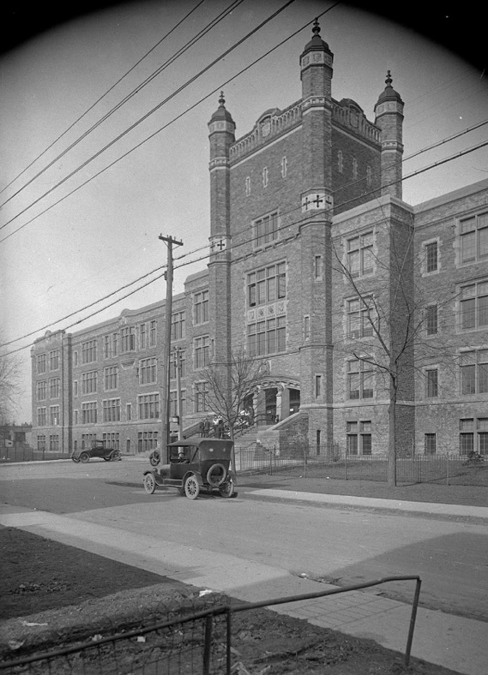
Central Technical School, Toronto, March 23, 1921.

Slide 14
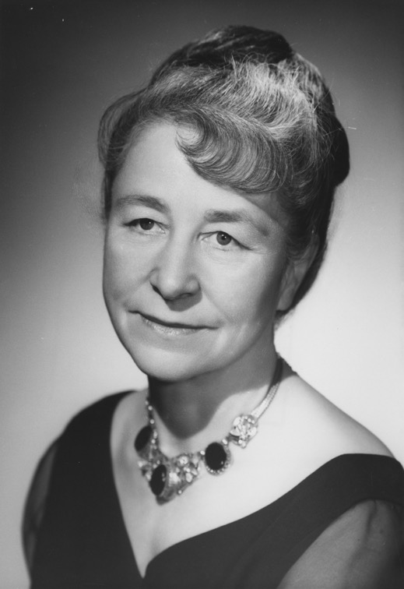
Portrait of Doris McCarthy for her debut as the first woman president of the Ontario Society of Artists, 1966.

Slide 15
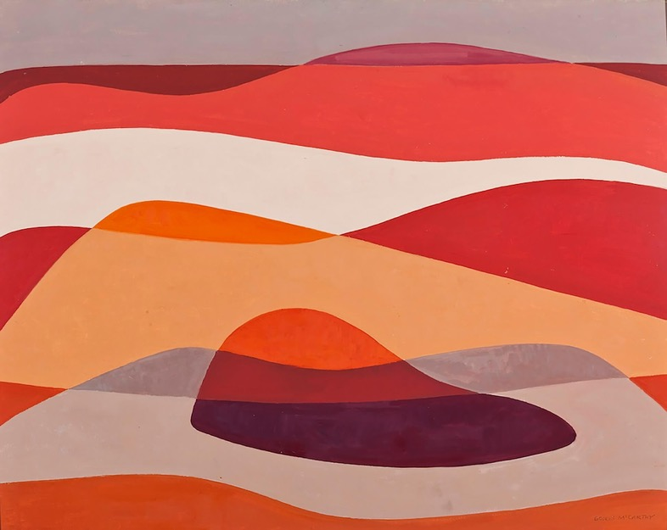
Learning Activity #1
Doris McCarthy, Rhythms of Georgian Bay, 1966. Using simplified forms, McCarthy captures the special qualities of Georgian Bay to produce this striking and yet highly abstract painting.

Slide 16
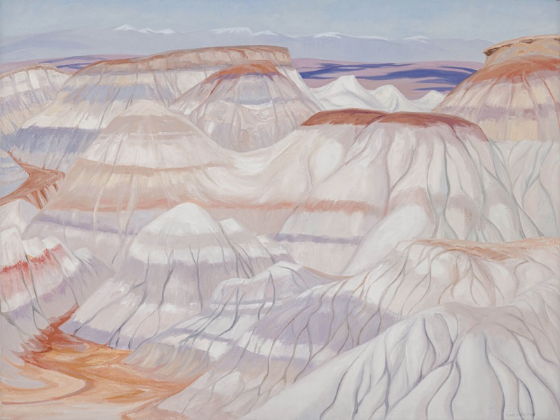
Learning Activity #1
Doris McCarthy, Badlands Revisited, 1989. After a trip to Alberta in 1977, McCarthy took up the Canadian Badlands as the subject matter of a series of works produced later in her career.

Slide 17
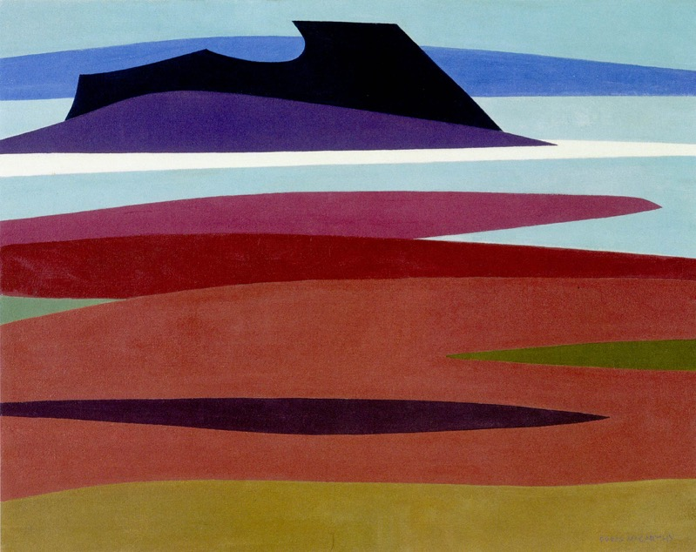
Learning Activity #1
Doris McCarthy, Dark Island, 1967. McCarthy produced around one hundred works in the abstract style pictured in this painting between the 1960s and 1970s.

Slide 18
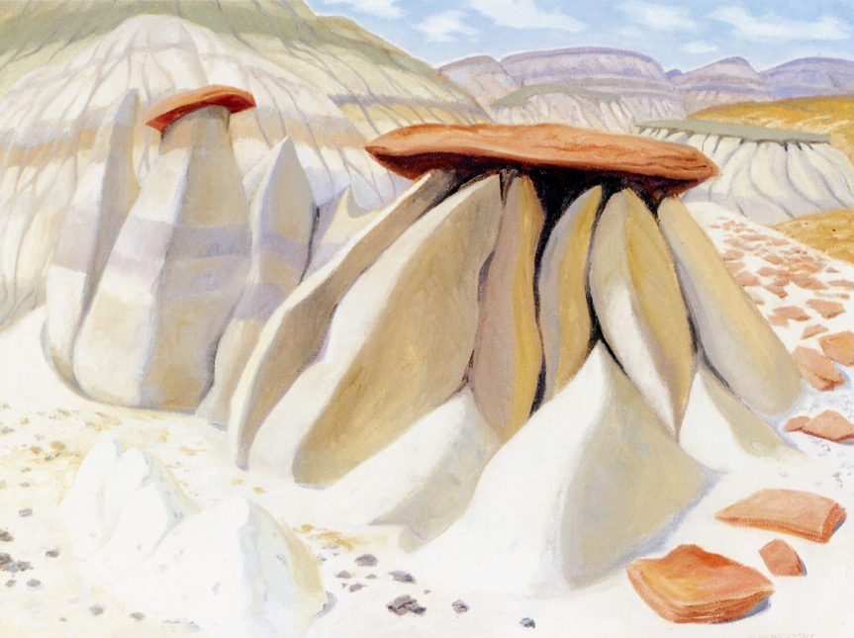
Learning Activity #1
Doris McCarthy, Hoodoos at Dinosaur Park, 1994. In this work, McCarthy depicts the odd rock formations in Dinosaur Provincial Park, which were formed naturally over millions of years.

Slide 19
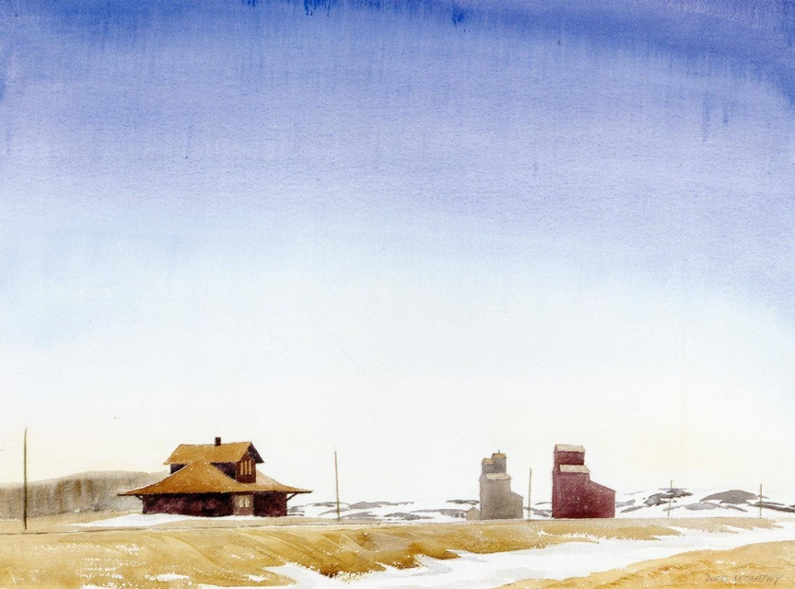
Learning Activity #1
Doris McCarthy, Rockglen, Saskatchewan, 1983. This image is dominated by a vast sky—a characteristic of the Canadian Prairies.

Slide 20
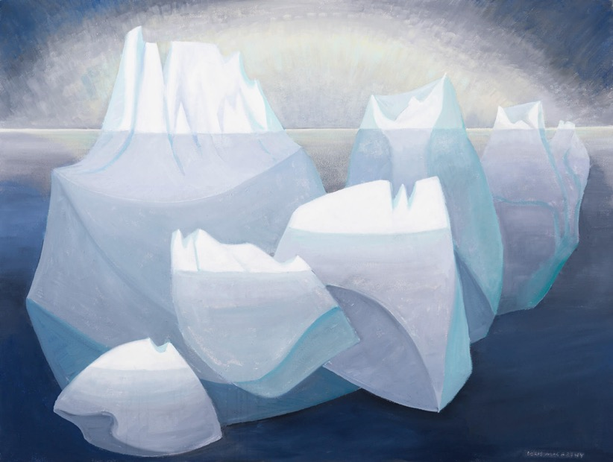
Learning Activity #2
Doris McCarthy, Aurora and the Bergs, 1996. Like much of McCarthy’s iceberg works, this painting is based on a personal interpretation of the Arctic landscape.

Slide 21
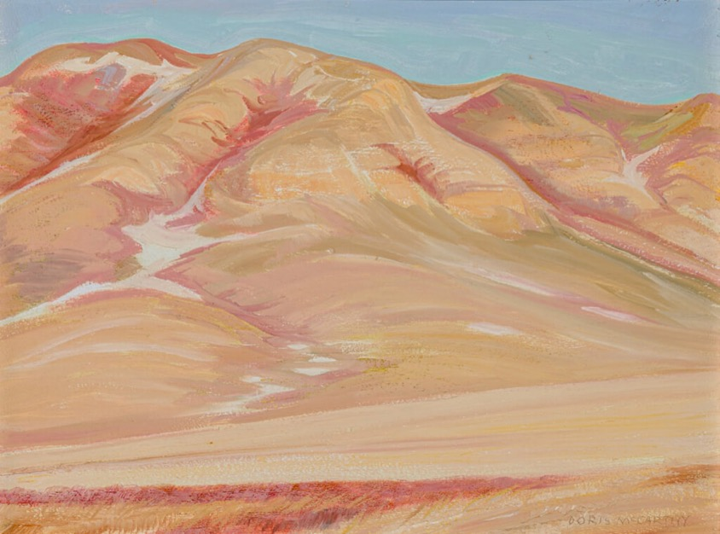
Learning Activity #2
Doris McCarthy, South Saskatchewan Hillocks, 1982. In this painting, McCarthy juxtaposes the flat prairie ground with imposing hills.

Slide 22
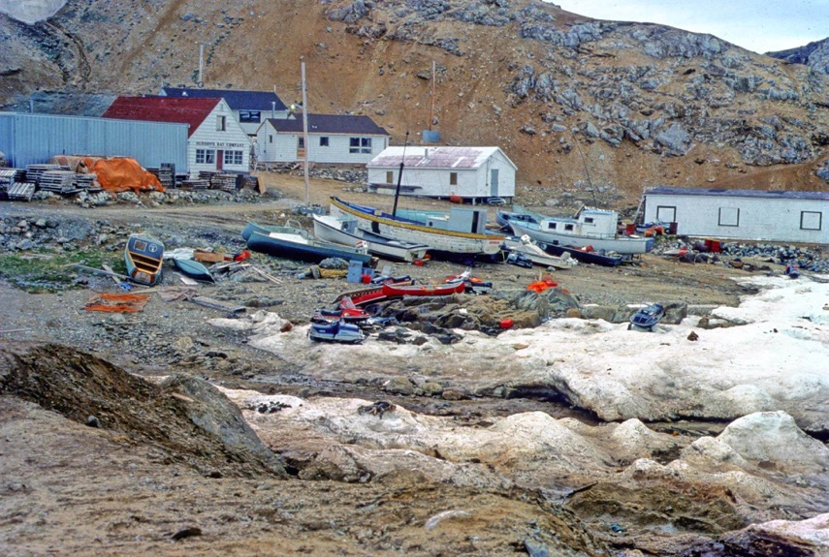
Learning Activity #2
Reference for Houses and Boats on Shore, n.d. McCarthy frequently took photographs of the places she visited to record changes in light and atmosphere, elements she worked to evoke in her paintings.

Slide 23
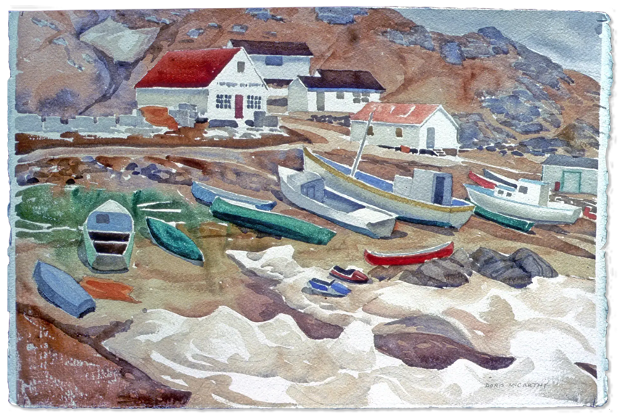
Learning Activity #2
Doris McCarthy, Houses and Boats on Shore, n.d. This painting bears a striking resemblance to a slide of similar subject matter, showing that McCarthy used photography as a memory aid.

Slide 24
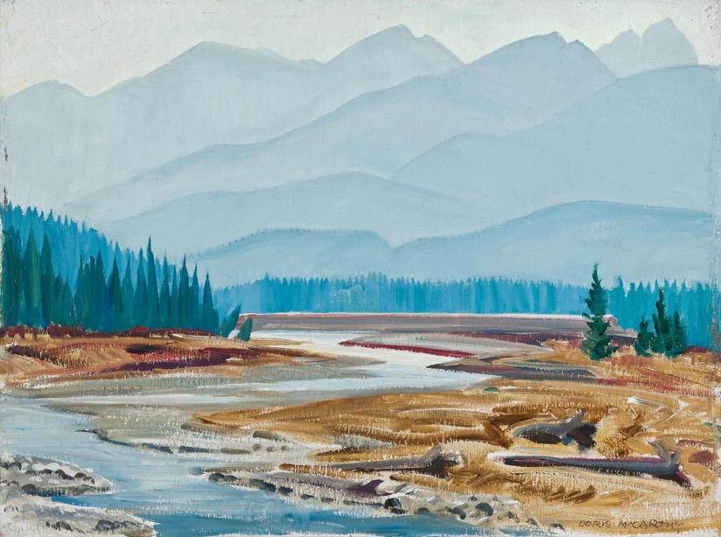
Learning Activity #2
Doris McCarthy, Kicking Horse River West of Field, B.C., 1974. This painting of the Rockies includes McCarthy’s signature approach to composition, with a path that can be traced from the foreground to the background.

Slide 25
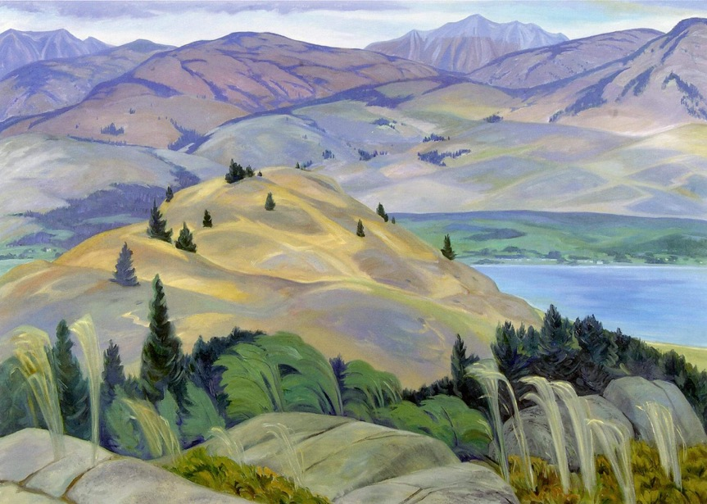
Learning Activity #2
Doris McCarthy, Okanagan Valley Near Osoyoos, B.C., 1989. McCarthy illustrates the characteristic lakes and hills of the Okanagan Valley, a region north of the Cascade Mountains.

Slide 26
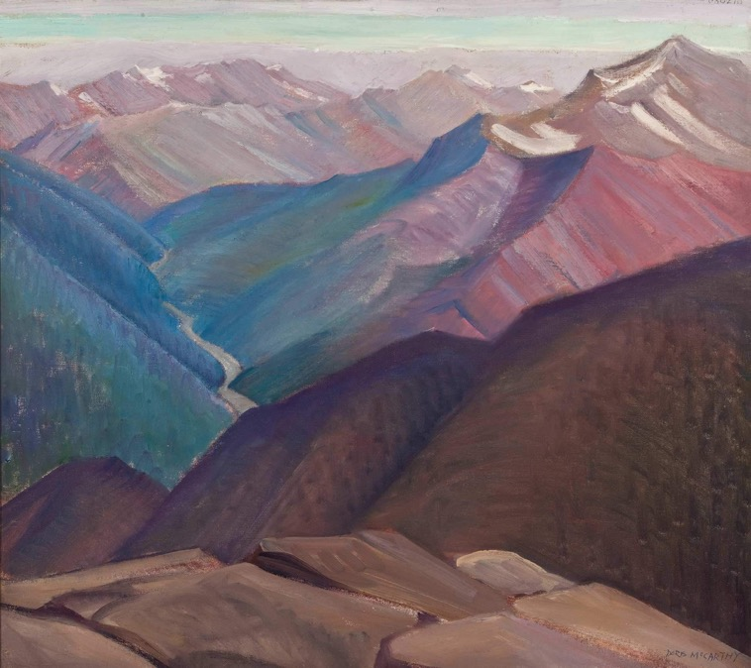
Culminating Task
Doris McCarthy, Valley of the Bow River Above Revelstoke, 1938. This image of the Bow Valley hints at the slightly elevated perspective that McCarthy honed during her career.

Slide 27
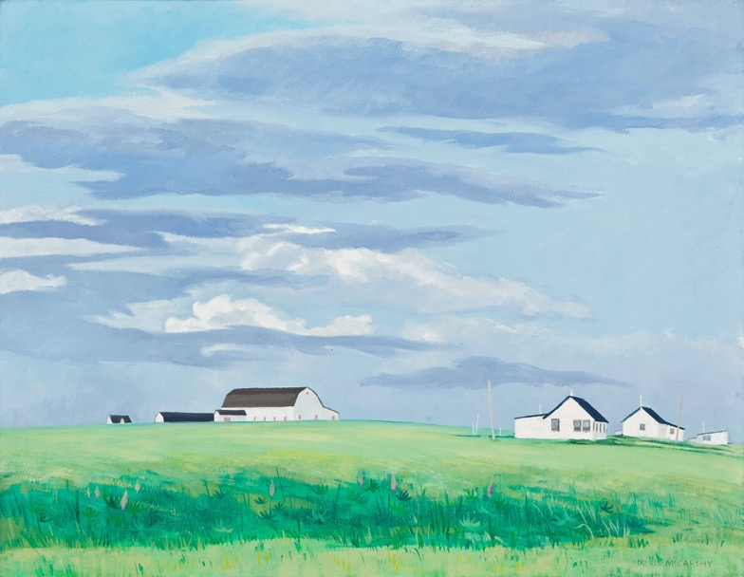
Culminating Task
Doris McCarthy, Neighbours, P.E.I., 1985. McCarthy has depicted this scene in Canada’s smallest province with an interest in the relationships between humans and the natural world.

Slide 28
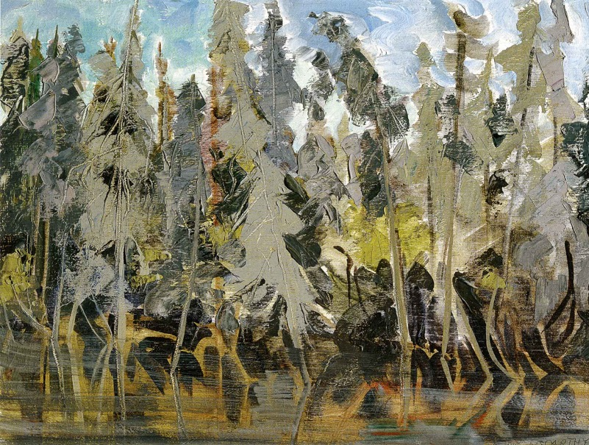
Culminating Task
Doris McCarthy, Grey Spruce in the Ditch, 1977. In this highly tactile work, McCarthy attempts to capture differing textures and details with the use of simple brushwork.

Slide 29
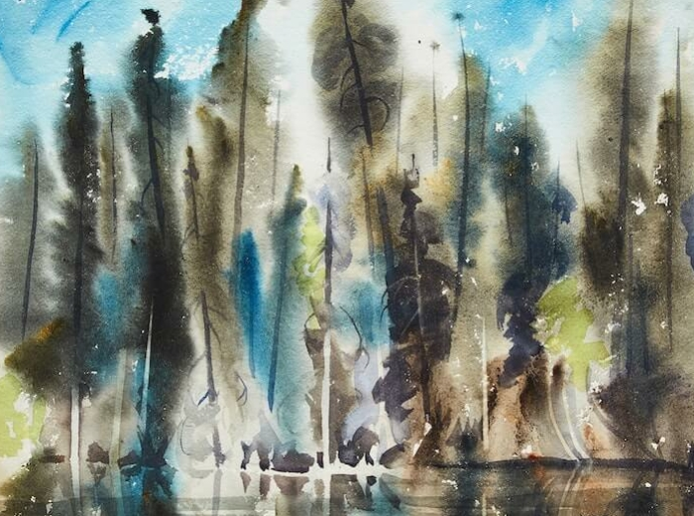
Culminating Task
Doris McCarthy, Grey Spruce, Inuvik, 1977. Based on its title, this painting was likely produced during McCarthy’s trip to the Northwest Territory community of Inuvik in June 1977.

Slide 30
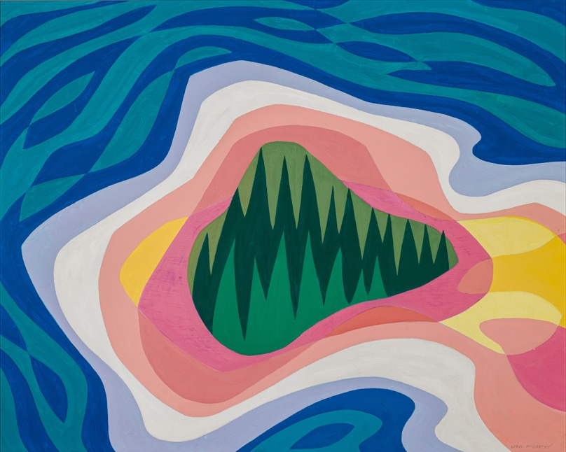
Doris McCarthy, Georgian Bay from the Air, 1966. In her hard-edged landscapes, McCarthy pushed against the boundaries between representational and abstract art.

Slide 31
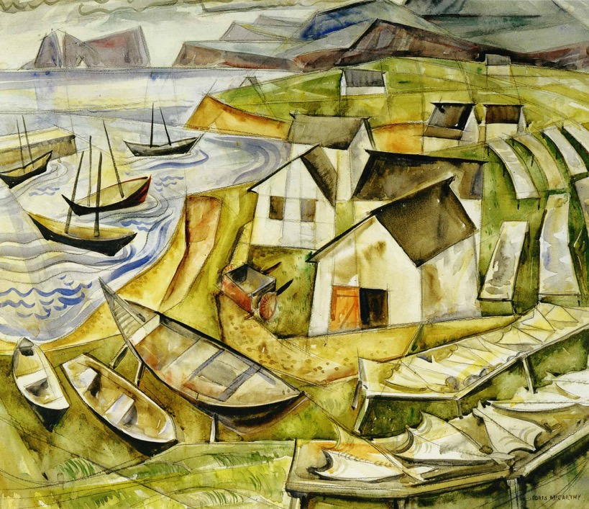
Doris McCarthy, Mal Bay with Fish Rack, 1954. McCarthy developed her signature compositional techniques in works such as this one, which depicts a fishing village in Quebec.

Slide 32
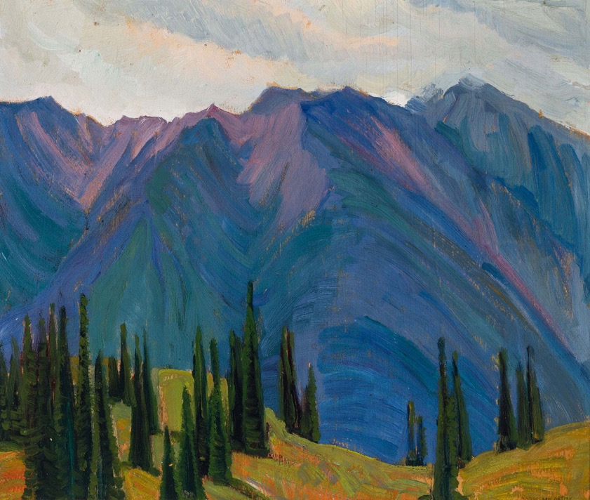
Doris McCarthy, Mountains Near Revelstoke, B.C., 1937. This painting of the Rocky Mountains near Revelstoke was made during McCarthy’s first trip to British Columbia.

Slide 33
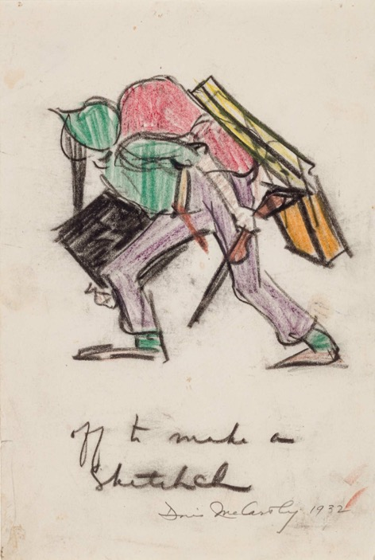
Doris McCarthy, Off to Make a Sketch, 1932. McCarthy documented her painting trips with small sketches like this one.

Slide 34
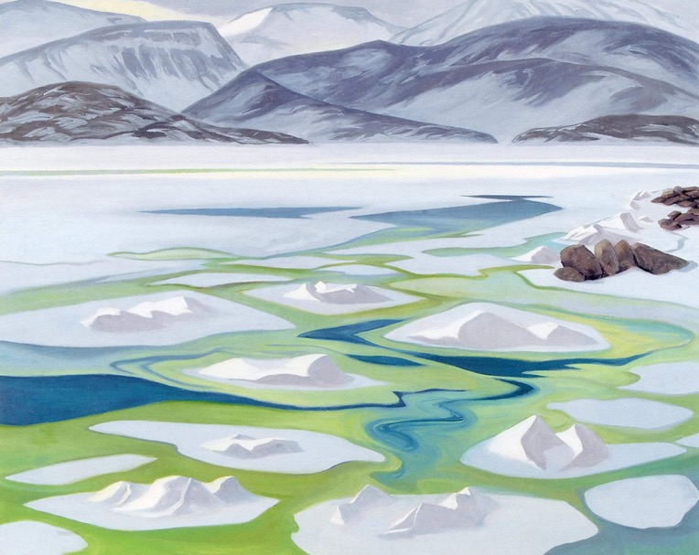
Doris McCarthy, Broughton Ballet, 1978. As McCarthy’s landscape works evolved, so too did her use of colour, which she used to evoke the feelings of the places she painted.

