Slide 2
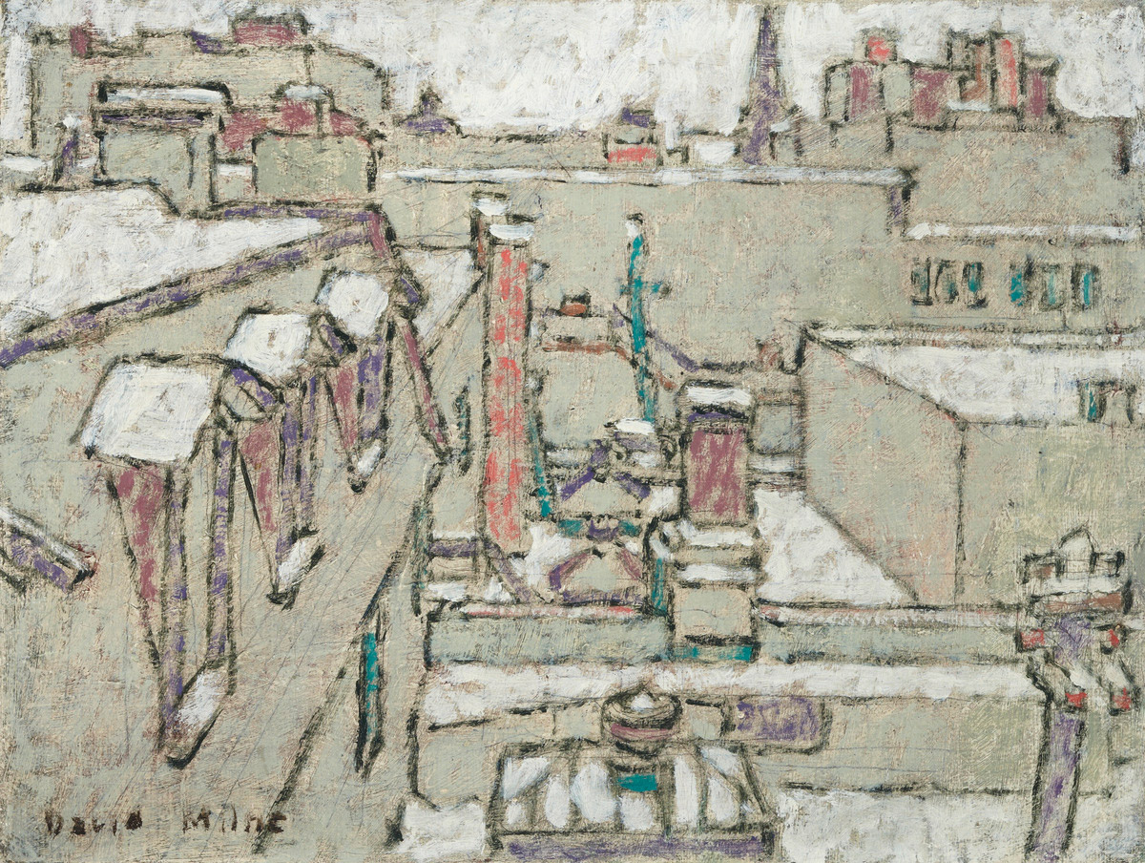
David B. Milne, From an Upper Window, Ottawa II, 1924. Though Milne only briefly resided in Ottawa, he produced a number of works depicting the city from his studio on Sparks Street.

Slide 3
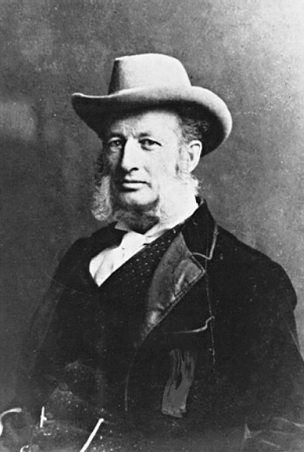
Photograph of Lucius R. O’Brien.

Slide 4
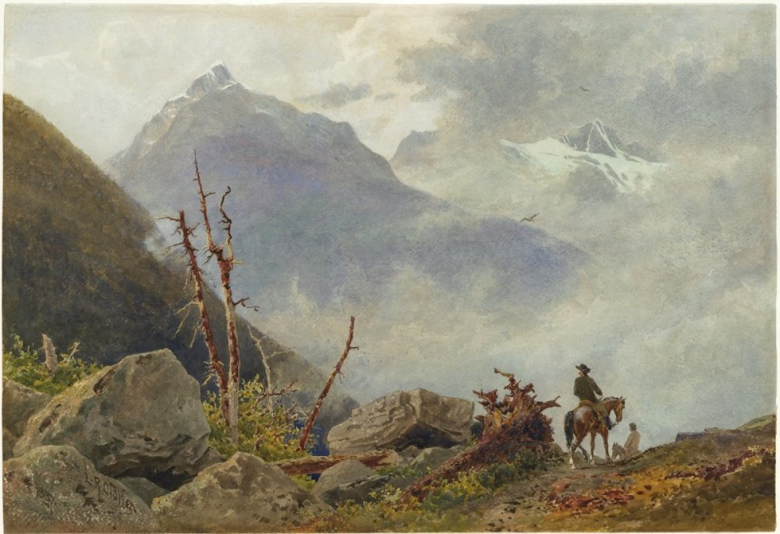
Lucius R. O’Brien, A Mountain Trail, 1887. O’Brien produced this work during his sojourn to the Rocky Mountains via the transcontinental line of the Canadian Pacific Railway.

Slide 5
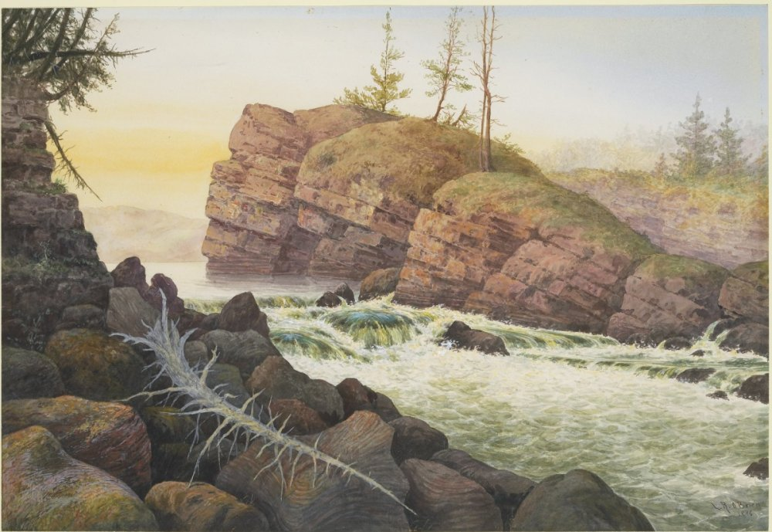
Lucius R. O’Brien, Song of Les Erables Rapids, Ottawa River, 1876. By the 1860s, the site depicted here had become a key portage site to the timber trade and logging industry established along the Ottawa River.

Slide 6
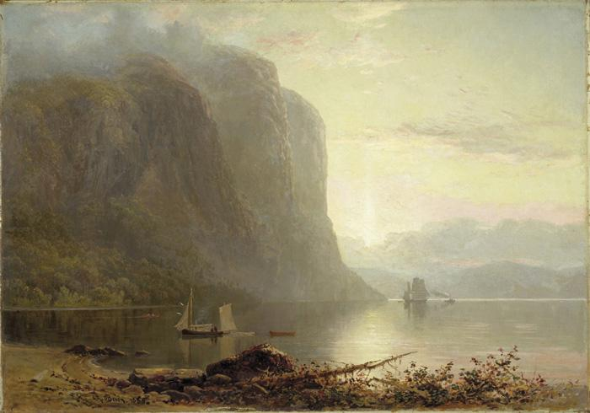
Lucius R. O’Brien, Sunrise on the Saguenay, Cape Trinity, 1880. Considered one of O’Brien’s masterworks, this painting was one of the first to be acquired by the newly established National Gallery of Canada.

Slide 7
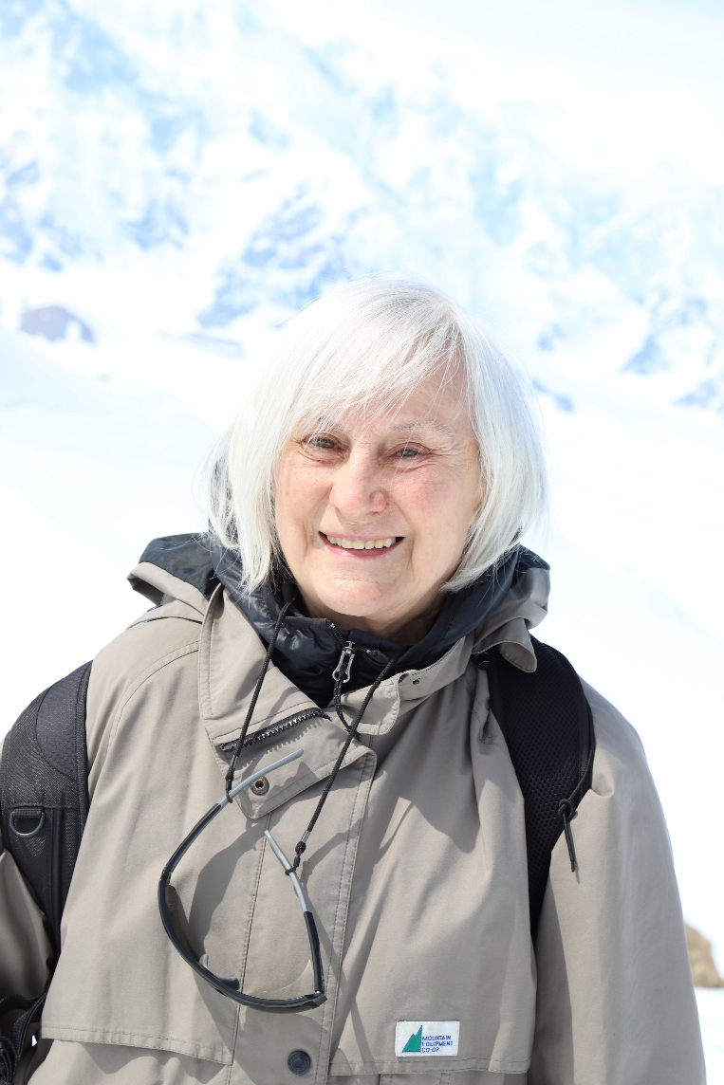
Leslie Reid in the Kluane Icefields, Yukon, 2022.

Slide 8
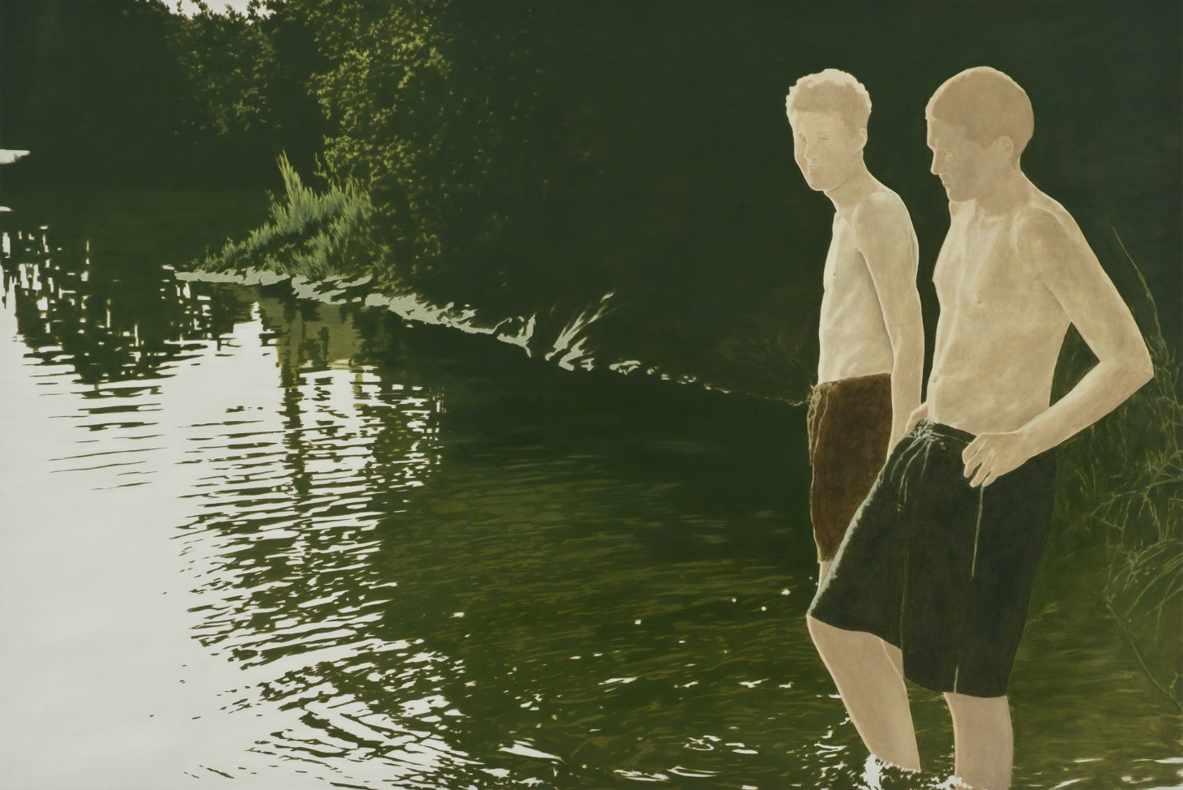
Leslie Reid, Calumet: In Time, 2006. Reid’s paintings are typically produced from photographs that she projects onto the surface of the canvas.

Slide 9
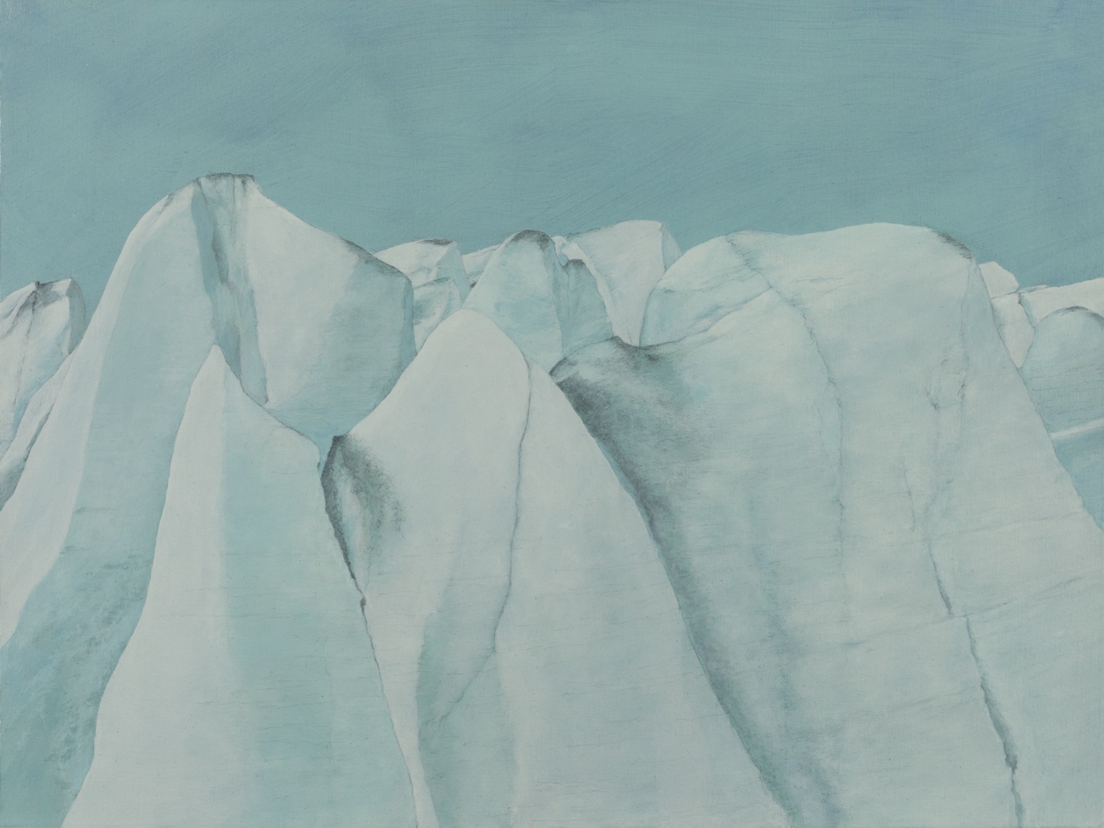
Leslie Reid, Llewellyn III 59°04’N; 134°05’W, 2015. This work is one of a series of paintings documenting climate change in the Canadian North with images of shrinking glaciers.

Slide 10
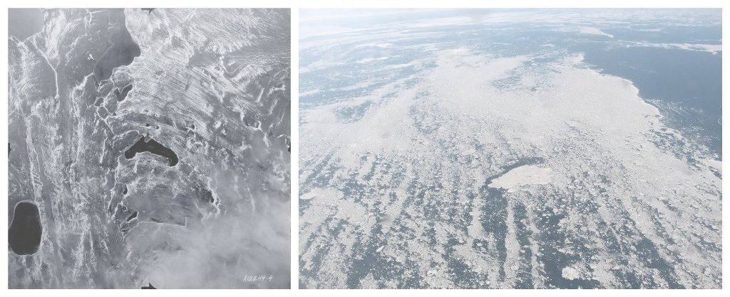
Leslie Reid, Resolute I 1949-08-28; 2013-08-16, 2016. This work is the result of Reid’s extensive travel in the High Arctic, particularly around Resolute Bay, the site of the Canadian government’s High Arctic Relocation program in the 1950s.

Slide 11
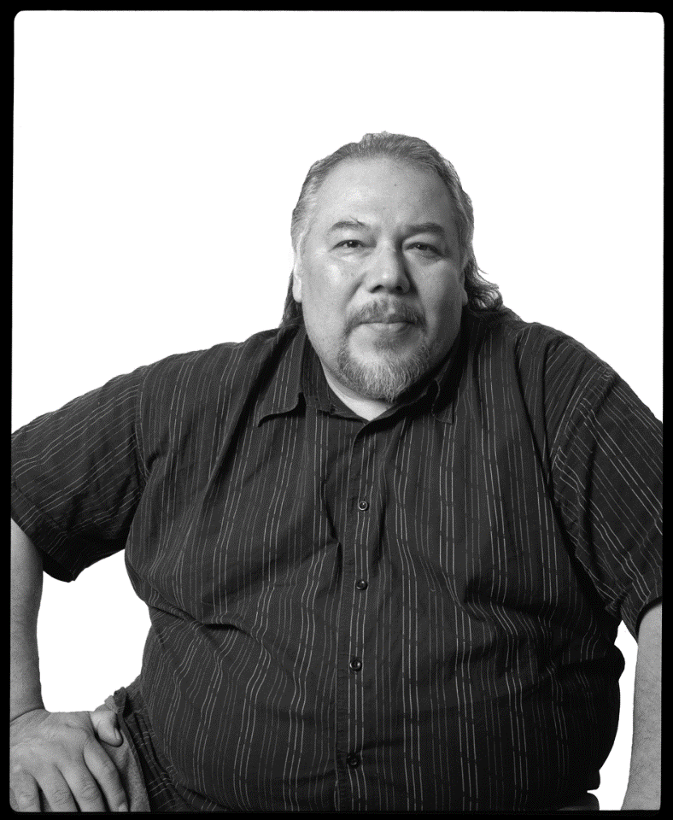
Photograph of Jeff Thomas.

Slide 12
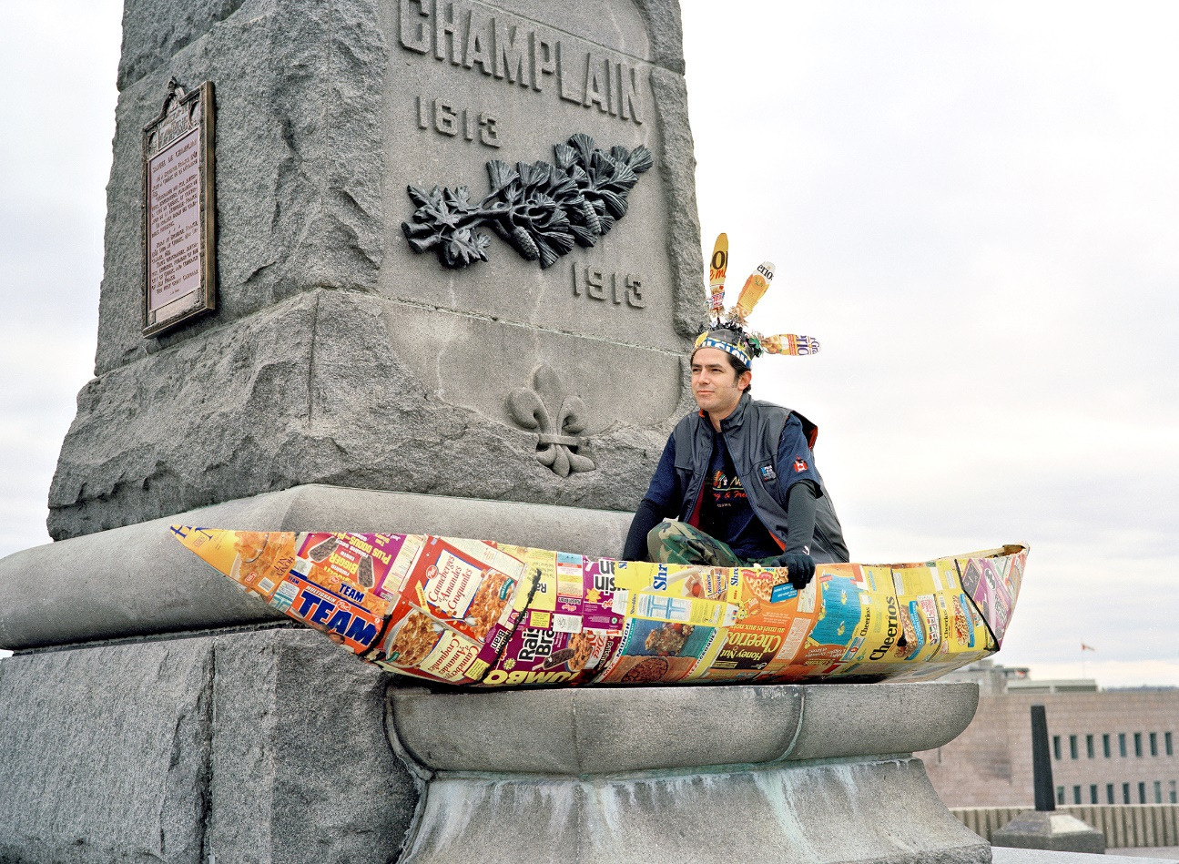
Jeff Thomas, Champlain, Greg Hill in His Cereal Box Canoe, Ottawa, Ontario, 2000. Mohawk artist and curator Greg Hill directed the Department of Indigenous Art at the National Gallery of Canada from 2007 to 2022.

Slide 13
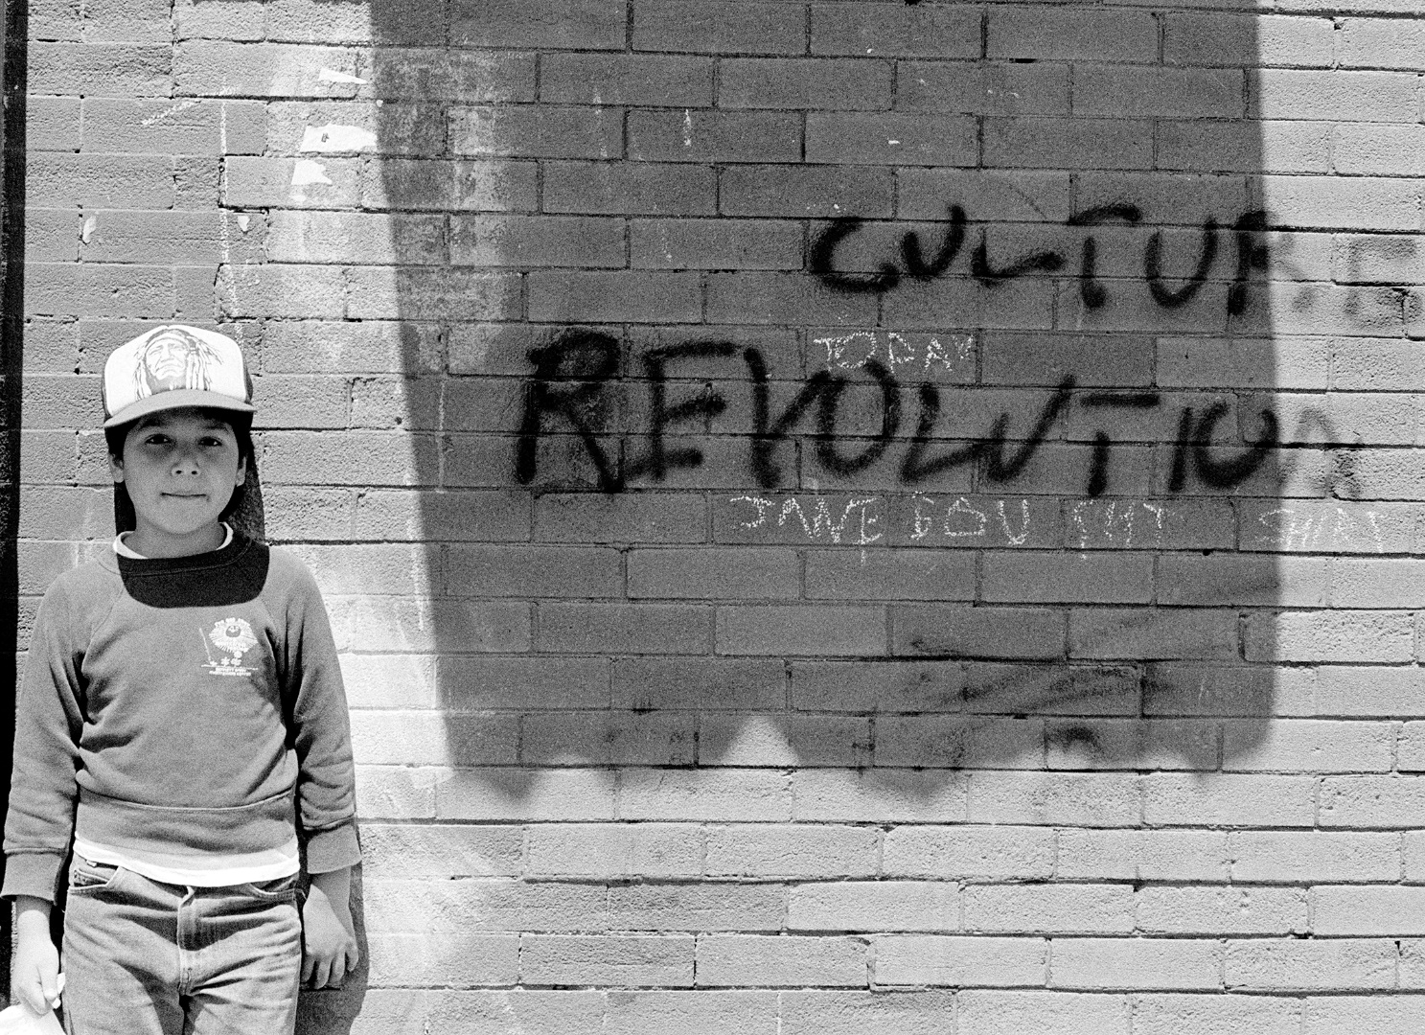
Jeff Thomas, Bear Portraits, Culture Revolution, Toronto, Ontario, 1984. This portrait of Thomas’s son was the catalyst for a longer series of works examining the experiences and perspectives of Indigenous people living in cities.

Slide 14
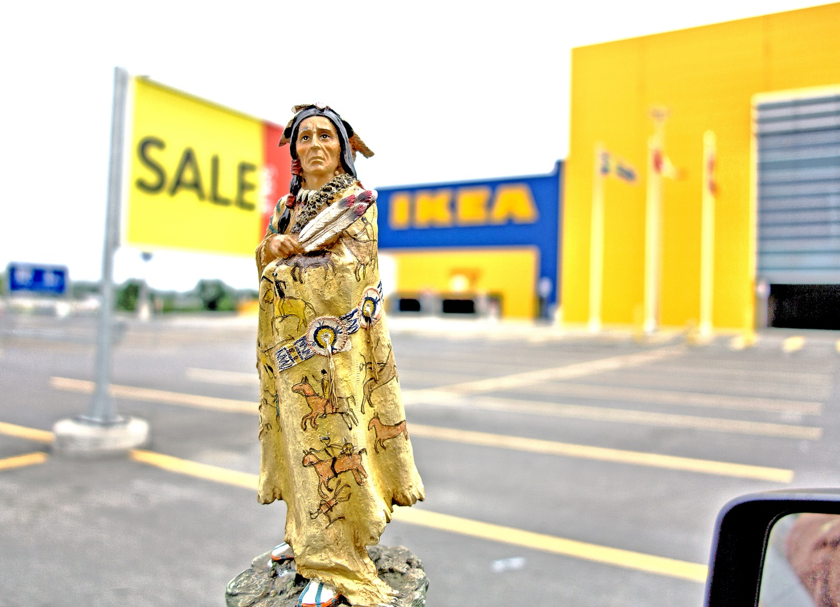
Jeff Thomas, Buffalo Robe—Happy Canada Day, Ottawa, 2013. Thomas has incorporated figurines like the one pictured here into his works documenting the erasure of Indigenous peoples from urban spaces.

Slide 15
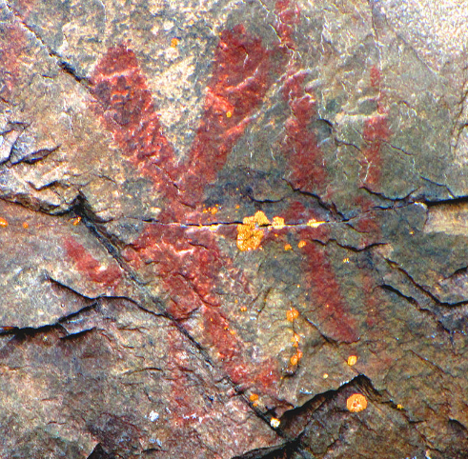
Learning Activity #1
Pictographic representation of Nanabozho found at Mazinaw Lake, Bon Echo Provincial Park, Kaladar, Ontario. Nanabozho (Nanabush) is a powerful, shape-shifting being and a key figure in creation stories among Anishinaabe and Cree peoples.

Slide 16
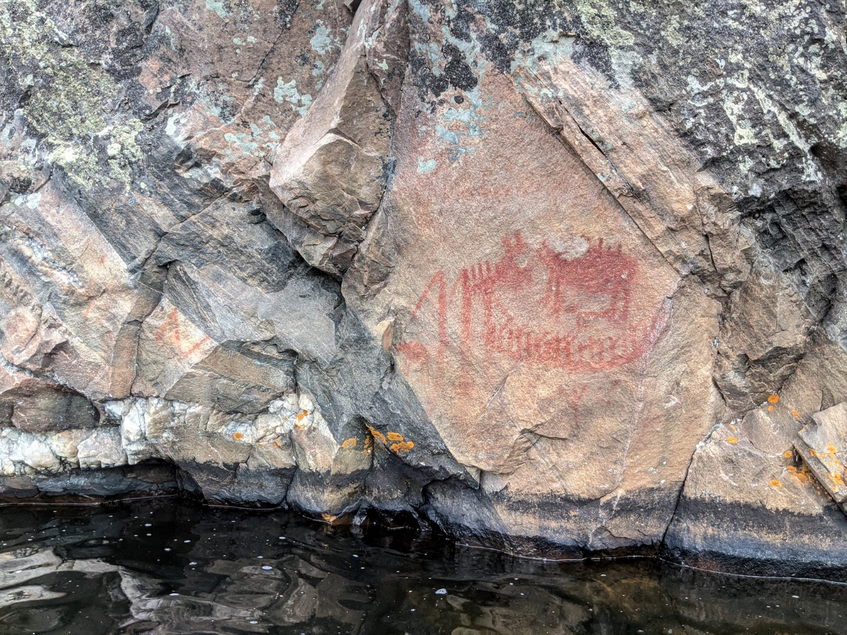
Learning Activity #1
Pictographic representations found at Mazinaw Lake, n.d., Bon Echo Provincial Park, Kaladar, Ontario.

Slide 17
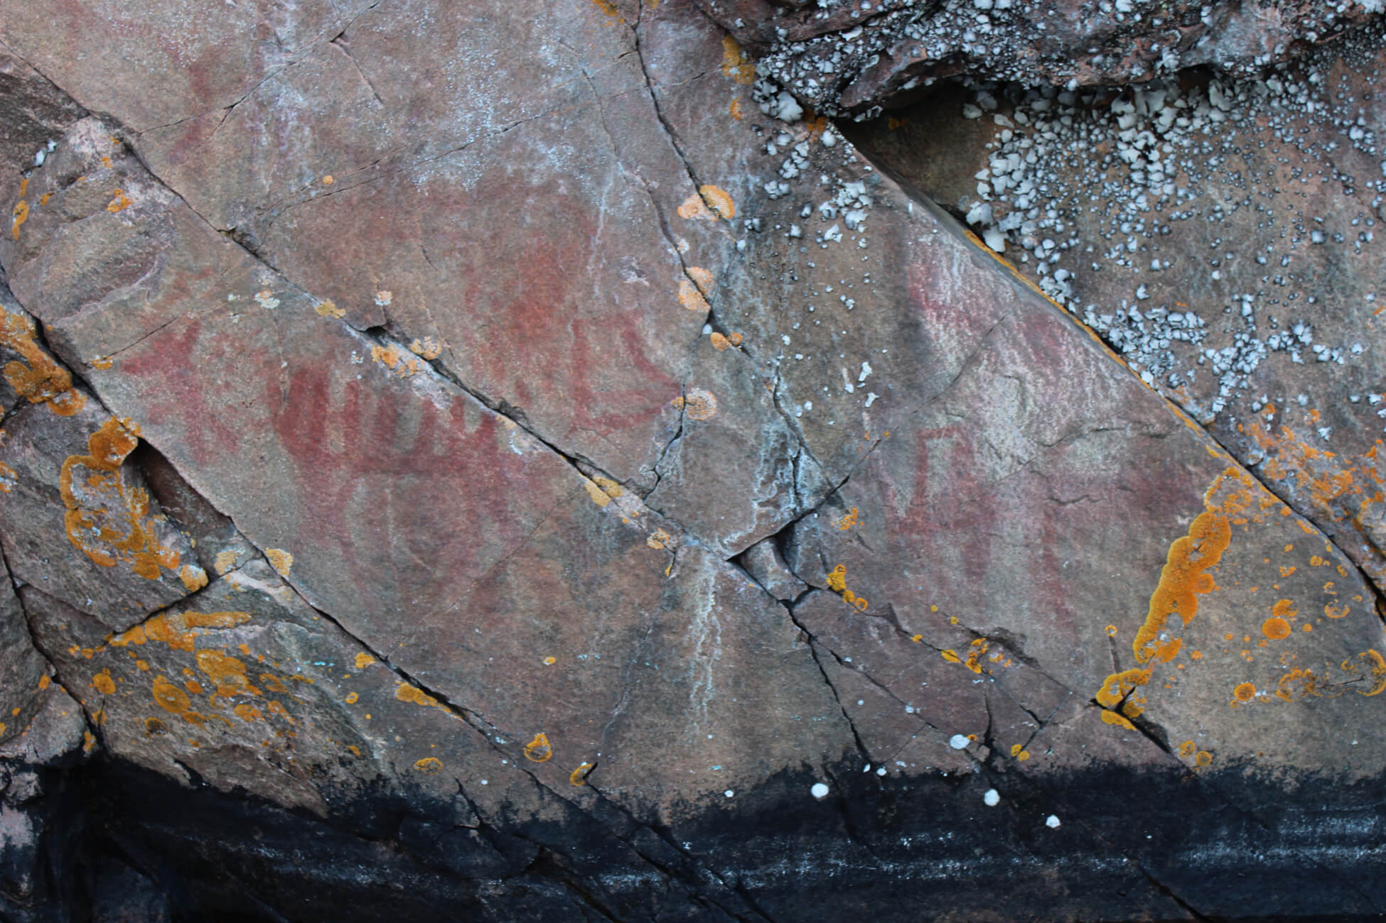
Learning Activity #1
Pictographic representations on the rock face, Mazinaw Lake, n.d., Bon Echo Provincial Park, Kaladar, Ontario.

Slide 18
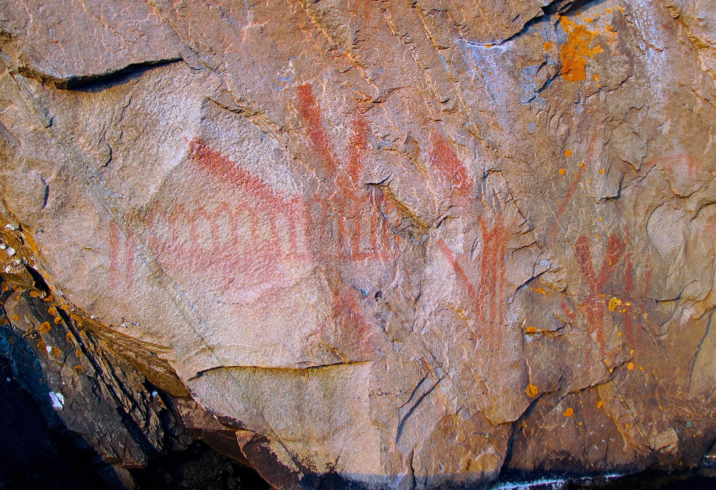
Learning Activity #1
Pictographic representations on the rock face, Mazinaw Lake, n.d., Bon Echo Provincial Park, Kaladar, Ontario.

Slide 19
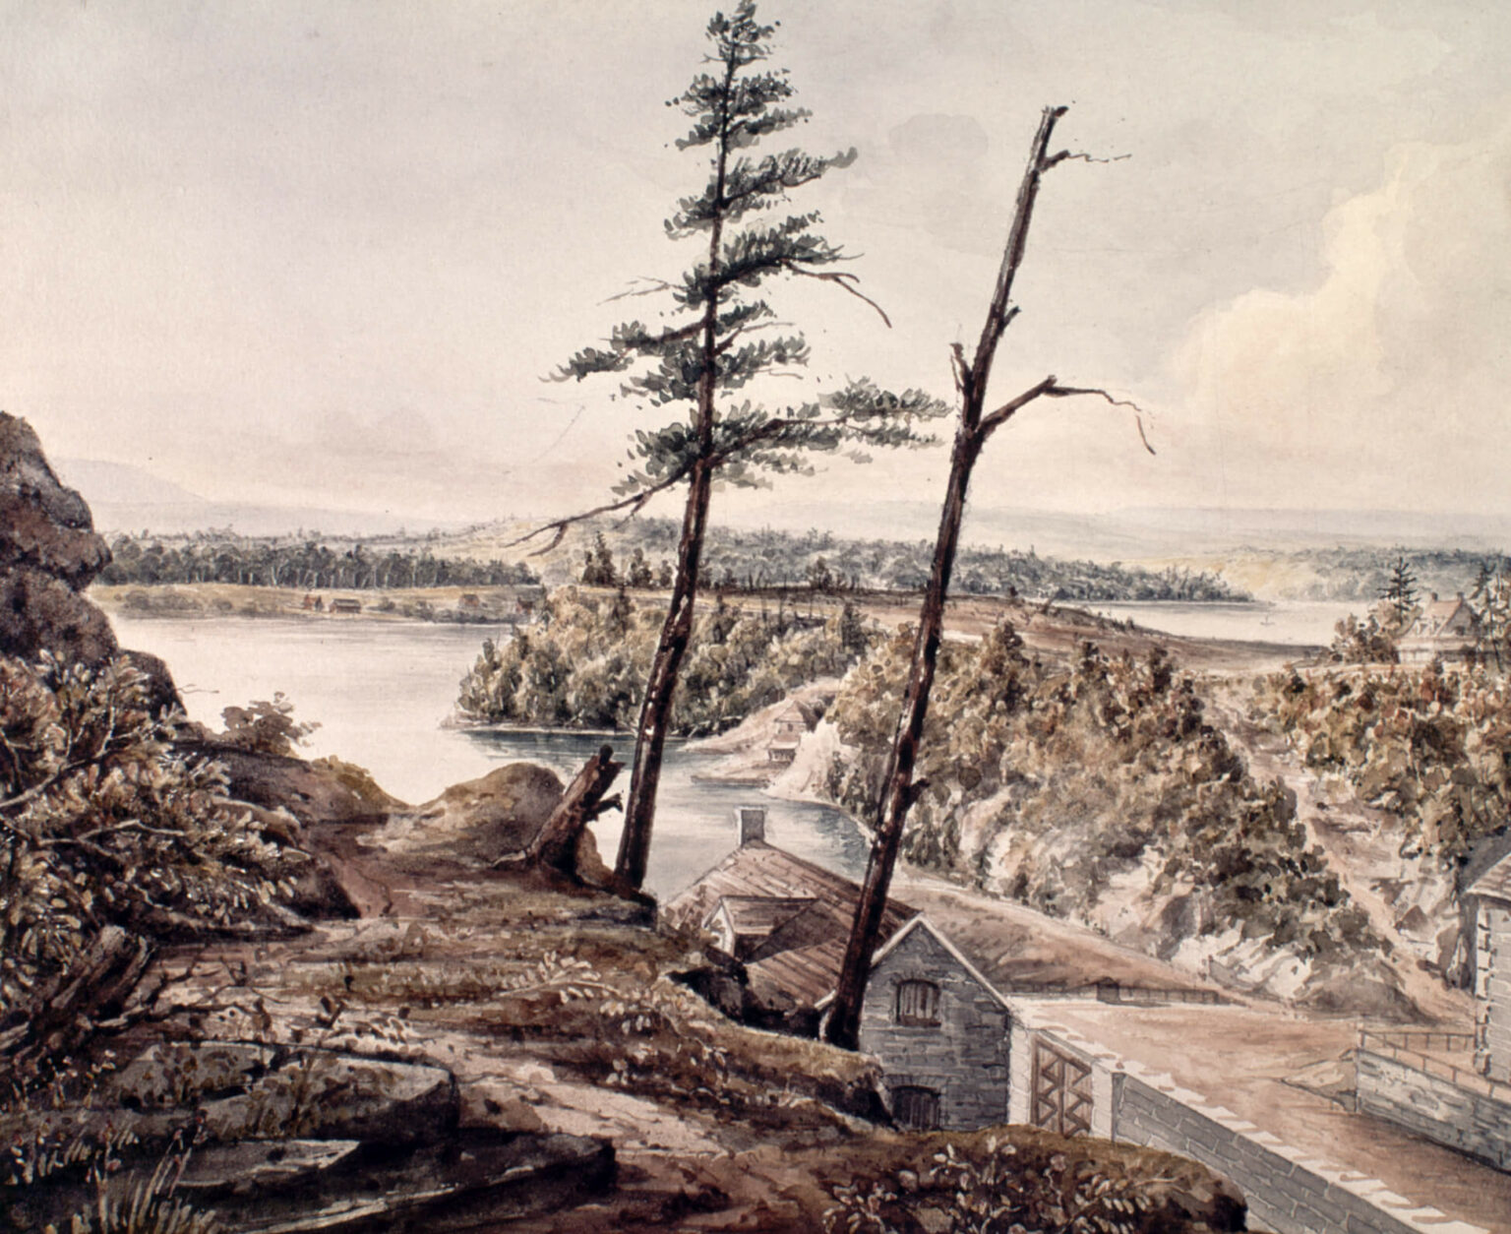
Learning Activity #2
Henry Pooley, Rideau Canal, Ottawa, Canada, 1833. British officer Lieutenant Pooley’s sketches of the Rideau Canal played a significant role in the industrial growth and development of Bytown.

Slide 20
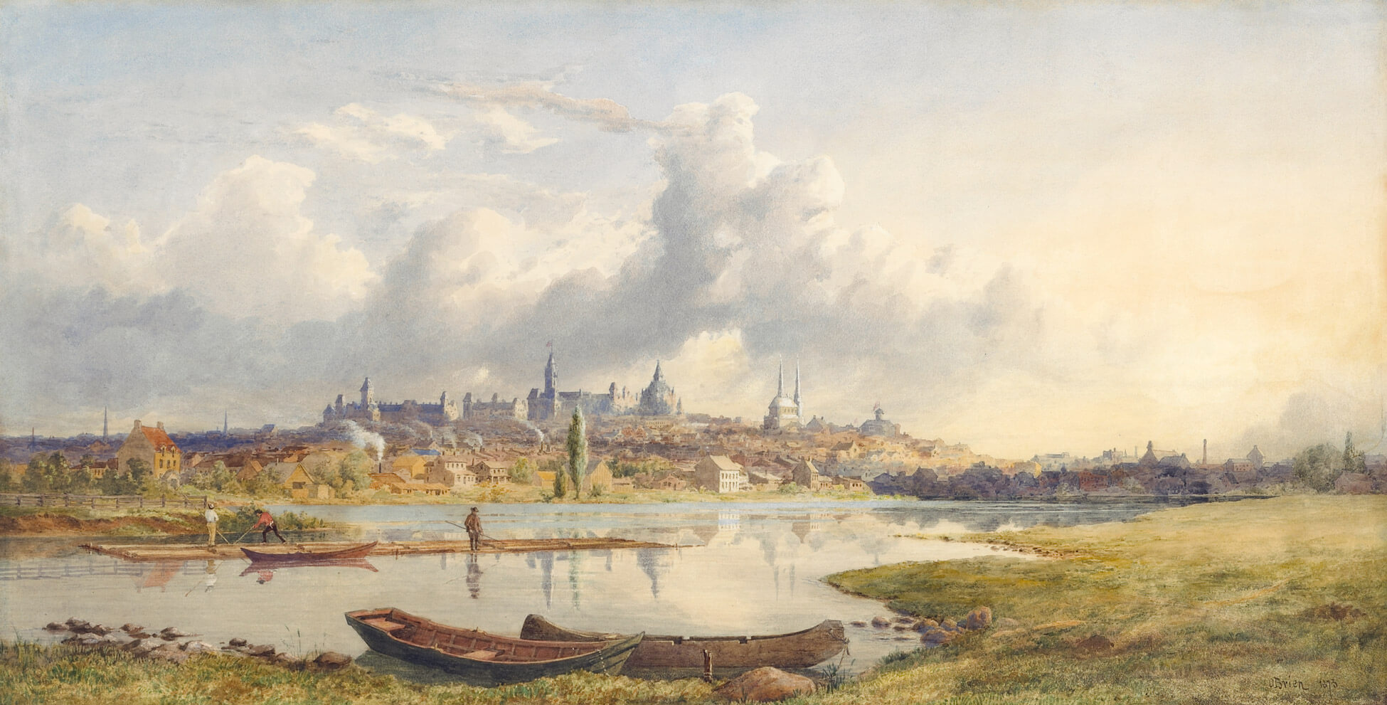
Learning Activity #2
Lucius R. O’Brien, Ottawa from the Rideau, 1873. Ottawa’s selection as the nation’s capital profoundly affected its built environment, resulting in the construction of landmarks like the Parliament Buildings pictured here.

Slide 21
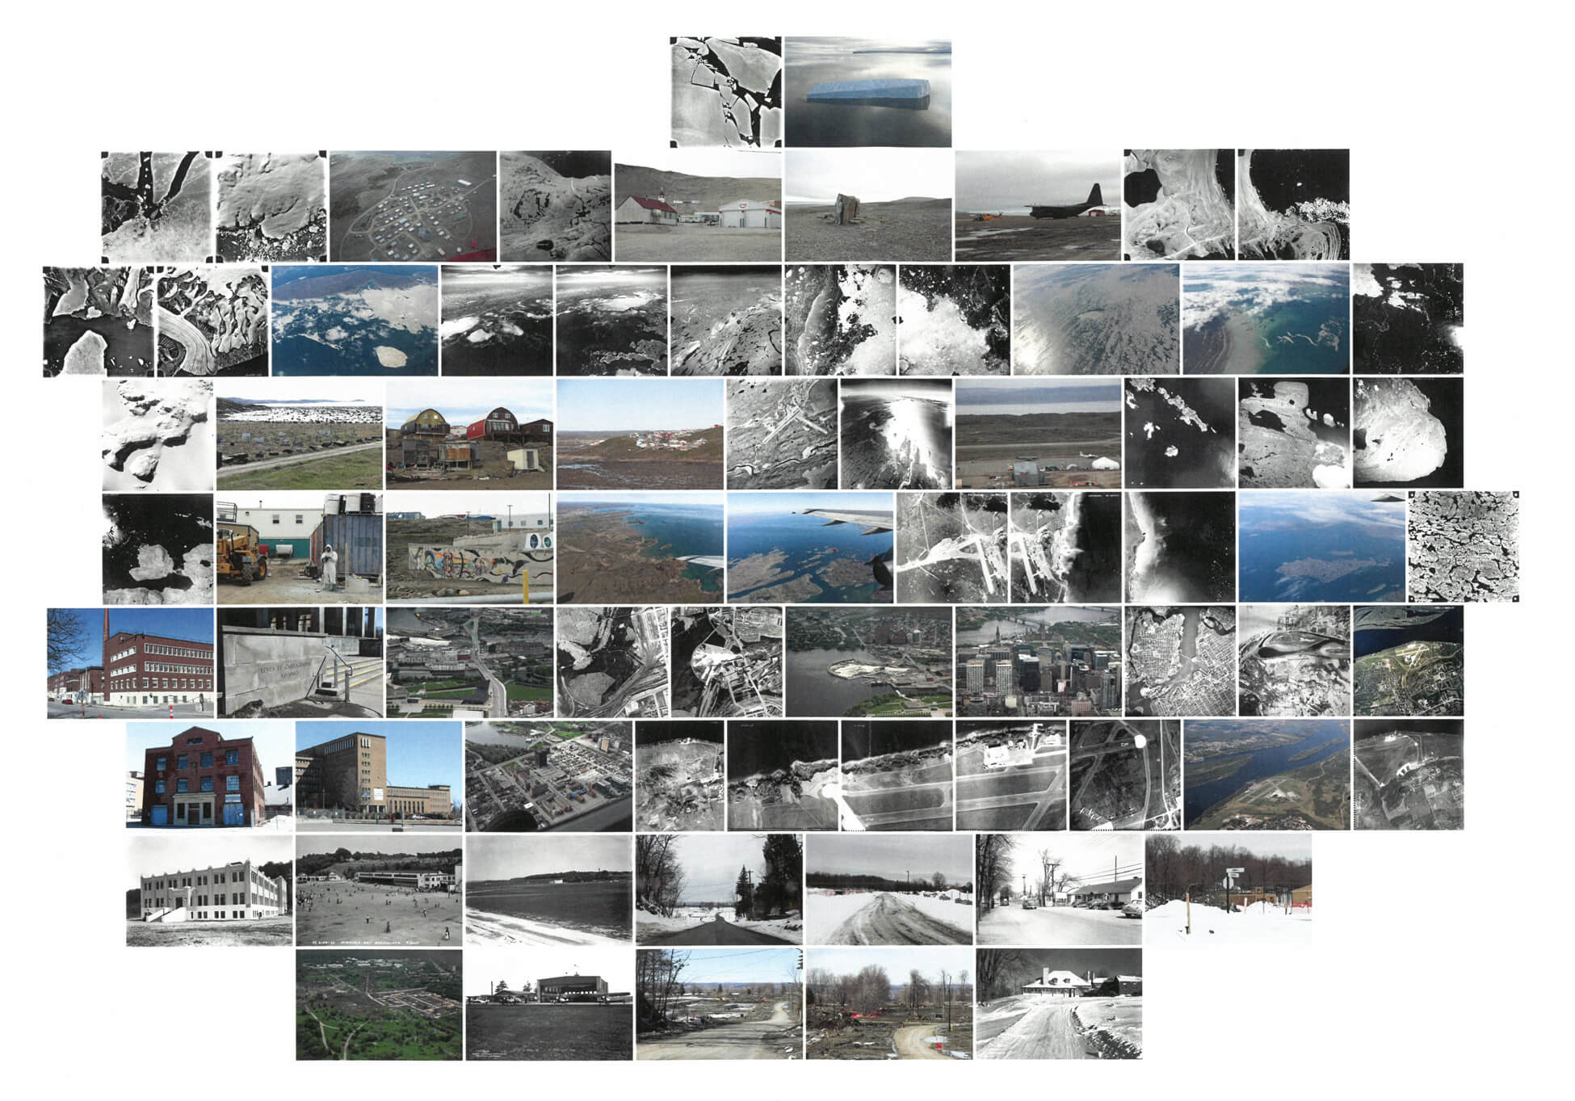
Learning Activity #2
Leslie Reid, Flight Line—Erasure, 2017. Reid’s installation uses historic and contemporary photographs showing the transformation of the city of Ottawa alongside government interventions in the Canadian North.

Slide 22
Learning Activity #2
Leslie Reid, Flight Line—Erasure (detail), 2017.

Slide 23
Learning Activity #2
Leslie Reid, Flight Line—Erasure (detail), 2017.

Slide 24
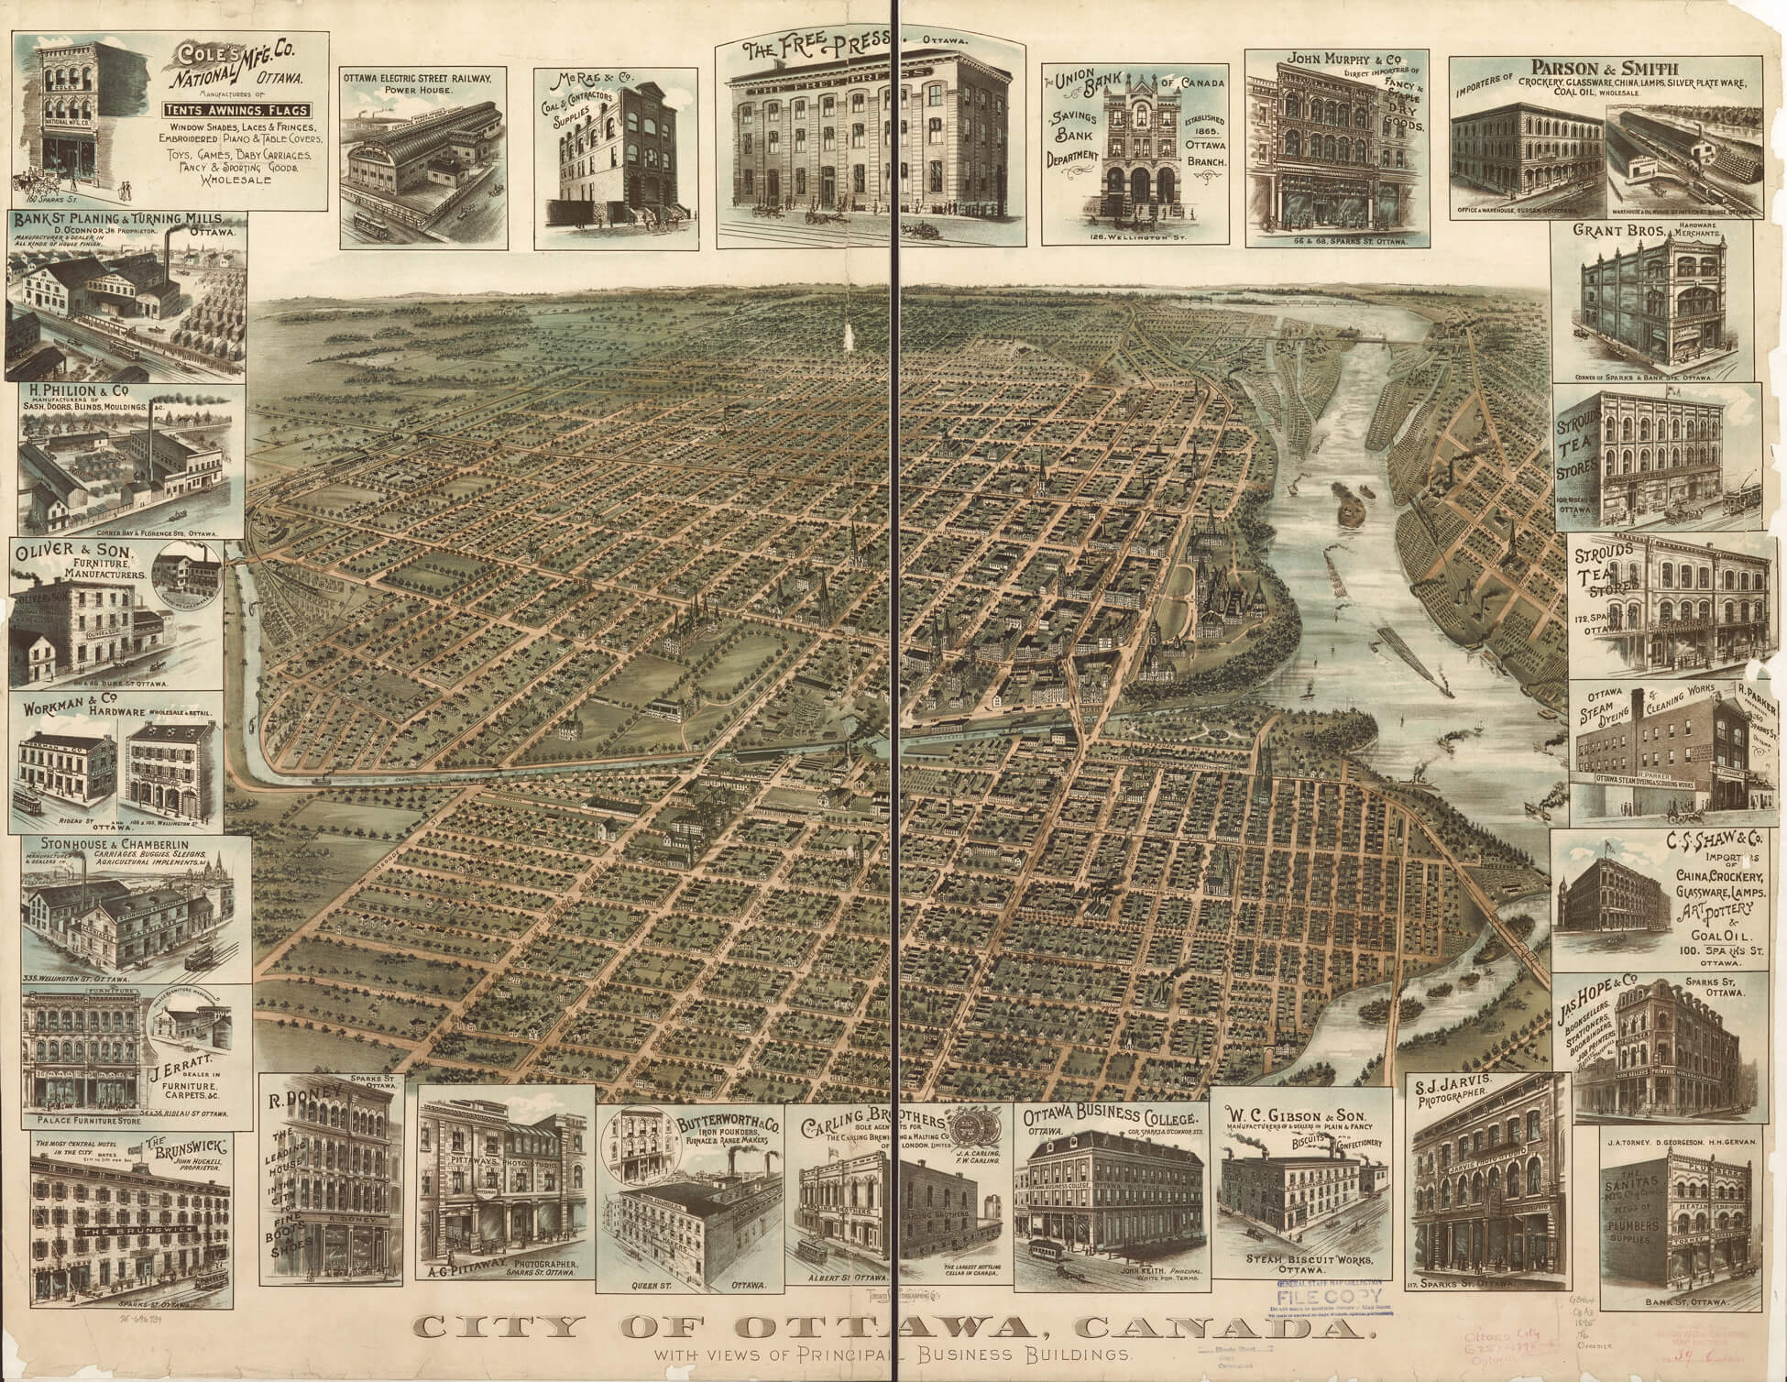
Learning Activity #2
City of Ottawa, Canada with Views of Principal Business Buildings, 1895, published by Toronto Lithographing Company. This unusual print records the growth of the city in the decades after Confederation.

Slide 25
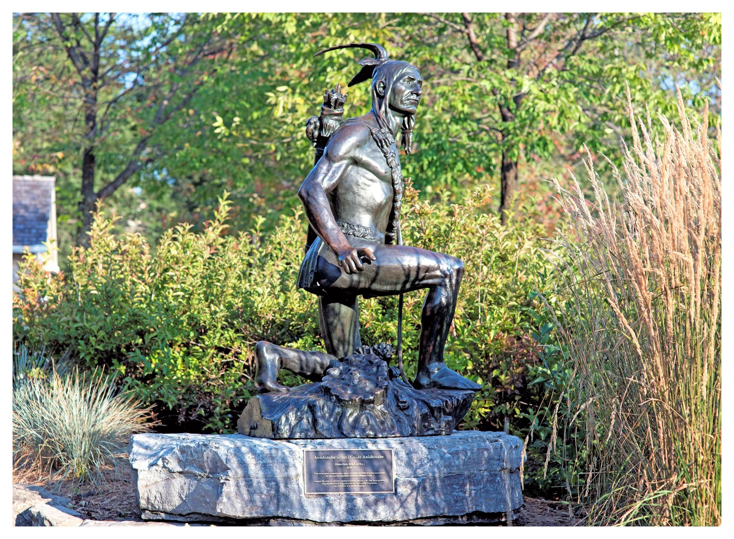
Culminating Task
Jeff Thomas, Lest We Forget Major’s Hill: Kitchi Zibi Omàmìwininì, 2013. In 2013, Thomas and members of the Indigenous Ottawa collective held a naming ceremony with an Algonquin elder, who gave this sculpture the name “Kitchi Zibi Omàmìwininì” (Big River People).

Slide 26
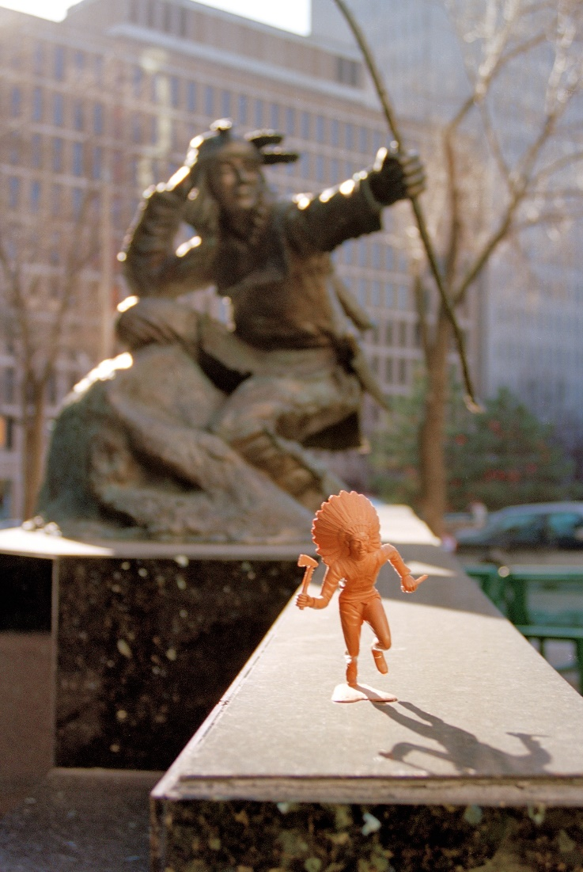
Culminating Task
Jeff Thomas, War Dancer, Hunter Statue, Queen Street, 2000. This work was created during one of Thomas’s many photo walks through the city of Ottawa and sparked the artist’s Indians on Tour series.

Slide 27
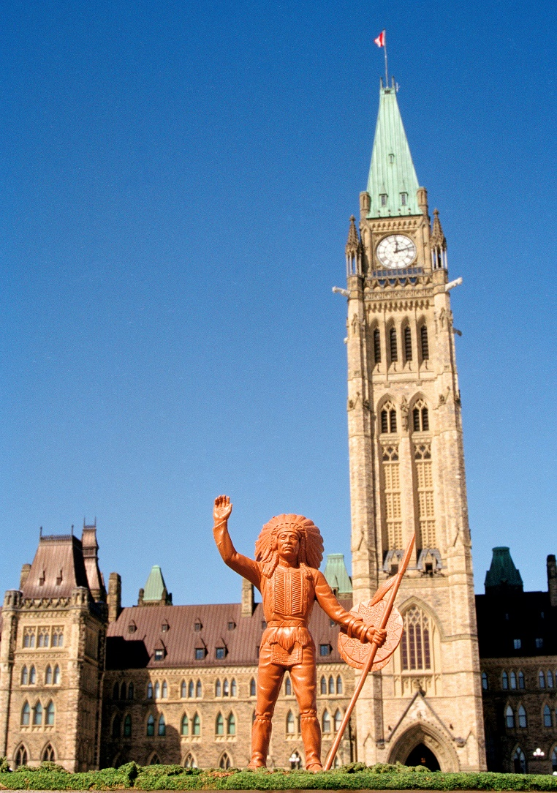
Culminating Task
Jeff Thomas, Peace Chief at Parliament Hill and Peace Tower, Ottawa, 2003. The plastic figurines pictured in this series evoke stereotypical depictions of Indigenous peoples in popular media and material culture.

Slide 28
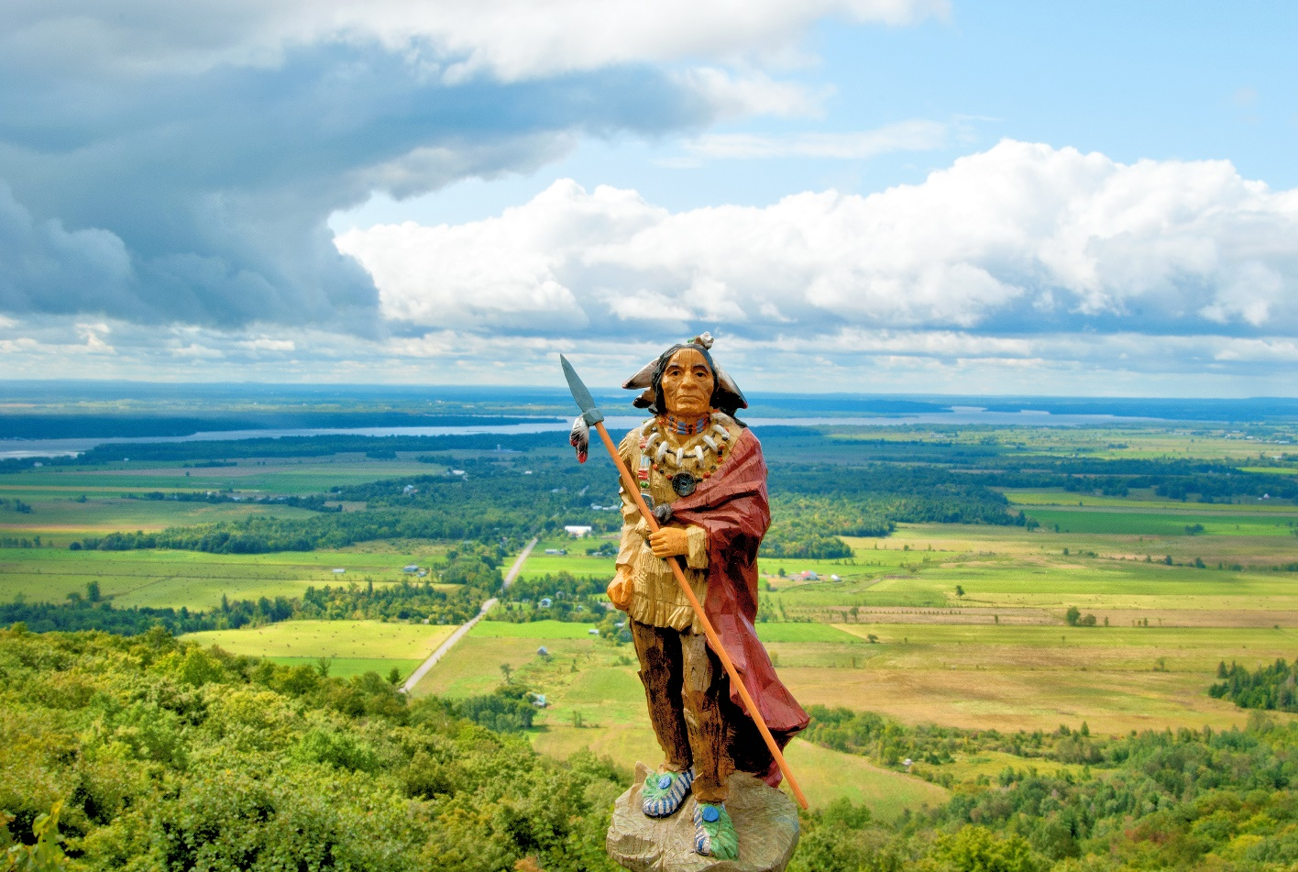
Culminating Task
Jeff Thomas, Chief Red Robe, Champlain Lookout, 2009. In this image, Thomas has placed a figurine in front of the Champlain Lookout, one of the most spectacular vistas in Gatineau Park.

Slide 29
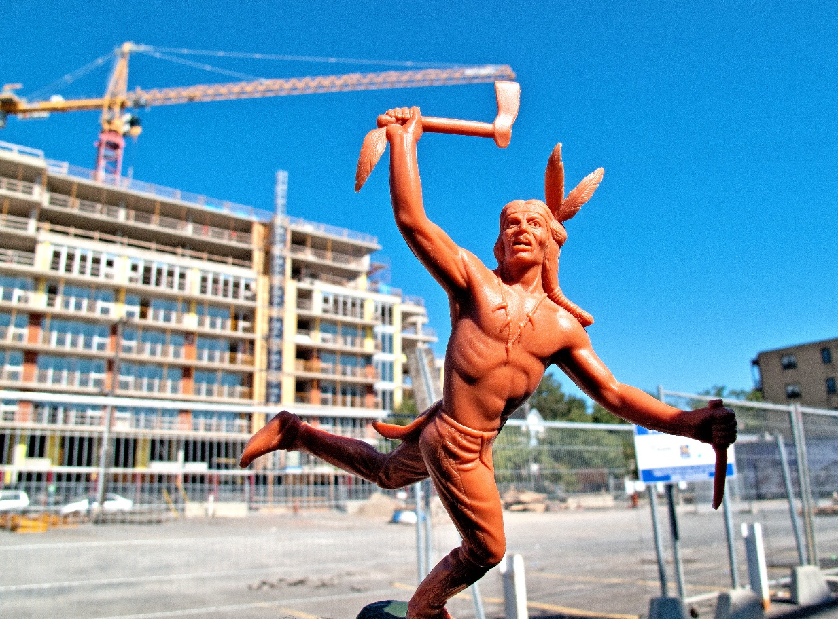
Culminating Task
Jeff Thomas, Buffalo Dancer, Condo Construction Site, 2011. This image comments on widespread commercial development in Ottawa, which continues to displace much of the city’s urban Indigenous population.

Slide 30
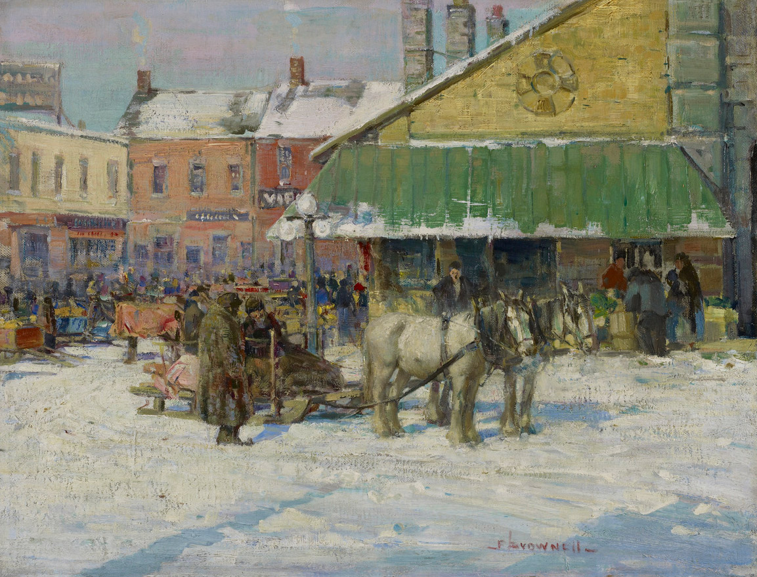
Franklin Brownell, Byward Market, c.1915. Brownell carried out an artistic career in Ottawa for over fifty years, producing numerous paintings depicting everyday life in the city.

Slide 31
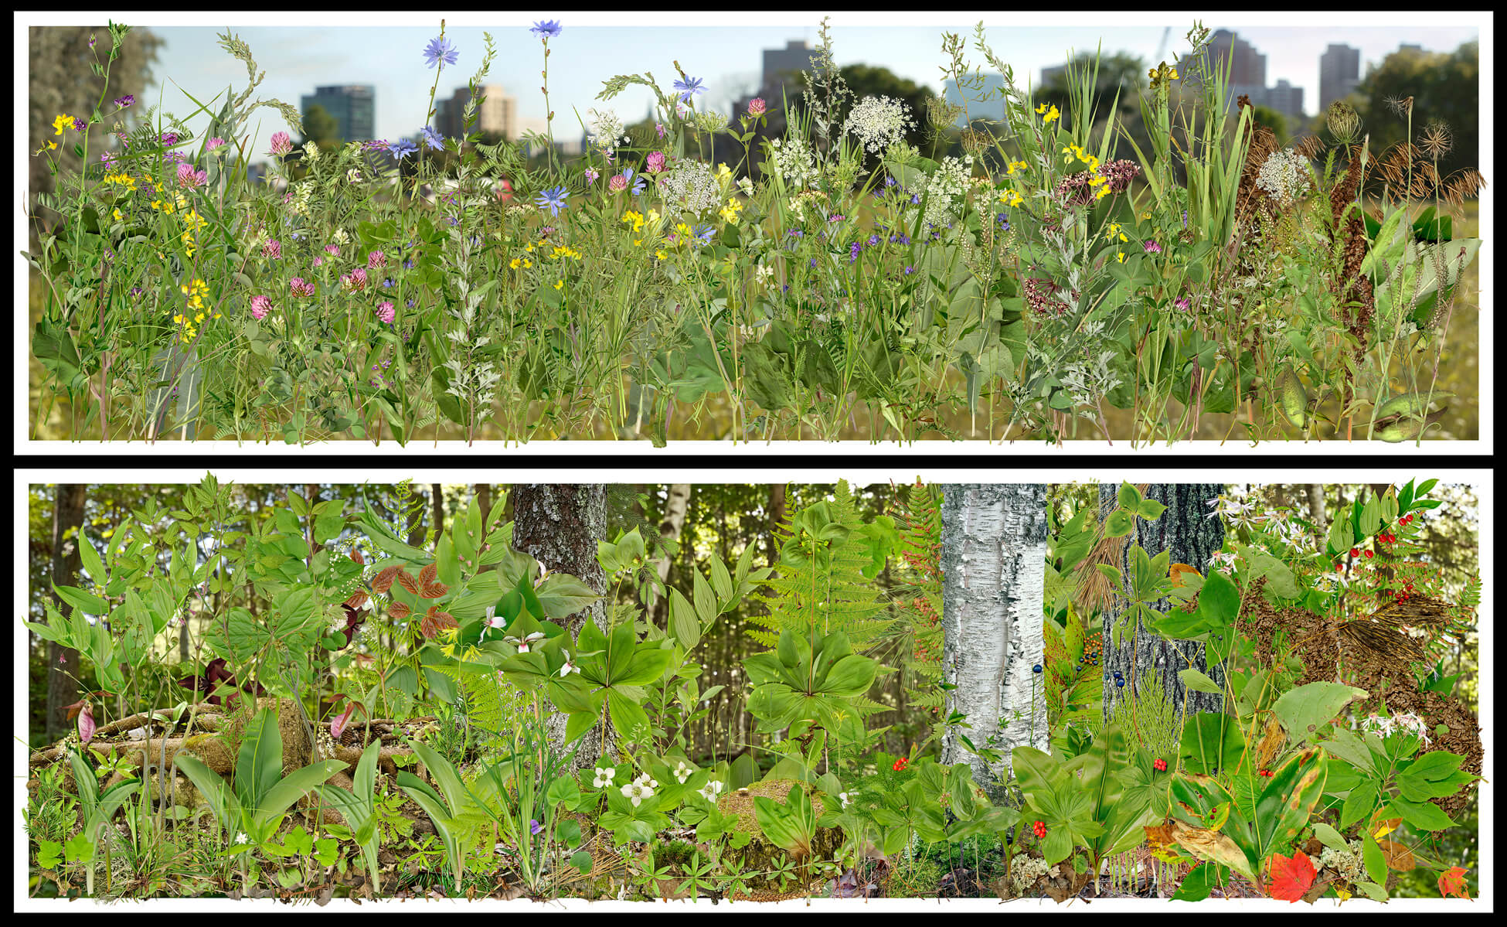
Lorraine Gilbert, Once (Upon) a Forest Diptych: Lebreton Flats, Ottawa, Ontario and Boreal Forest Floor, La Macaza, Quebec, 2010. Formerly a residential area, Lebreton Flats has remained largely vacant since the 1960s due to disputes over use of the land.

