Slide 2
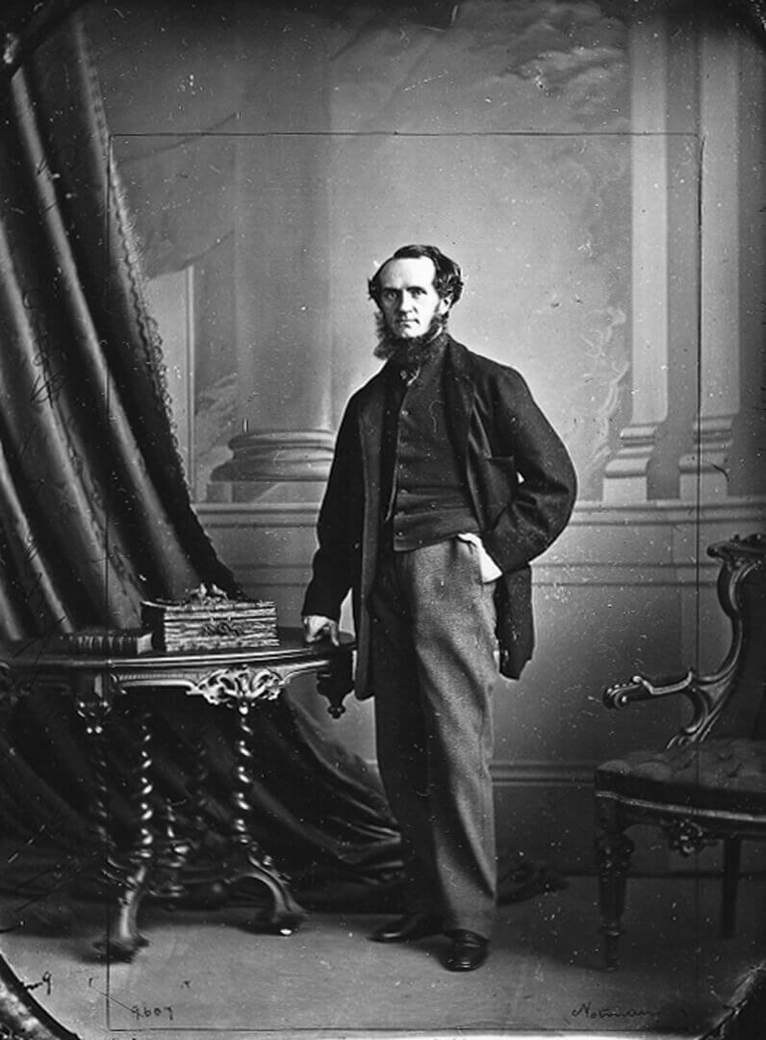
William Notman, William Notman, Photographer, Montreal, 1863. With this ornate setting and his fine clothes, Notman presents himself as dignified businessman.

Slide 3
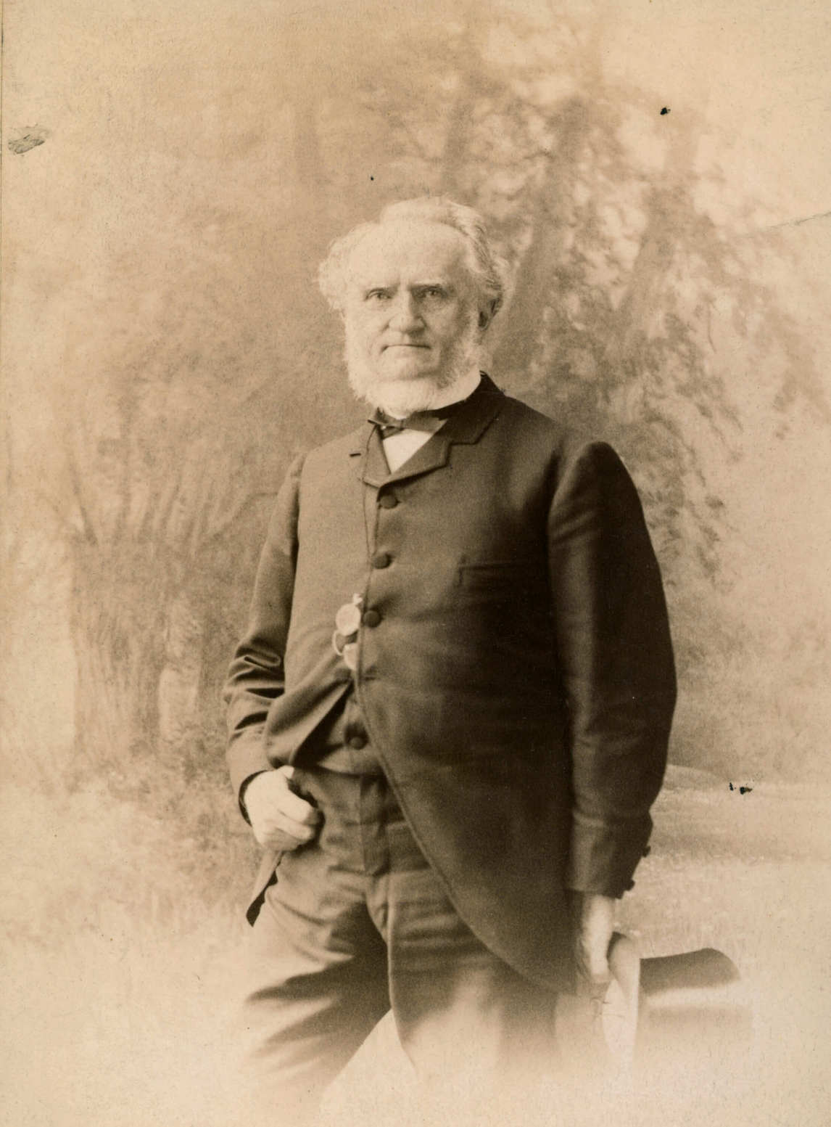
Notman Photographic Co. Ltd., William Notman, Photographer, Boston, c.1888.

Slide 4
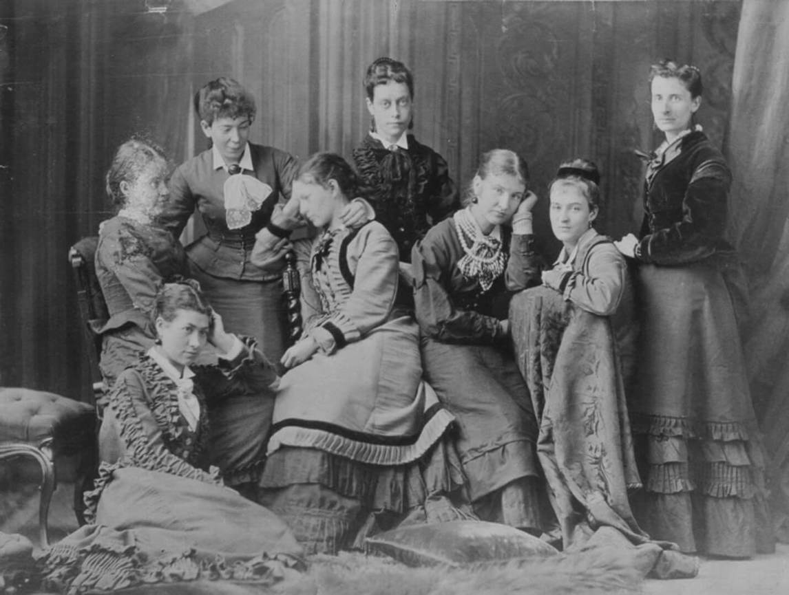
William Notman, Young Ladies of Notman’s Printing Room, 1876. Notman had a large staff, all of whom contributed to the running of the studio and photographic production.

Slide 5
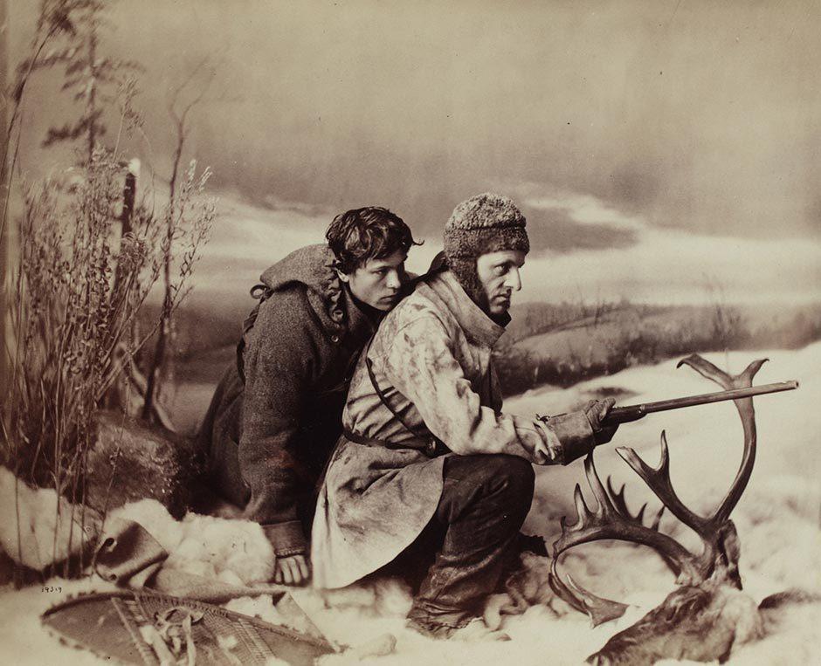
William Notman, Caribou Hunting, The Chance Shot, Montreal, 1866. Notman created elaborate settings and also provided costumes for his elite clientele.

Slide 6
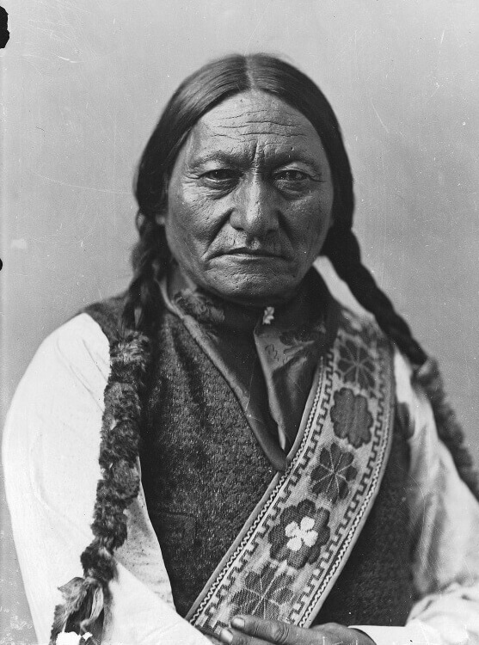
William Notman & Son, Sitting Bull, Montreal, 1885. Notman photographed the famed Lakota Sioux holy man and Indian rights activist during his visit to Canada.

Slide 7
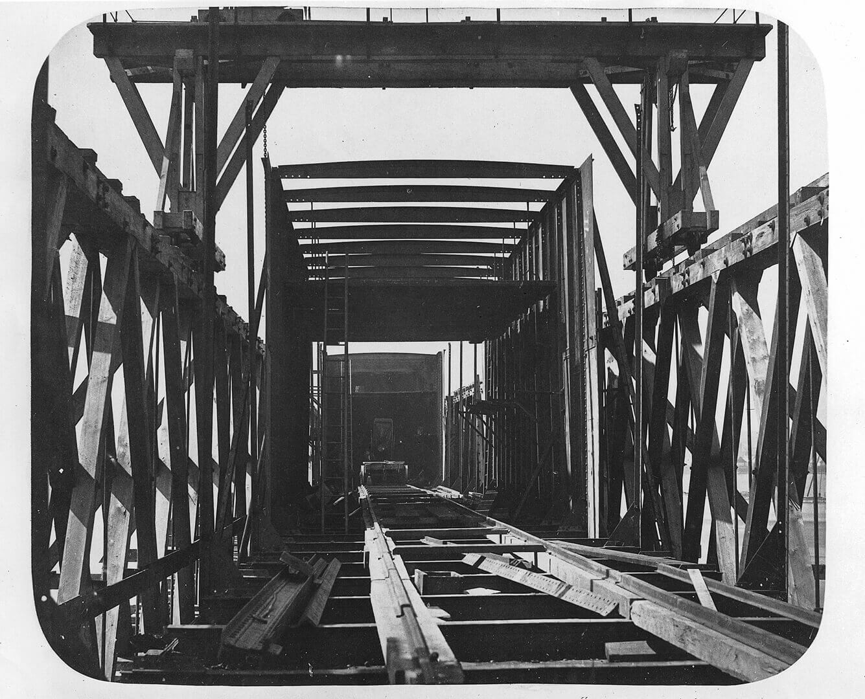
William Notman, Framework of Tube and Staging Looking In, Victoria Bridge, Montreal, 1859. Notman famously photographed the construction of this new bridge linking Canada and the US.

Slide 8
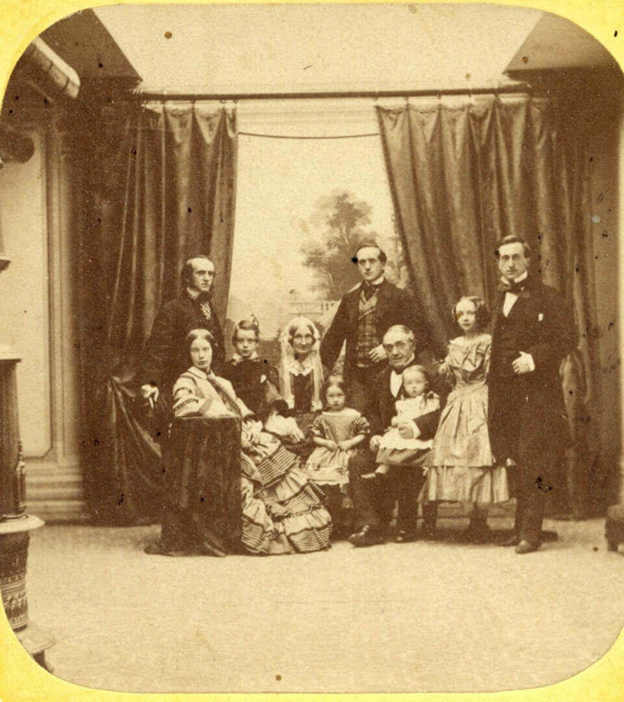
William Notman, William Notman and Family, Montreal, 1859.

Slide 9
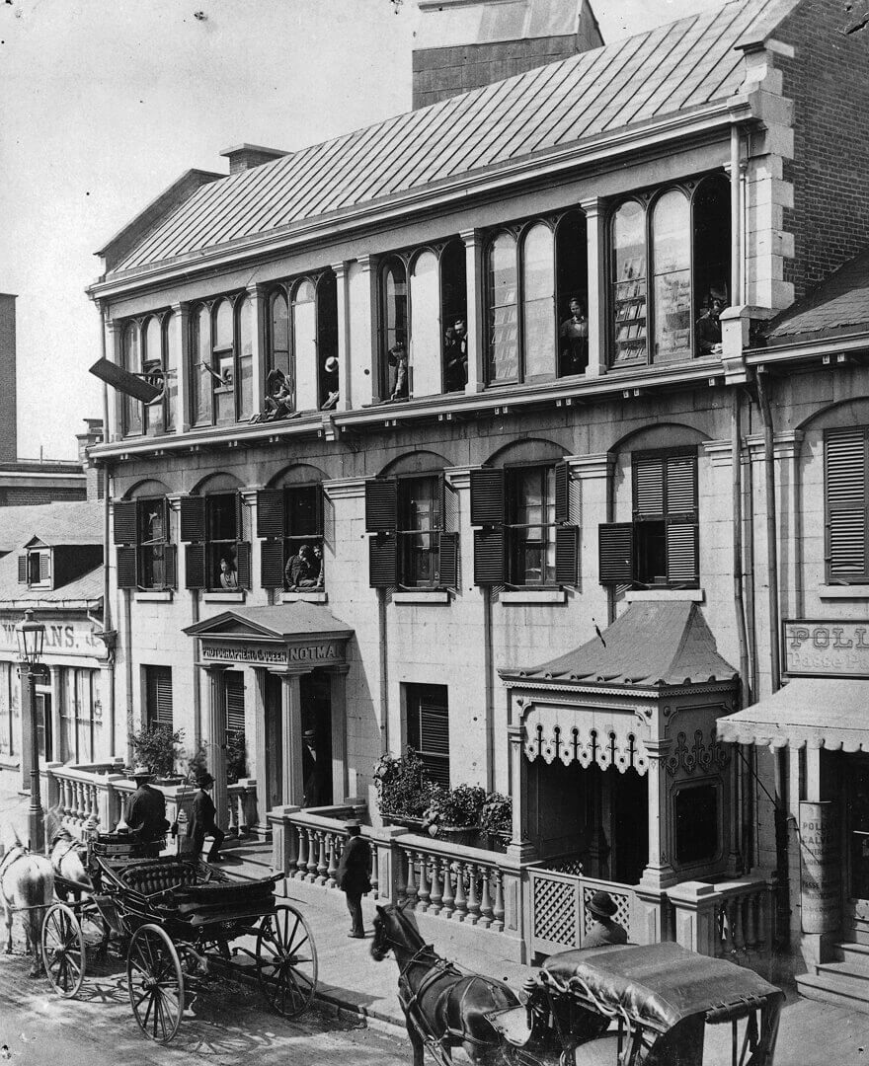
Notman & Sandham, William Notman Studio, 17 Bleury Street, Montreal, c.1875. A view of clients entering the studio.

Slide 10
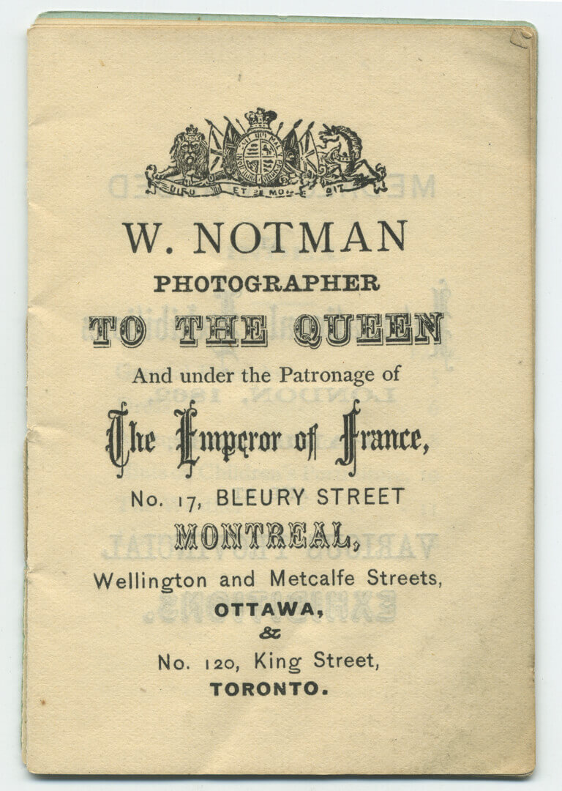
Opening page from the pamphlet “Photography: Things You Ought to Know” by William Notman, after 1867.

Slide 11
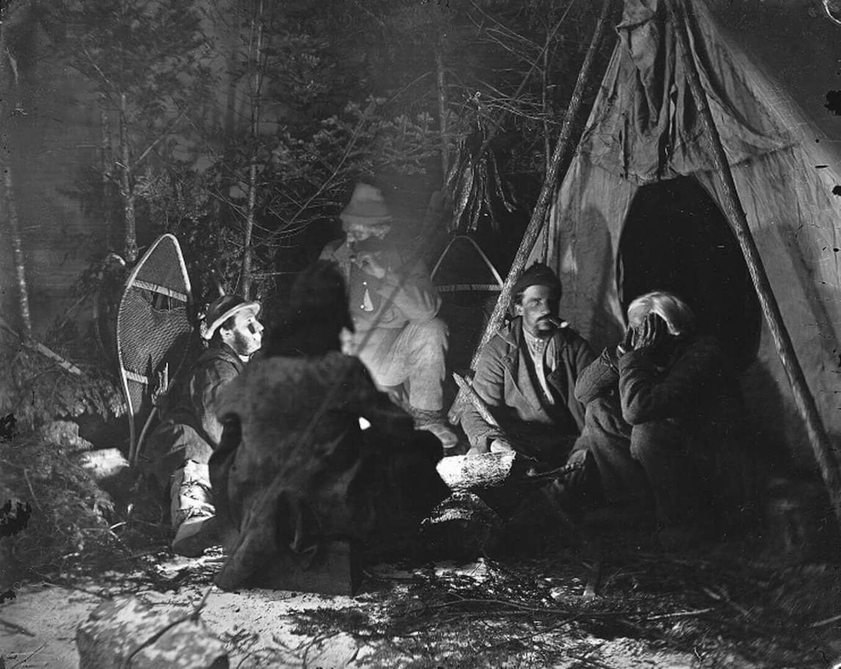
William Notman, Around the Camp Fire, Caribou Hunting series, Montreal, 1866. A magnesium flare successfully lights this dark scene.

Slide 12
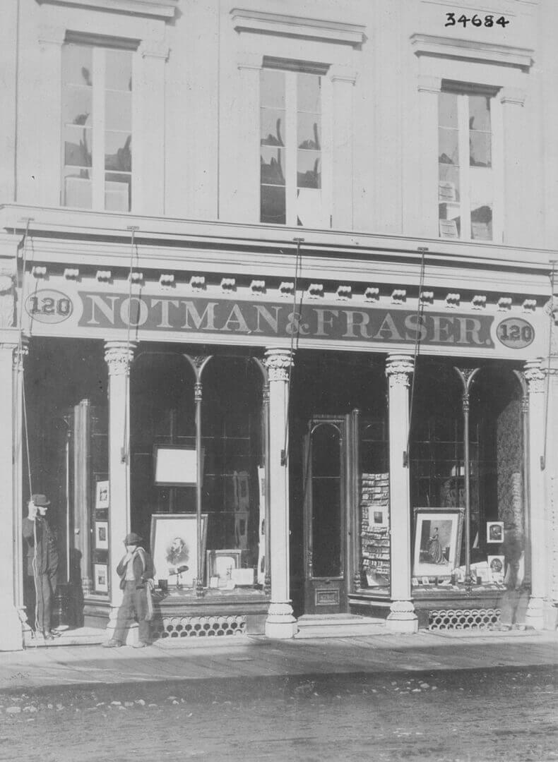
William Notman, Notman & Fraser Photographic Studio, Toronto, 1868. Notman advertised the offerings of the studio by lining the windows with framed photographs.

Slide 13
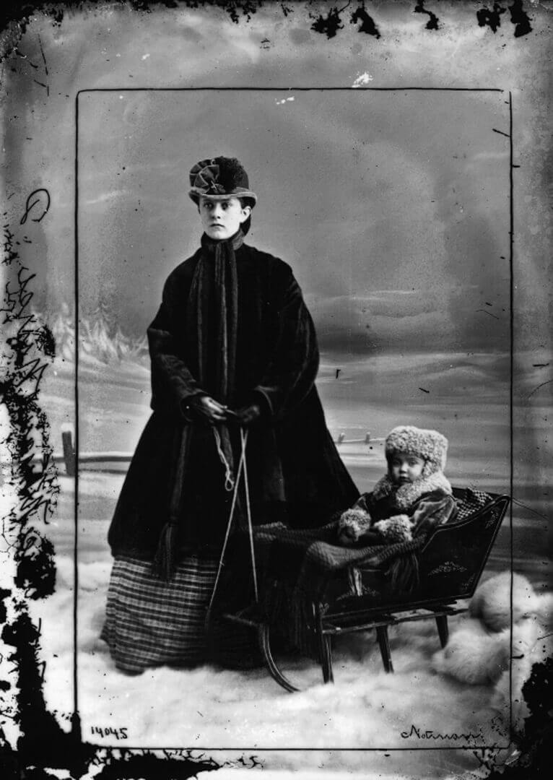
William Notman, Missie Alice Notman in Sleigh with Nurse, Montreal, 1865. The edges of this photograph, in the area beyond the photographer’s black crop marks, reveal chemical residue from the wet collodion process.

Slide 14
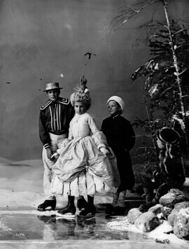
William Notman, Lovell’s Group of Children Skating in Costume, Montreal, 1867. In the nineteenth century, people used photographs as statements of wealth and status. Notman’s studio would often provide elaborate and expensive costumes for his clients, to facilitate their desired look.

Slide 15
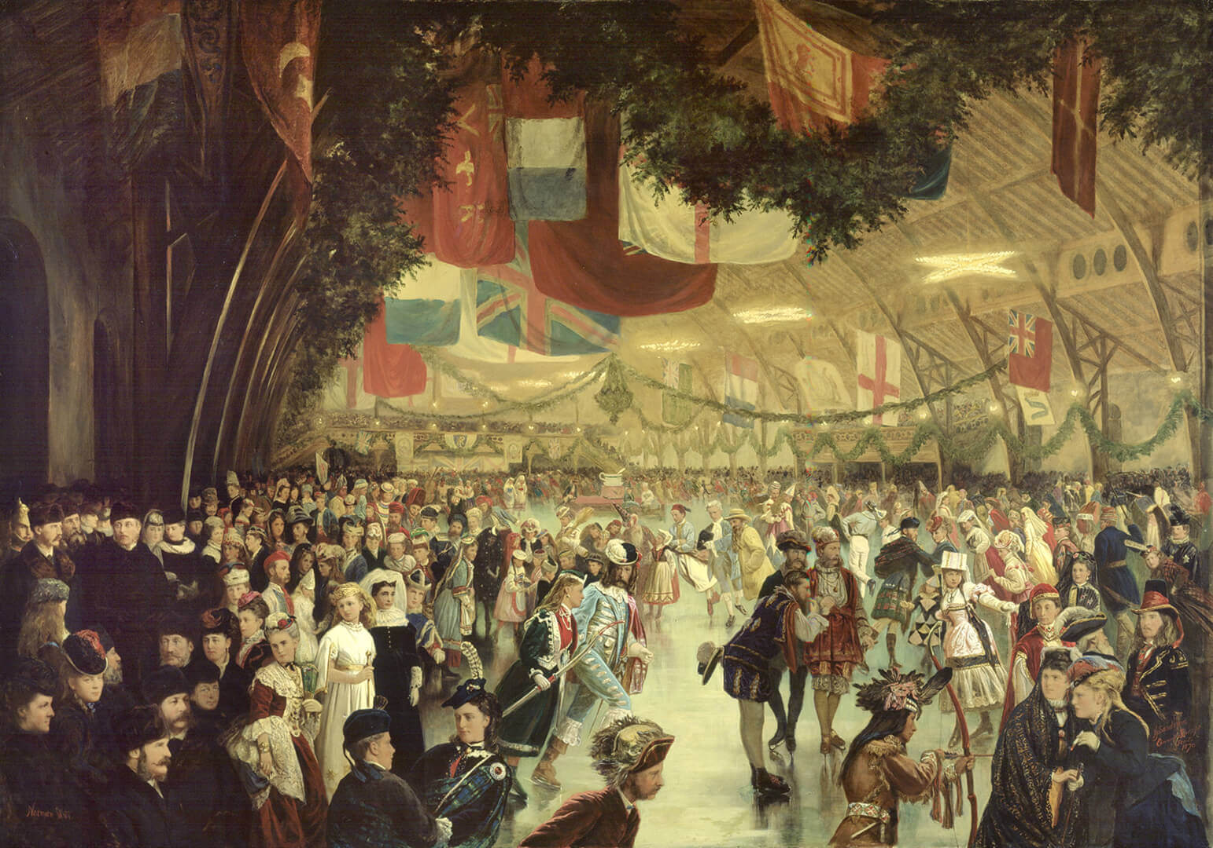
Learning Activity #2
William Notman, Skating Carnival, Victoria Rink, Montreal, 1870. This image was created from hundreds of individual portraits.

Slide 16
Learning Activity #2
William Notman, Caribou Hunting, The Chance Shot, Montreal, 1866. Notman was adept at recreating realistic winter scenes inside his studio.

Slide 17
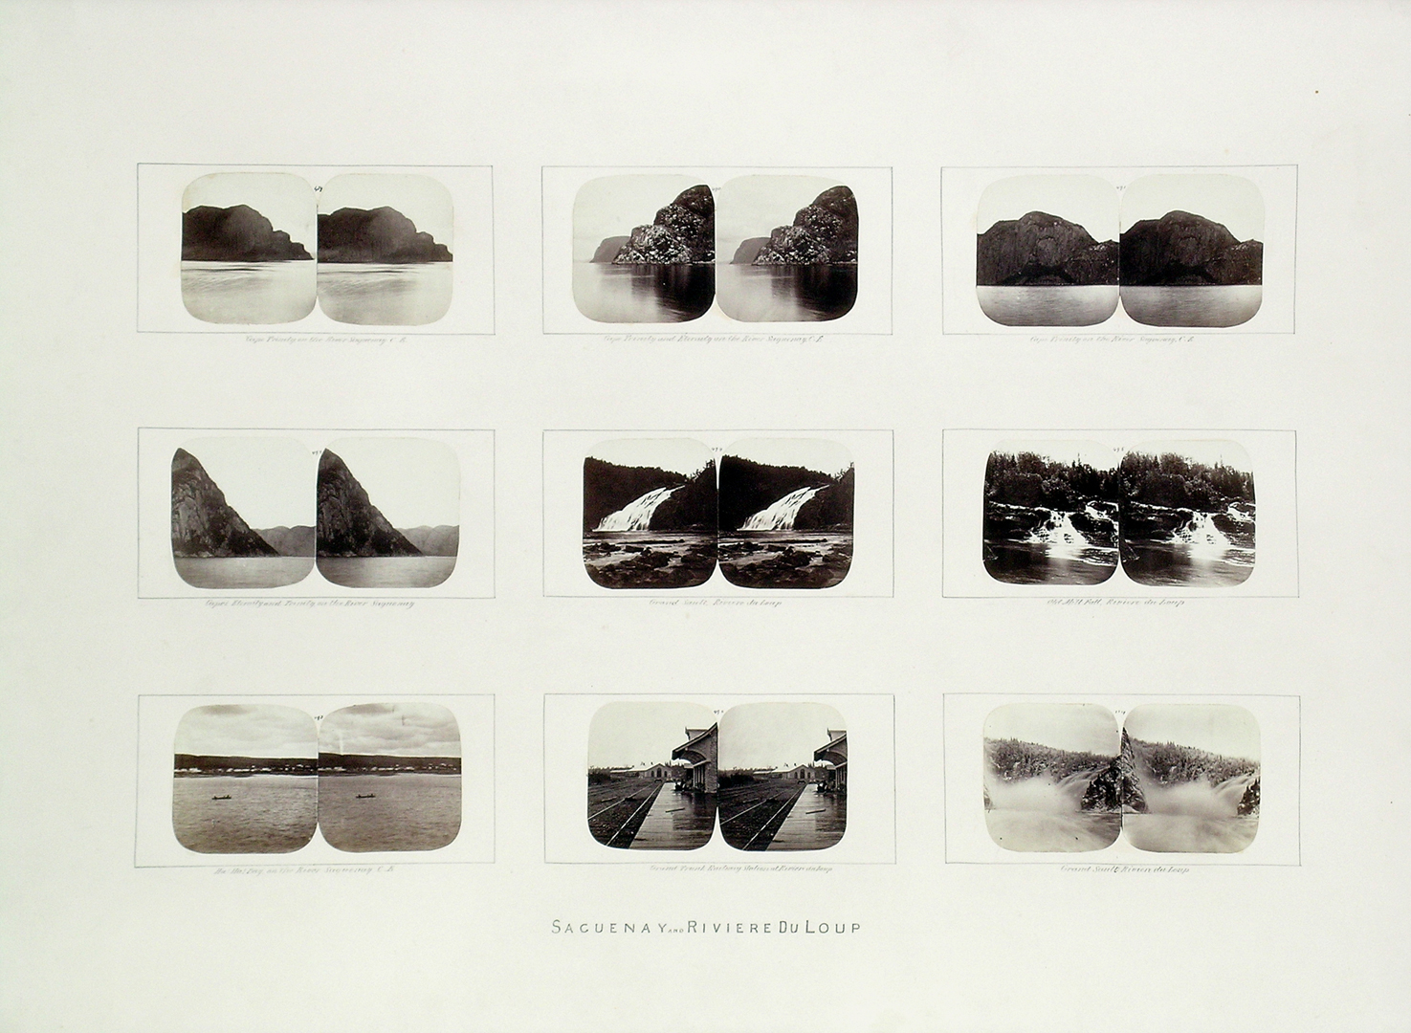
Learning Activity #2
William Notman, Group of stereographs from the maple box, Saguenay and Rivière-du-Loup, Quebec, 1859–60. Stereoscopic photographs were one of the most popular photographic formats.

Slide 18
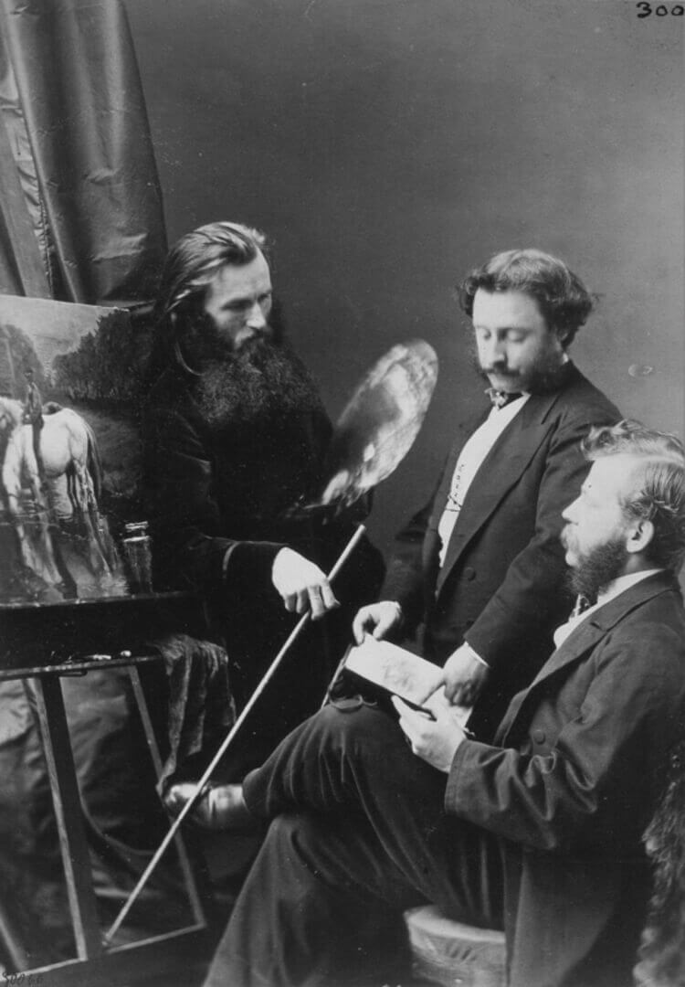
William Notman, Adolphe Vogt, John Fraser and Henry Sandham, Notman Staff, Montreal, 1868. Fraser led Notman’s art department, responsible for painting backdrops, retouching negatives, creating composites, and hand-colouring prints.
The department was integral to the studio’s success.

Slide 19
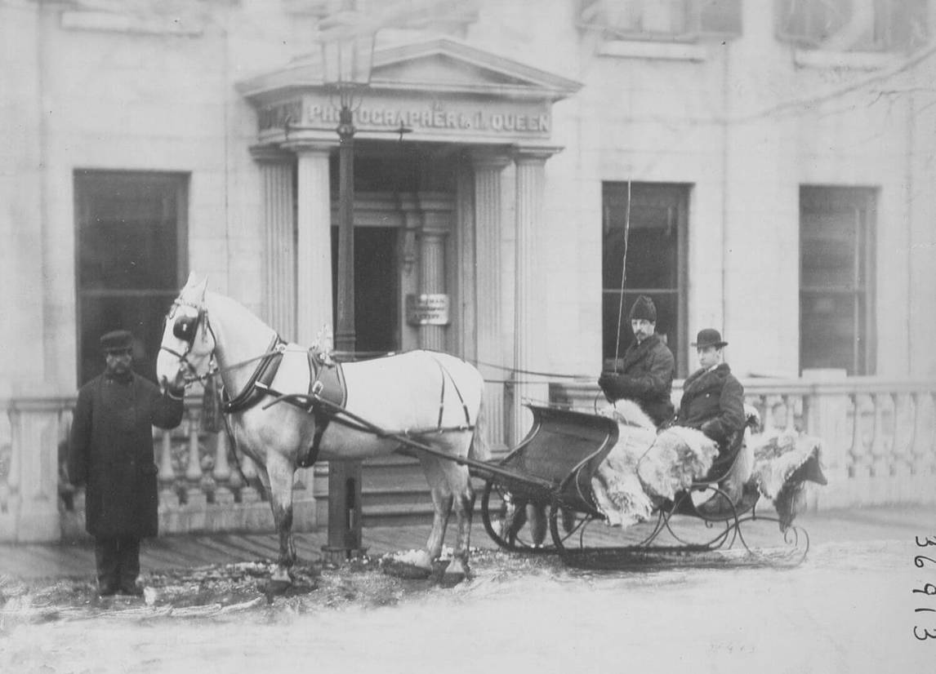
William Notman, Mr. Collins’ Sleigh at Notman’s Studio, Bleury Street, Montreal, 1868–69. Notman’s sign advertising himself as “Photographer to the Queen” was strategically placed above the studio door and often ended up in clients’ photographs, like this one. It was a successful way to freely market himself.

Slide 20
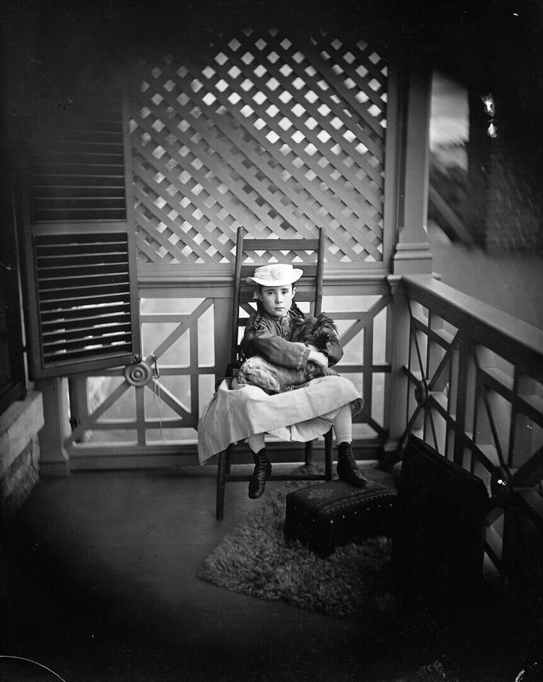
William Notman, Miss H. Frothingham, Montreal, 1871. The footrest would have helped keep the sitter comfortable during the long exposure process.

Slide 21
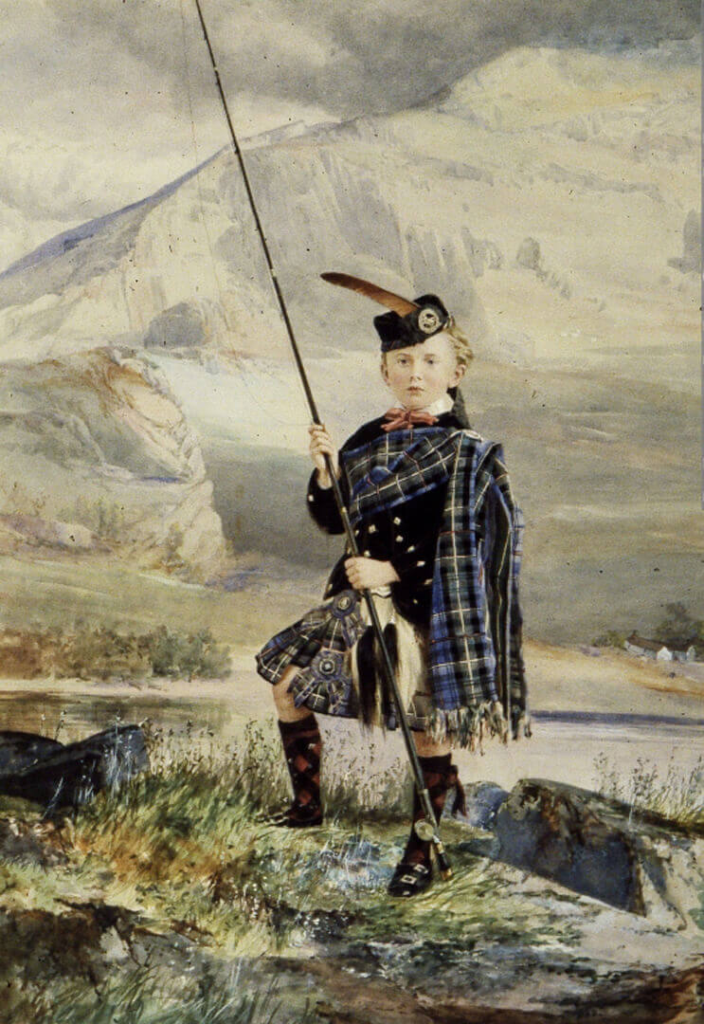
William Notman, Master Hugh Allan, Montreal,
1867. This photograph would
have been hand painted
after it was developed.

Slide 22
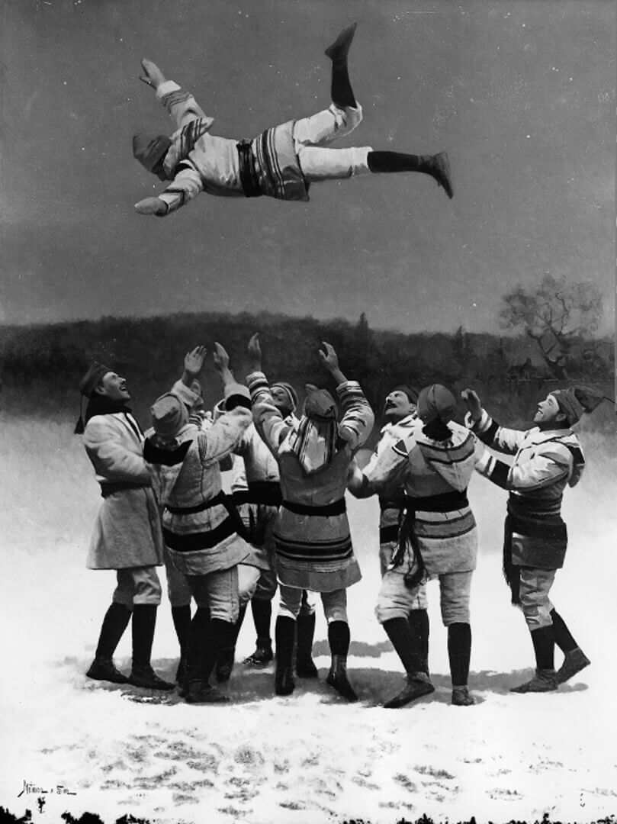
William Notman & Son, The Bounce, Montreal Snowshoe Club, 1886. An example of Notman’s composite technique.

Slide 23
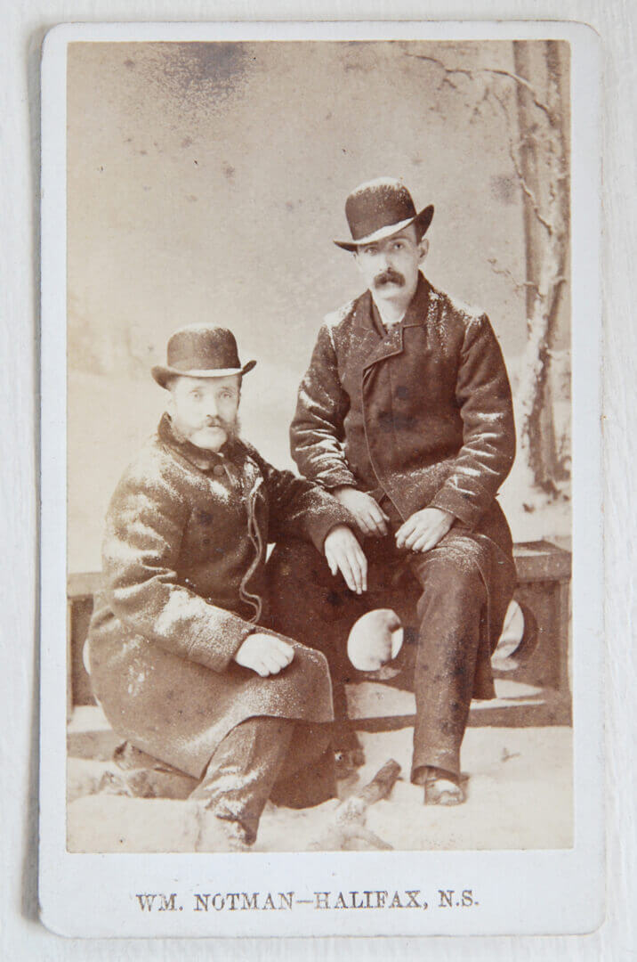
Front of a Notman
carte-de-visite, 1876.

Slide 24
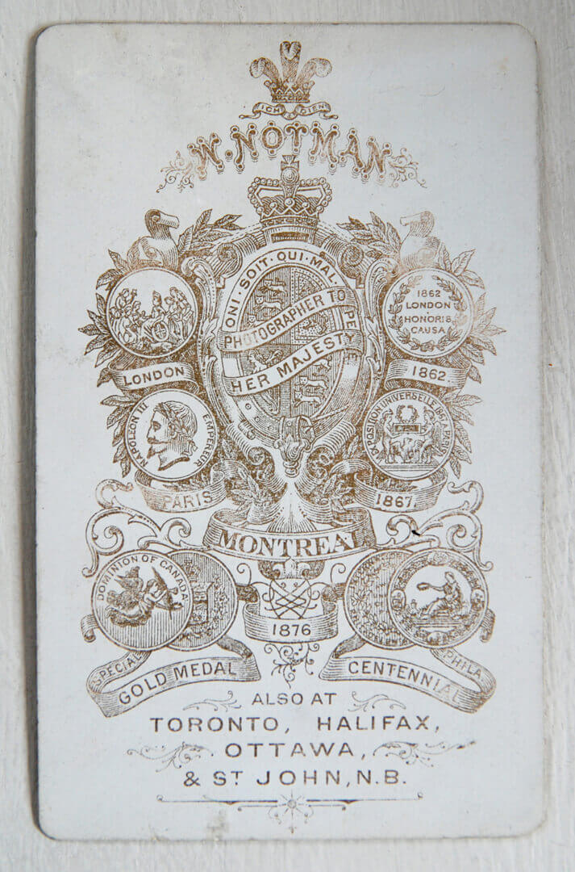
Back of a Notman
carte-de-visite, 1876.

Slide 25
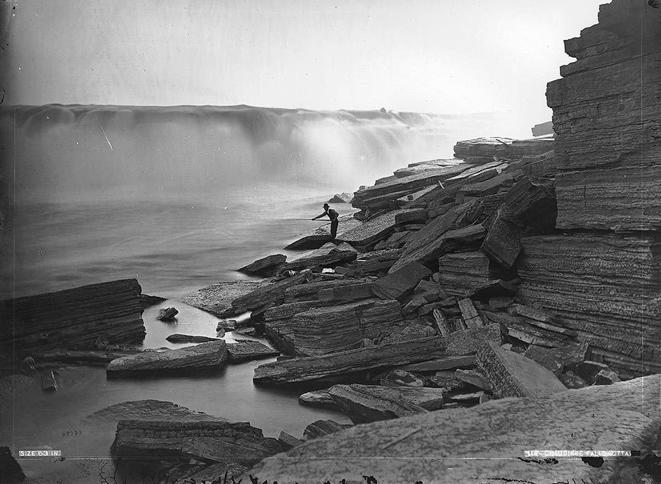
William Notman, Chaudière Falls, Ottawa, 1870. Scenic views were a mainstay of nineteenth-century photography.

Slide 26
William Notman, Group of stereographs from the maple box, Saguenay and Rivière-du-Loup, Quebec, 1859–60. Stereoscopic photographs were one of the most popular photographic formats.

