Slide 1
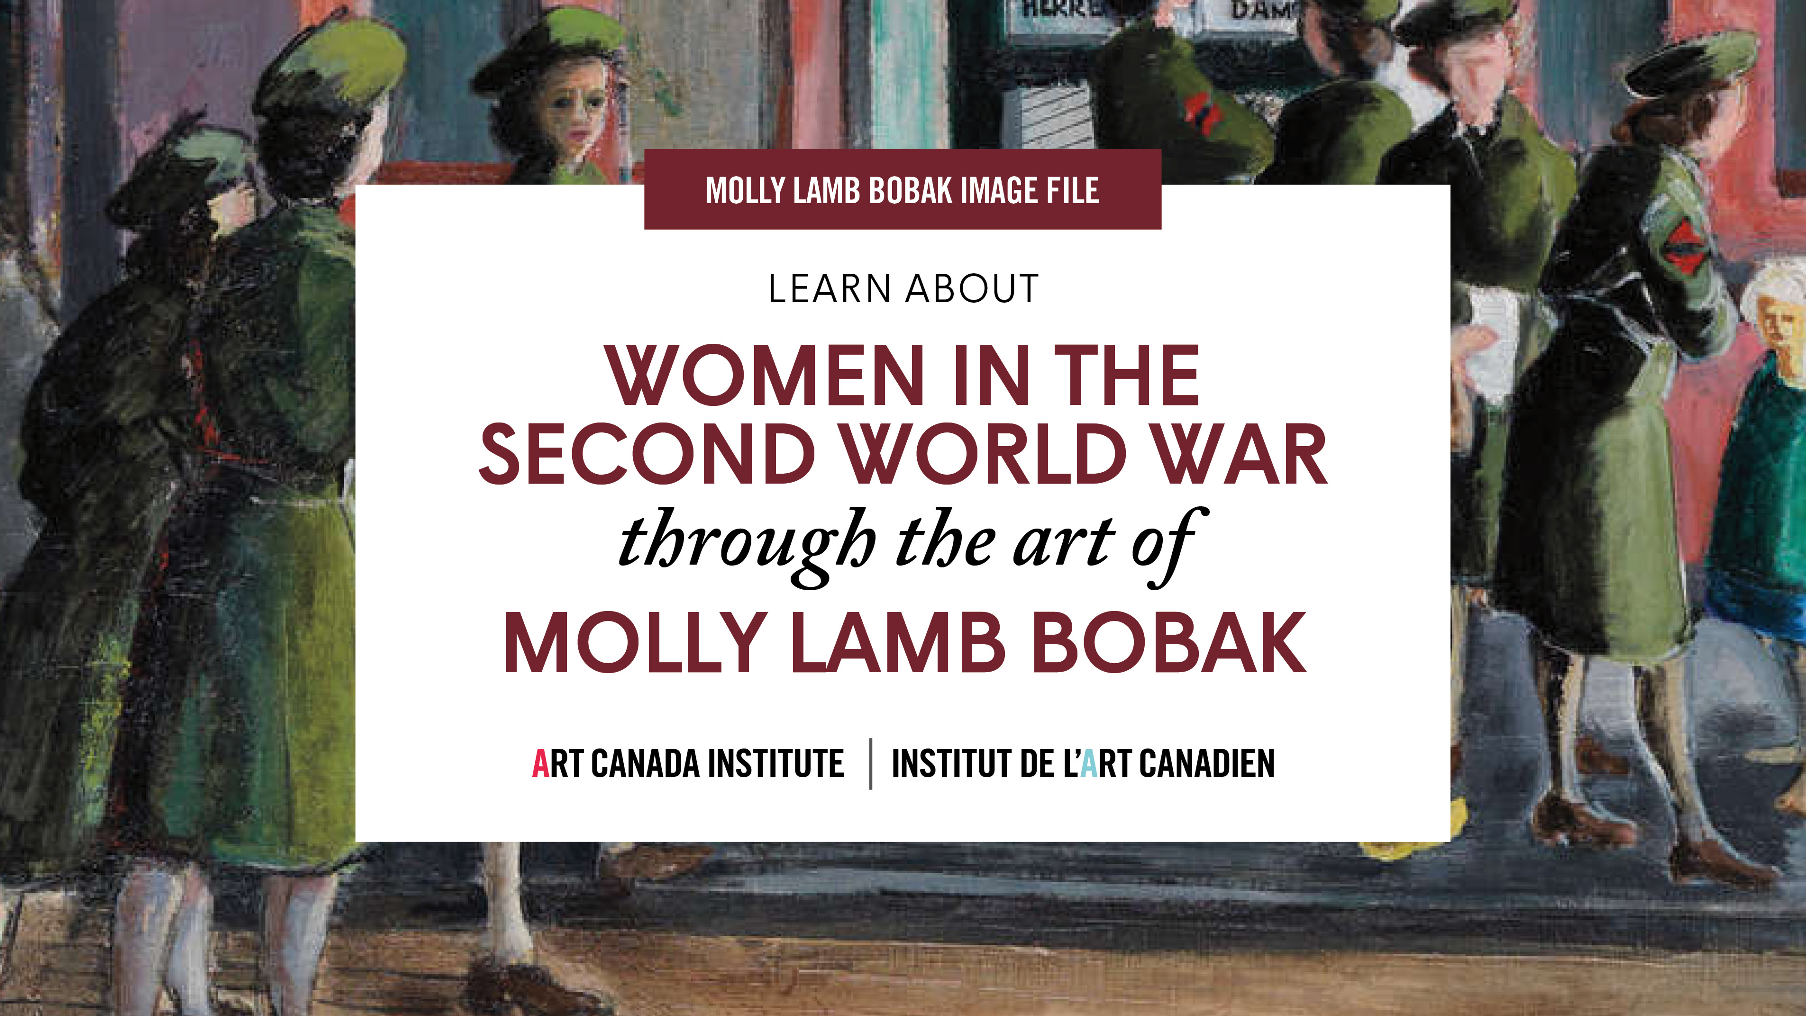

Slide 2
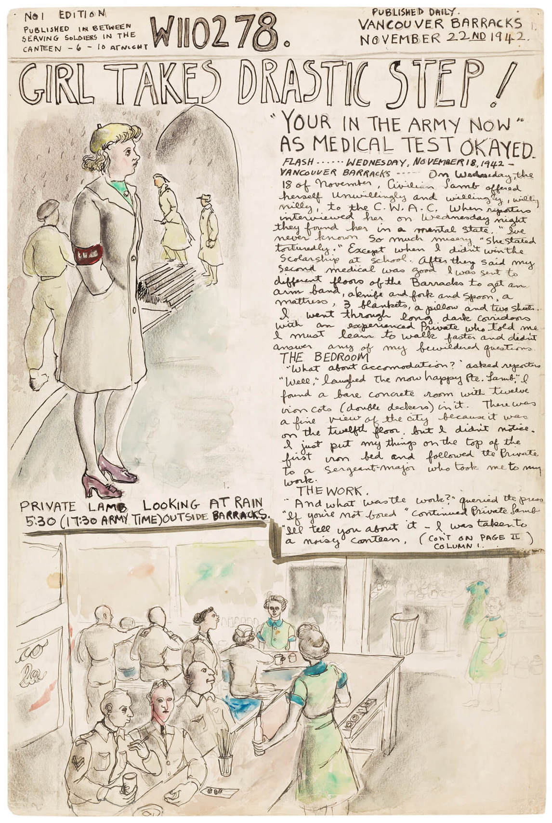
Molly Lamb, “Molly Lamb
Enters the Army,” November 22,
1942, from W110278: The Personal
War Records of Private Lamb, M.,1942–45. Lamb’s illustrated diary is both personal and a historical
record of daily life as a CWAC.

Slide 3
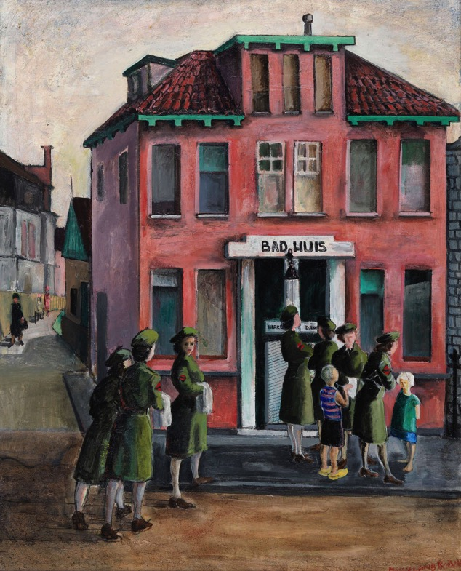
Molly Lamb Bobak, The Bath House, 1946. In addition to her sketches and diary Lamb Bobak also created finished paintings depicting the activities of her fellow CWACs.

Slide 4
Molly Lamb painting in London, England, July 12, 1945.

Slide 5
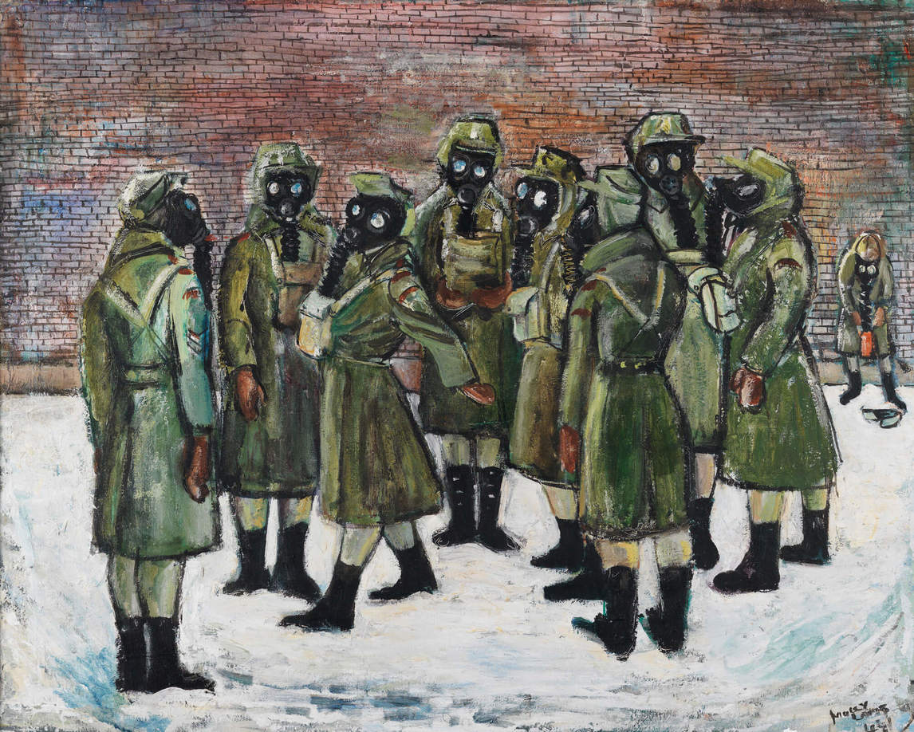
Molly Lamb, Gas Drill, 1944. Because she was a member of the Canadian Women’s Army Corps, Lamb’s war paintings and diaries are an important statement on women’s involvement in the Second World War.

Slide 6
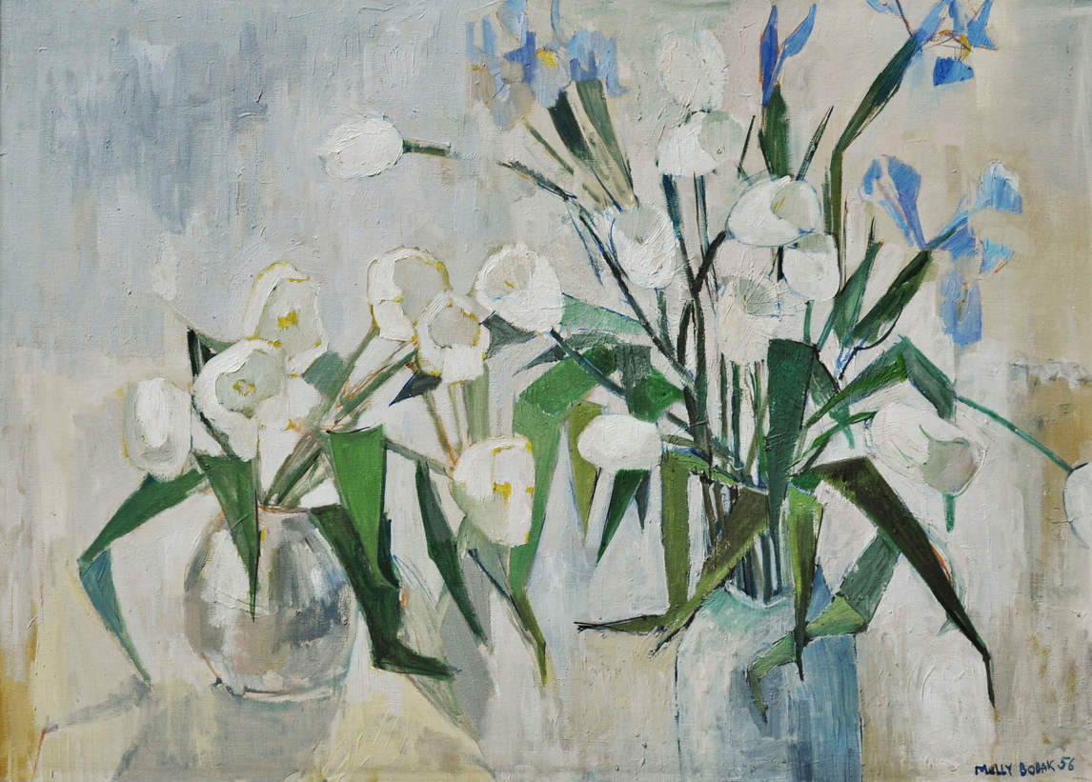
Molly Lamb Bobak, White Tulips, 1956. Lamb Bobak’s oil paintings and watercolours of flowers are some of her most beloved works.

Slide 7
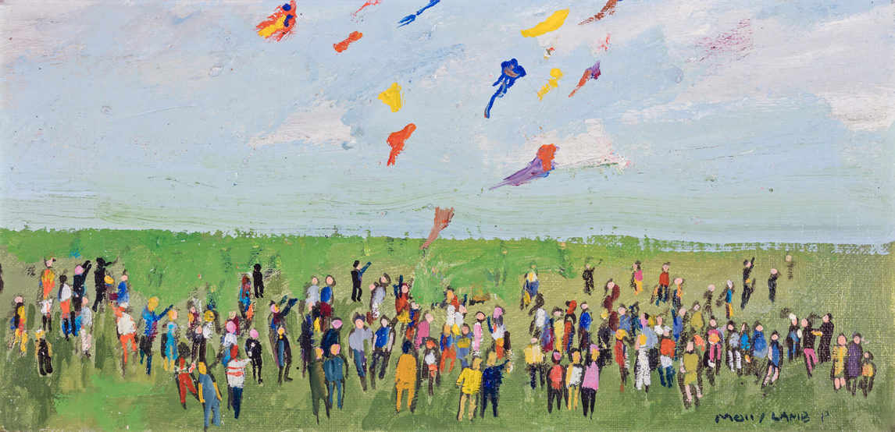
Molly Lamb Bobak, The Great Kite Festival No. 2, n.d. Lamb Bobak’s favourite subject was crowd scenes. In particular she enjoyed capturing movement, such as kites or flags blowing in the wind, or people skating around a rink or cheering and waving at fairs and parades.

Slide 8
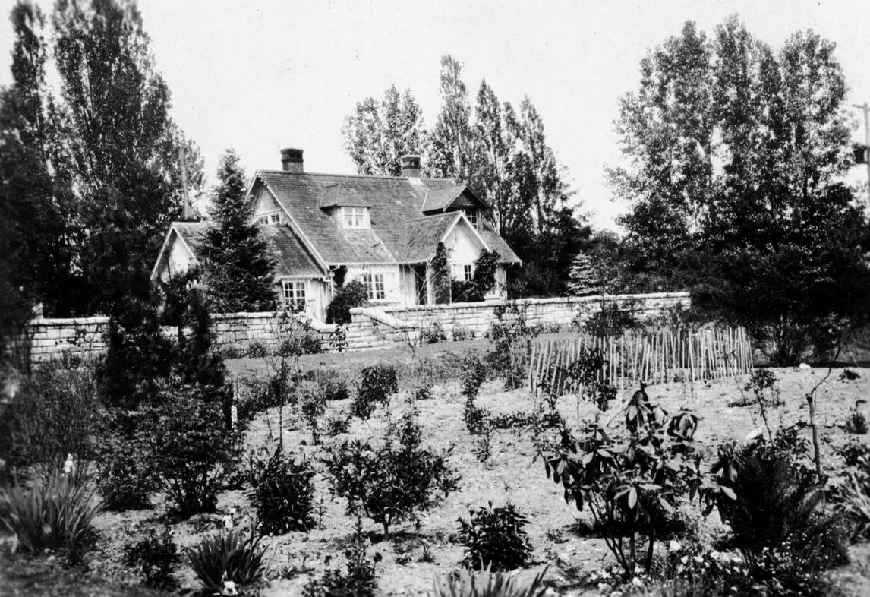
Photograph by Lamb Bobak’s father, Harold Mortimer-Lamb, of the family home on West 54th Avenue in Vancouver.

Slide 9
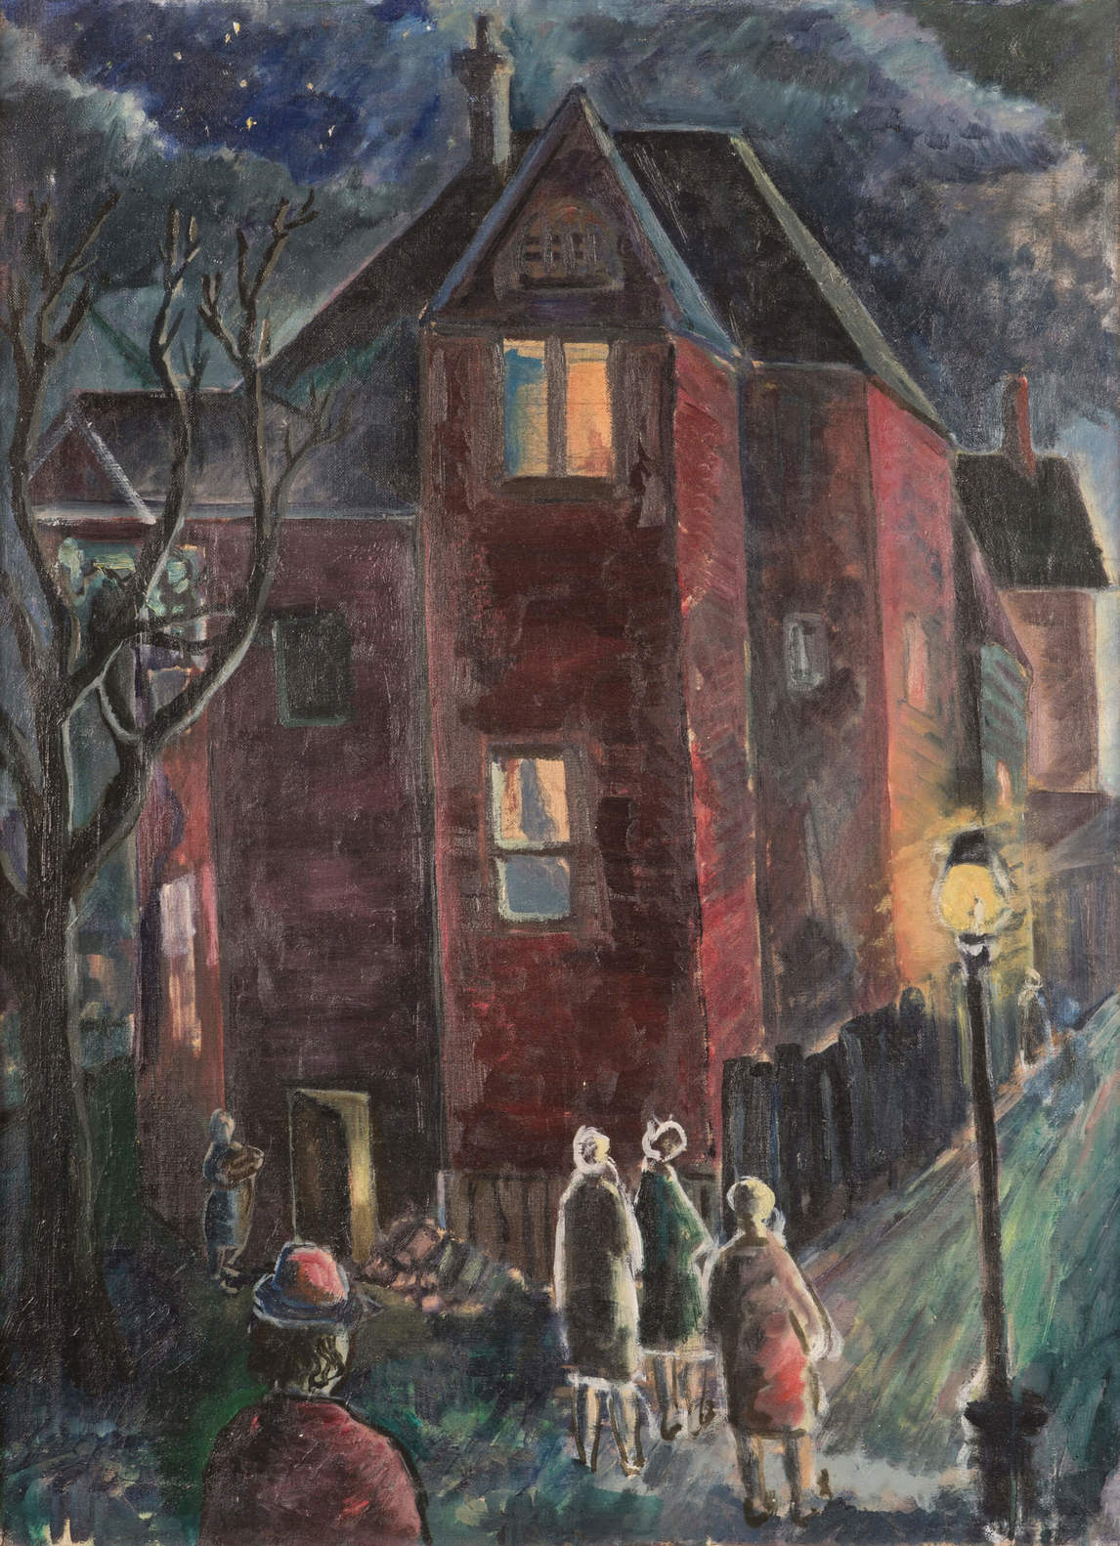
Molly Lamb, Untitled (Vancouver), 1941. This painting shows the influence of Lamb’s teacher at the Vancouver School of Art, Jack Shadbolt.

Slide 10
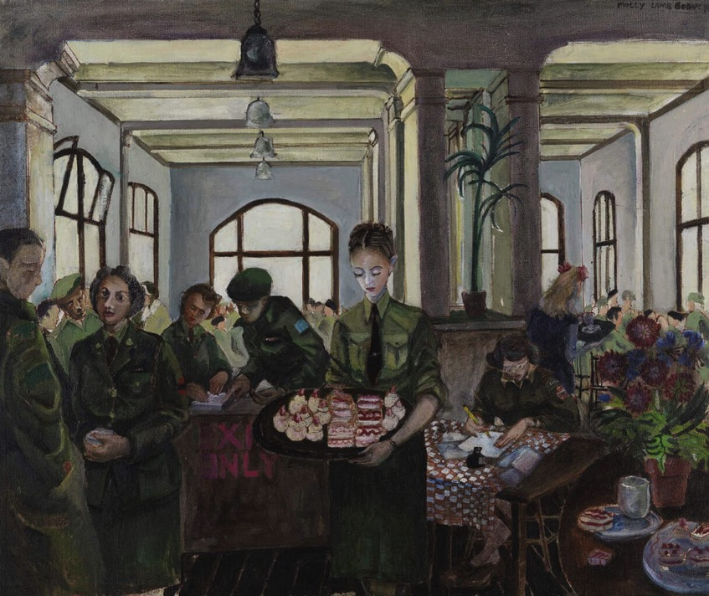
Molly Lamb, Canteen, Nijmegen, Holland, 1945. Lamb recorded daily life for CWACs as well as the aftermath of the war.

Slide 11
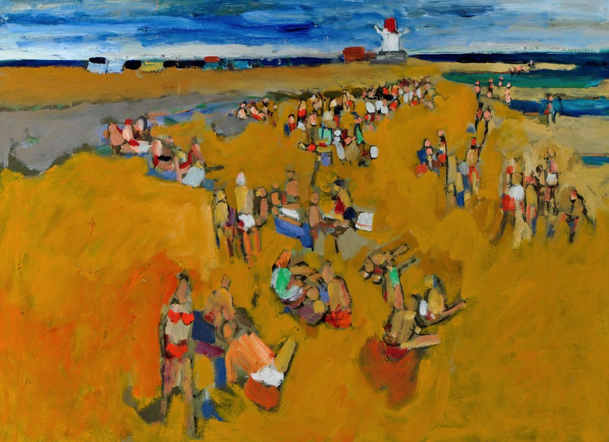
Molly Lamb Bobak, Shediac Beach (N.B.), 1972. While living in Fredericton, Lamb Bobak made many bright and joyful paintings of people at the beach.

Slide 12
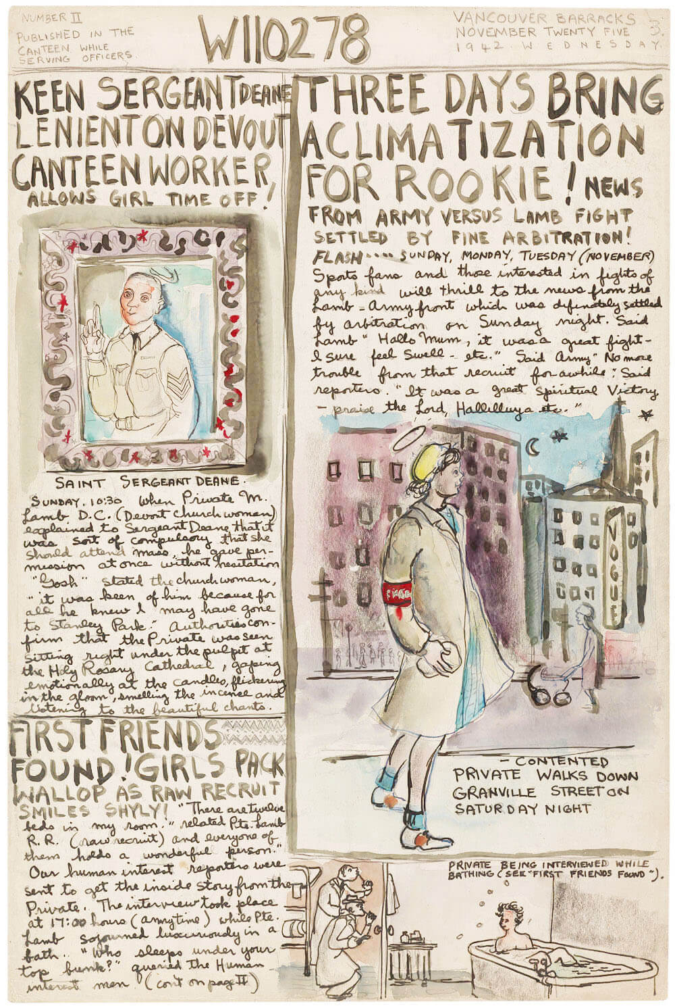
Learning Activity #1
Molly Lamb, “Sergeant Deane,” November 25, 1942, from W110278: The Personal War Records of Private Lamb, M., 1942–45. Lamb’s diary has headlines, editorials, special supplements, and interviews. On this page Lamb describes being a new recruit, from such universal things as trying to make friends and enjoying a day off, to the difficulties of being a woman in the male-dominated army of the mid-twentieth century.

Slide 13
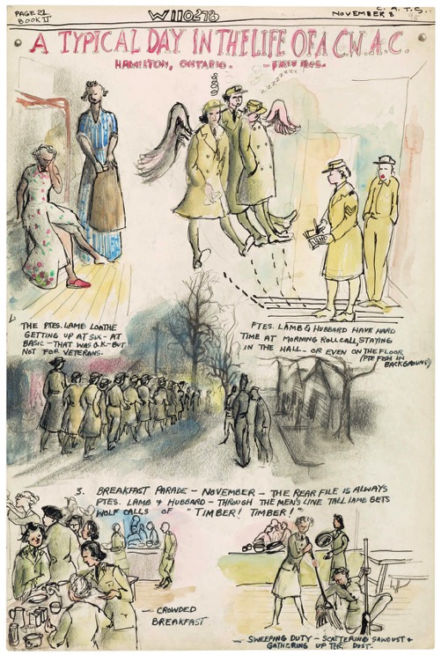
Learning Activity #1
Molly Lamb, “A Typical Day in the Life of a C.W.A.C.,” November 8, 1943, from W110278: The Personal War Records of Private Lamb, M., 1942–45. Lamb’s wartime diary is unique for both its newspaper-style format and its chronicling of army life from a woman’s point of view.

Slide 14
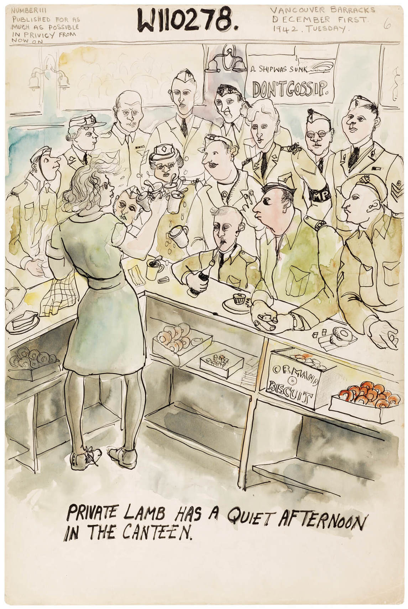
Learning Activity #1
Molly Lamb, “Private Lamb Has a Quiet Afternoon in the Canteen,” December 1, 1942, from W110278: The Personal War Records of Private Lamb, M., 1942–45. Lamb depicts the canteen full to bursting, humorously captioning it “a quiet afternoon.”

Slide 15
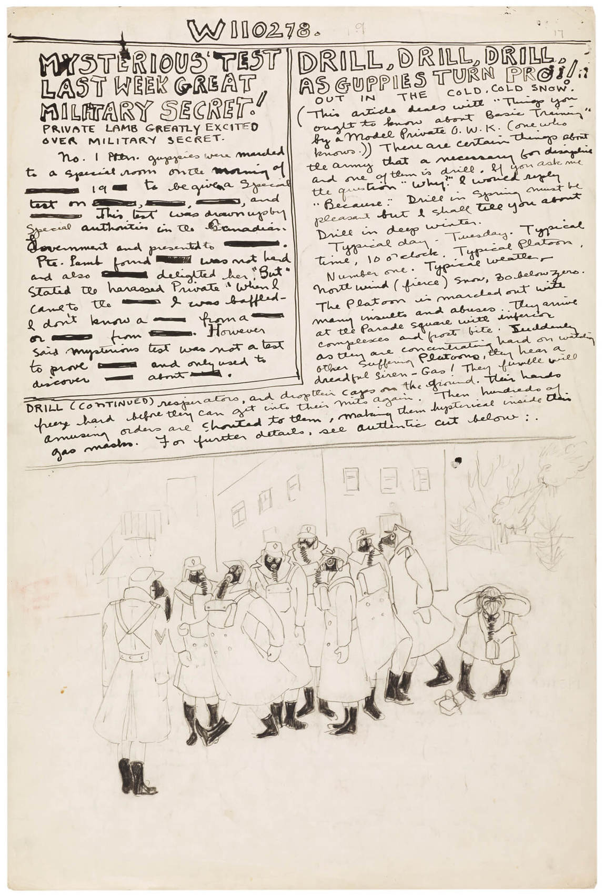
Learning Activity #1
Molly Lamb, “Gas Drill, Vermilion,” December 1942, from W110278: The Personal War Records of Private Lamb, M., 1942–45.
The caption “guppies turn pro” indicates the reason for the central figure strutting with confidence in her gas mask during this drill.

Slide 16
Learning Activity #1
Molly Lamb, Canteen, Nijmegen, Holland, 1945. Lamb was tasked to document the activities of her fellow CWACs both during training in Canada and overseas.

Slide 17
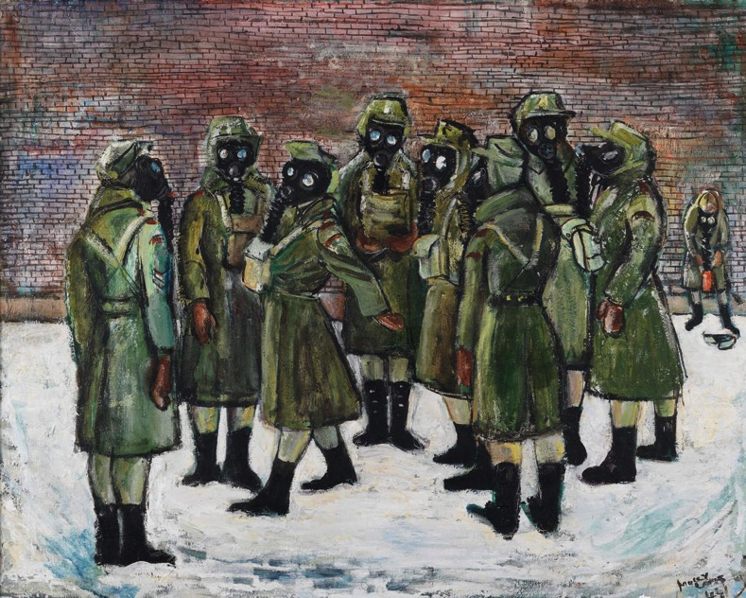
Learning Activity #1
Molly Lamb, Gas Drill, 1944. This painting demonstrates the group spirit of the CWACs as well as Lamb’s propensity for caricature.

Slide 18
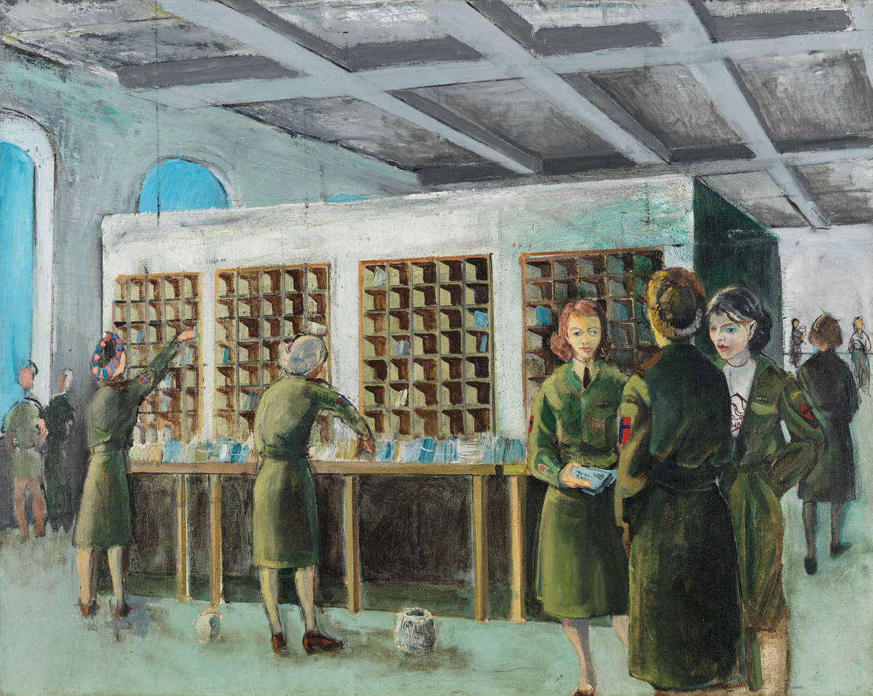
Learning Activity #1
Molly Lamb, CWACs Sorting Mail, n.d. Women performed activities far from the front lines, such as managing the mail rooms, that helped to maintain the war effort.

Slide 19
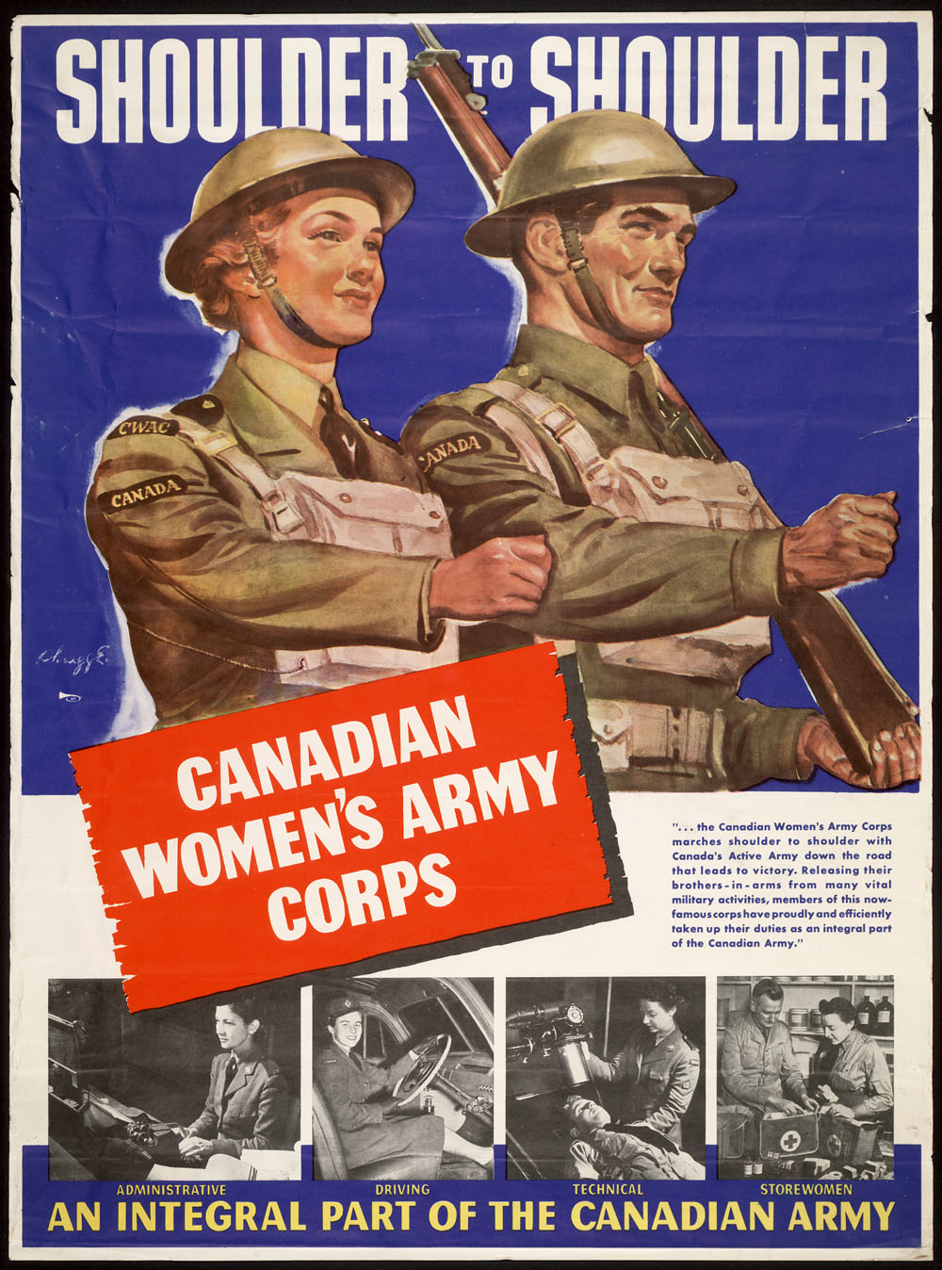
Learning Activity #2
A recruiting poster for the Canadian Women’s Army Corps, 1944.

Slide 20
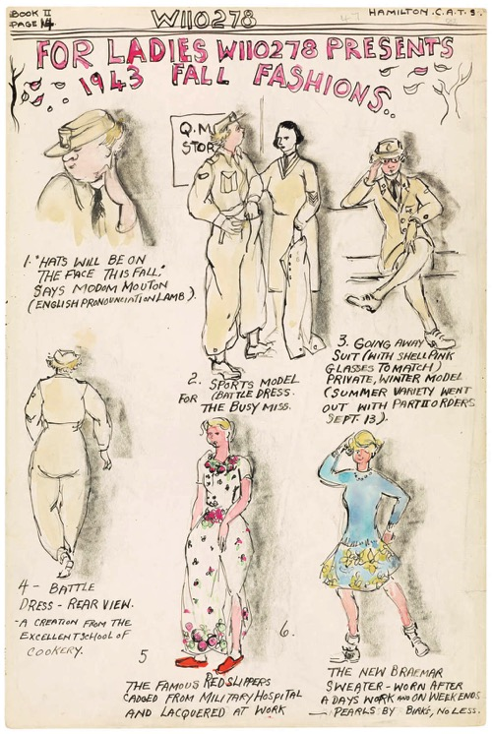
Learning Activity #2
Molly Lamb, “For Ladies W110278 Presents 1943 Fall Fashions,”1943, from W110278: The Personal War Records of Private Lamb, M., 1942–45. Using caricature to poke fun at gender bias, this work was based on contemporary newspaper advertisements for women.

Slide 21
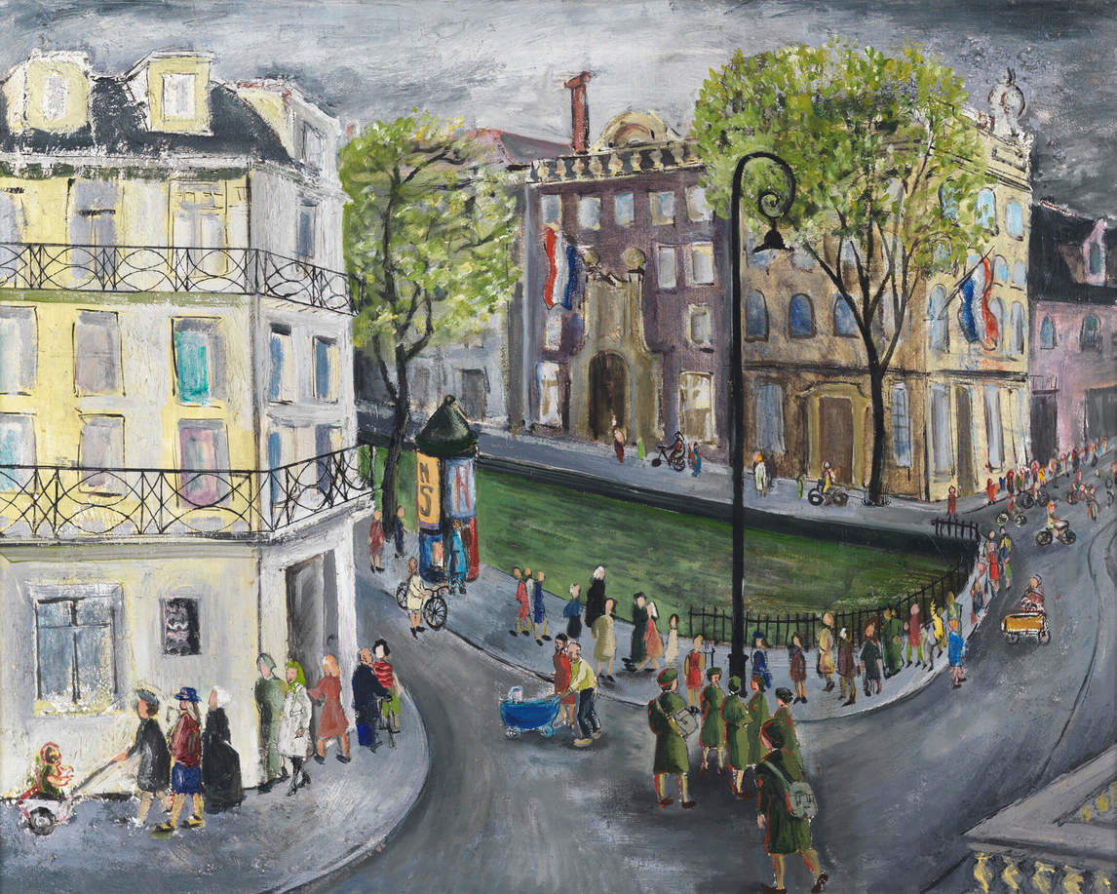
Molly Lamb Bobak, CWACs on Leave in Amsterdam, September, 1945, 1946. This painting is indicative of Lamb Bobak’s later paintings of crowd scenes. Here she depicts a rare day off for her fellow CWACs.

Slide 22
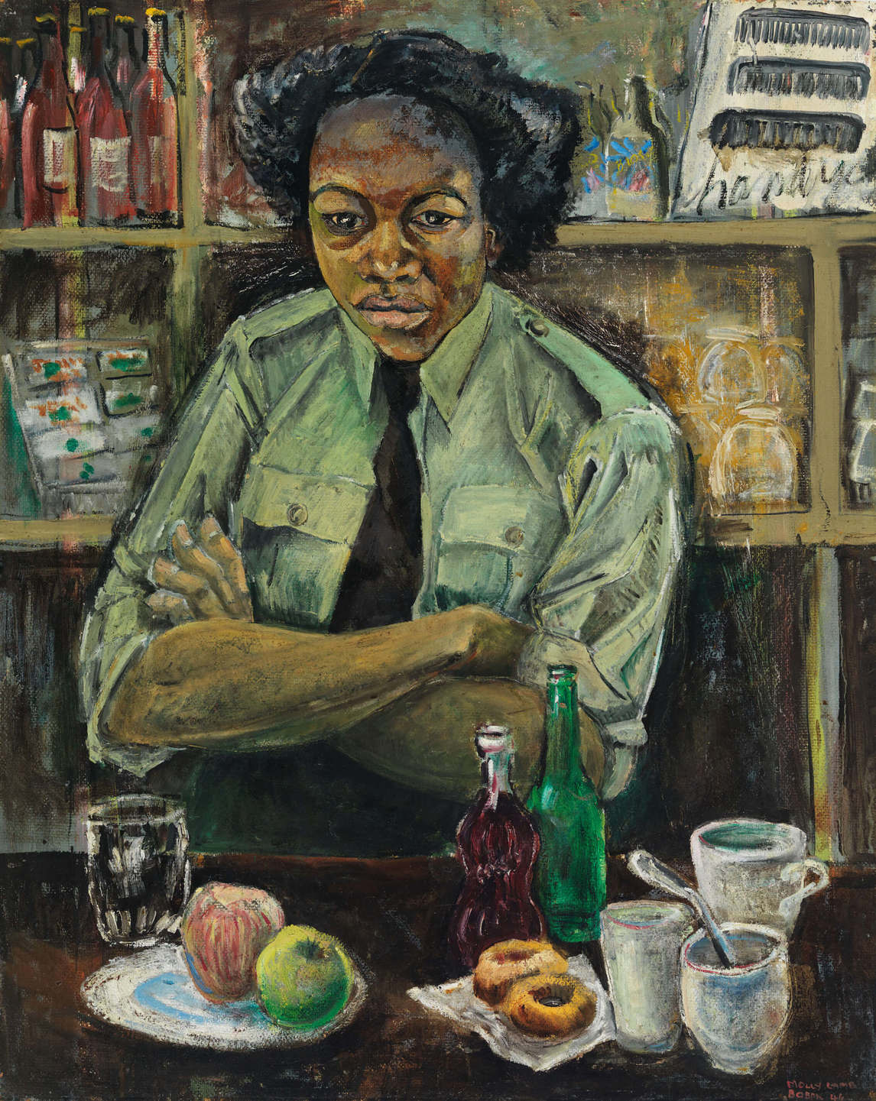
Learning Activity #3
Molly Lamb Bobak, Private Roy, Canadian Women’s Army Corps, 1946.

Slide 23
Molly Lamb, The Base Post Office, Lot, Belgium, n.d. From this sketch Lamb produced a larger finished oil painting. Sorting mail was an important task for the CWACs: it ensured that letters from both important officials and anxious family members reached their intended recipients.

Slide 24
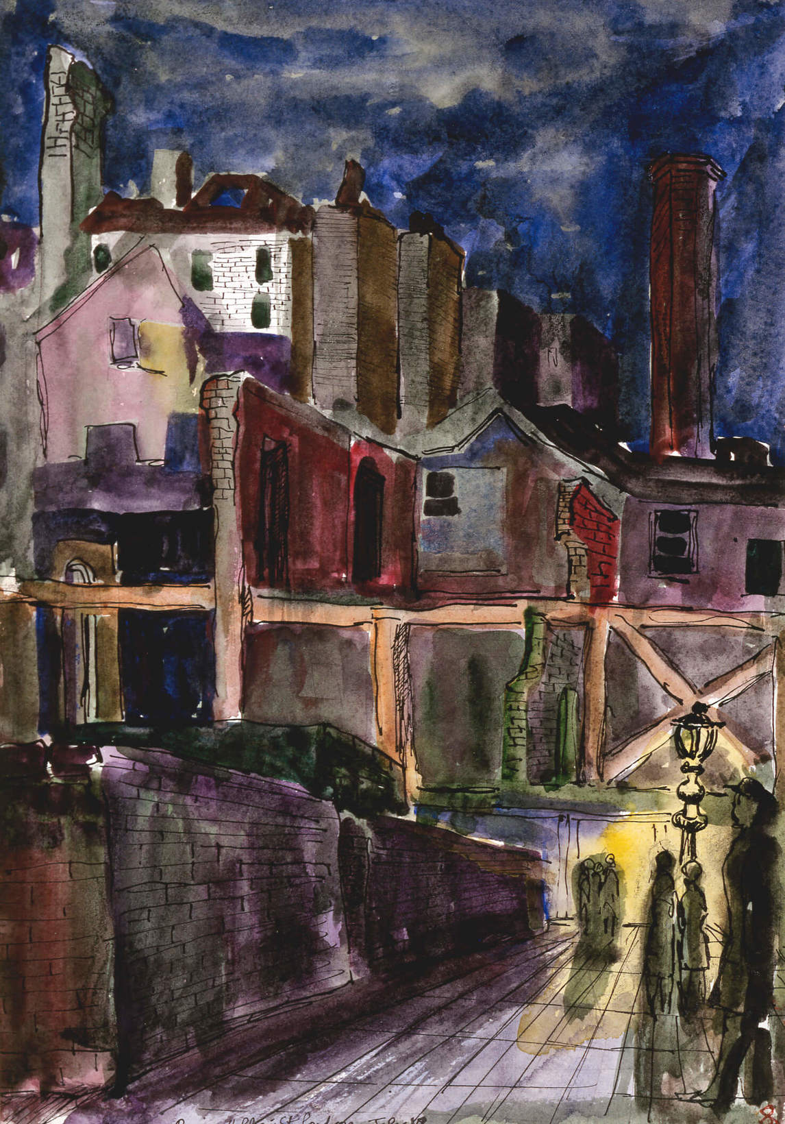
Molly Lamb, Ruins, Holborn Street, London, 1945. Lamb was given a car and driver for six weeks, with complete freedom to travel anywhere she liked in order to document the aftermath of the war.

Slide 25
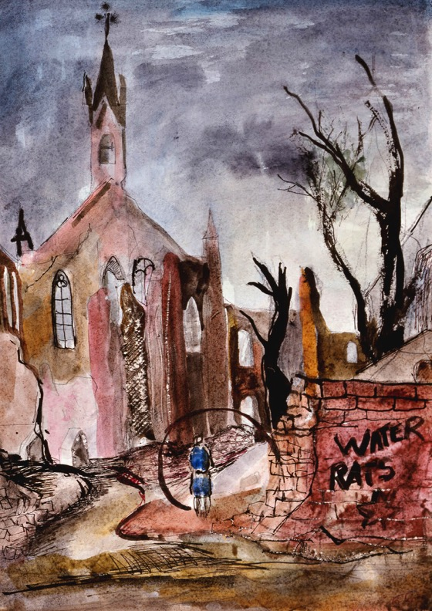
Molly Lamb, Ruins of Emmerich, Germany, 1945. The graffiti scrawled on the wall refers to the 3rd Canadian Infantry Division, which was given the nickname “the Water Rats” by General Bernard Montgomery.

Slide 26
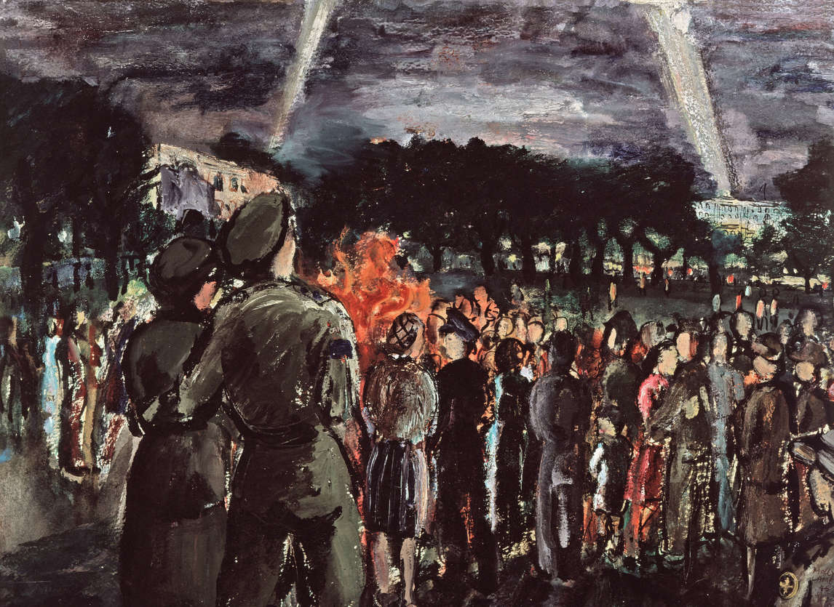
Molly Lamb Bobak, Victory Japan Celebrations, 1945. A man and woman are silhouetted by the raging bonfire, celebrating the end of the war with comrades and civilians.

Slide 27
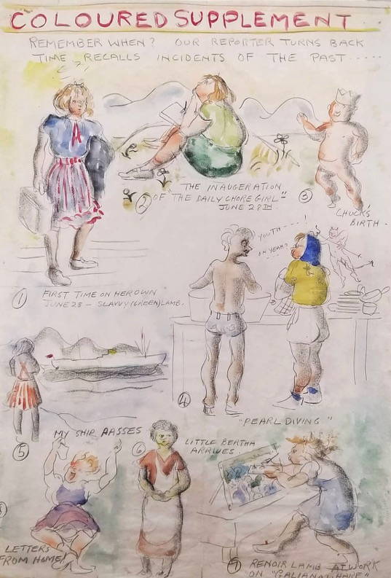
Molly Lamb, “Renoir Lamb at Work on Galiano Wharf (Coloured Supplement)” 1940, from The Daily Chore Girl—Galiano’s Dish Rag, 1940. While working at Yellow Point Lodge Lamb depicted her thoughts and the daily happenings in a newspaper-style illustrated diary.

Slide 28
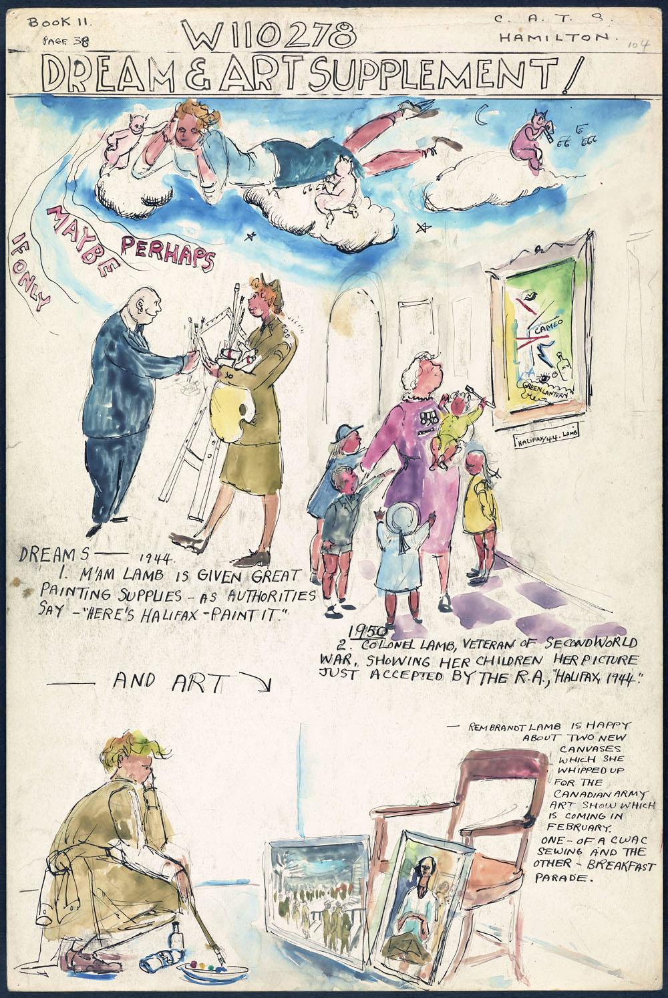
Molly Lamb, “Lamb’s Dreams, and Her Entries to the Canadian Army Art Show,” January 1944, from W110278: The Personal War Records of Private Lamb, M., 1942–45. Here Lamb reflects on her artistic aspirations.

Slide 29
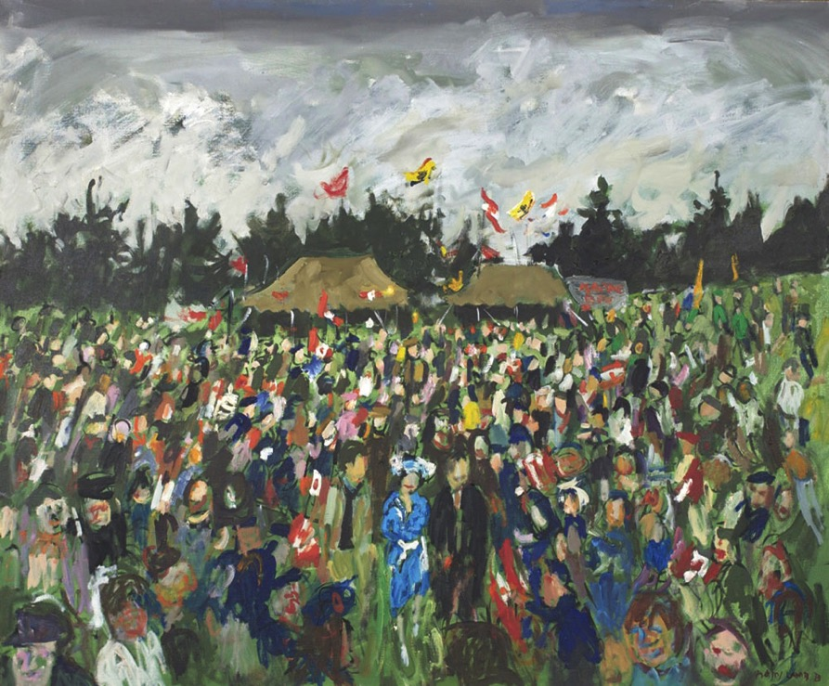
Molly Lamb Bobak, John, Dick, and the Queen, 1977. Lamb Bobak captures the exuberance of the crowd during Queen Elizabeth II’s official visit.

Slide 30
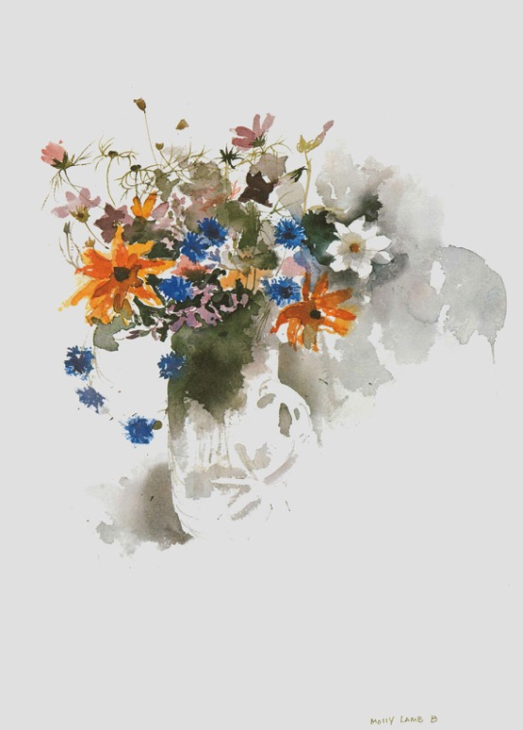
Molly Lamb Bobak, “A Jug of August Flowers,” 1977. A colourful illustration from Lamb Bobak’s book Wild Flowers of Canada, 1978.

Slide 31
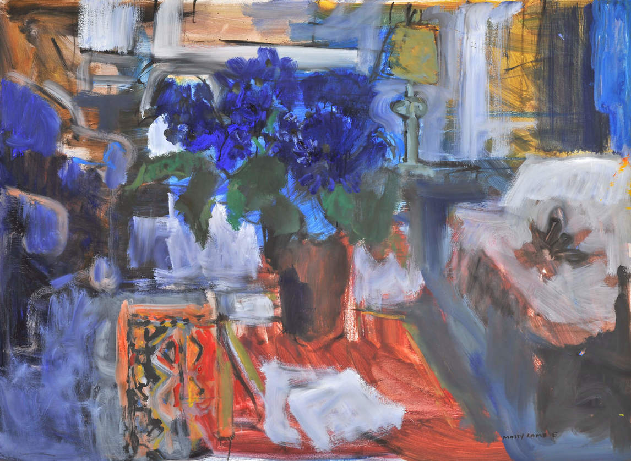
Molly Lamb Bobak, Interior with Moroccan Carpet, 1991. Lamb Bobak’s interior scenes, unlike her crowd scenes, are quiet and devoid of people. The flowers are the protagonist at the centre of this painting.

Slide 32
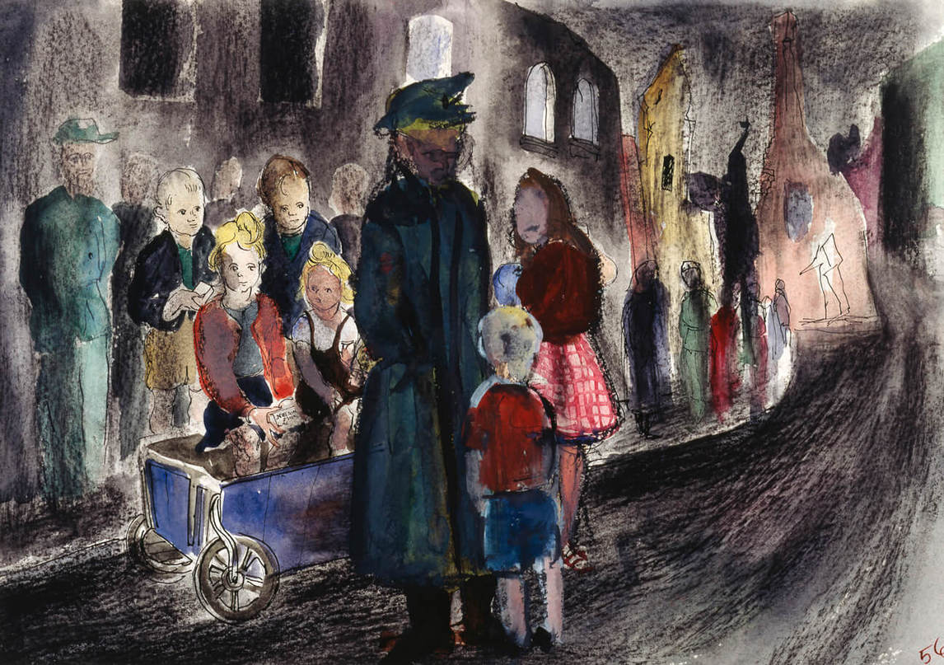
Molly Lamb, German Children in Bremen, Germany, 1945. This painting attests to the human casualties of war. Scenes of ruined towns depicted at nightfall are the only way Lamb portrayed violent subject matter.

Slide 33
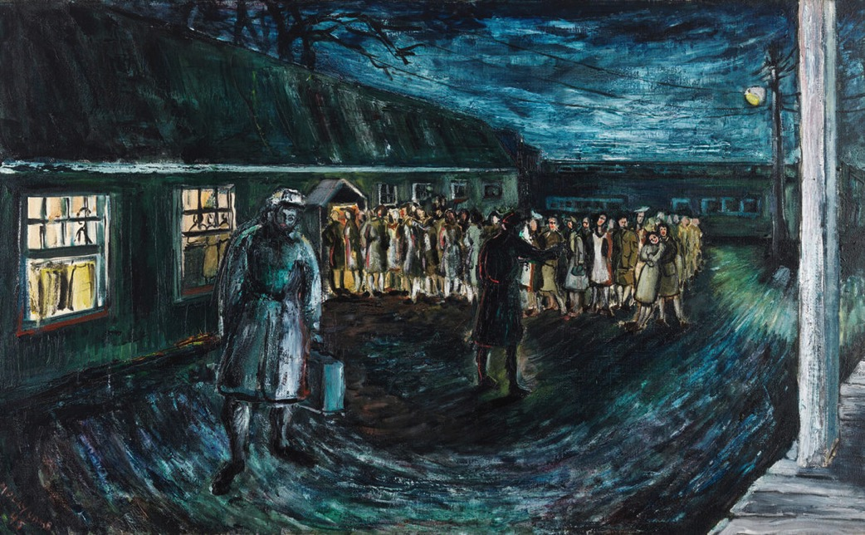
Molly Lamb, Signing Up for the Pacific, 1945. There is a sense of foreboding in this darkly lit painting. It appears the figure in the foreground has been recruited for the war efforts in Japan. A line forms as more sign their names.

